Slide 1
MATH 1330
Algebra Review

Slide 2
1. Find the slope of the line passing through the points (-10,6) and (14, -6).

Slide 3
2. Find the x- and y-intercepts of 5x – 12y = 30

Slide 4
3. Solve for x:
$$\frac{4}{5}x=−\frac{5}{7}$$

Slide 5
4. Solve for x:
$$\frac{2}{3}\left(x−7\right)+\frac{1}{4}\left(x+3\right)=\frac{5}{2}$$

Slide 6
5. The length of a rectangle is 2 inches less than double its width, and its perimeter is 26 inches. Find the length.

Slide 7
6. Three consecutive integers have a sum of 39. Find the value of the largest of these integers.

Slide 8
7. Solve by factoring: 3x² – x – 10 = 0

Slide 9
8. Solve for x: 3x² + 75 = 0

Slide 10
9. Perform the operation: (5i + 2) – (2 – i)

Slide 11
10. Perform the operation: -2i (5 + 7i)

Slide 12
11. Perform the operation: $\frac{4−2i}{3+i}$

Slide 13
12. Simplify: $\frac{5}{7+i}$

Slide 14
13. $−3<\frac{2x−10}{5}≤3$

Slide 15
14. Solve for x: 3 – 5|x + 2| = 1

Slide 16
15. Solve for x: 4|x + 3| < 12

Slide 17
16. Solve for x: |2x + 1| ≥ 3

Slide 18
17. Find the domain: $f\left(x\right)=\frac{x+5}{x−3}$

Slide 19
18. Find the domain: $g\left(x\right)=\sqrt{8−2x}$

Slide 20
19. Calculate f(-3) if f(x) = -x² + 4x – 7

Slide 21
20. Calculate f(2) if $f\left(x\right)=\left\{\begin{aligned}x^{2} x<1 \\ 6 x=1 \\ x+2 x>1\end{aligned}\right.$

Slide 22
21. Solve for x using substitution: $2x+5\sqrt{x}+2=20$

Slide 23
22. What transformations will take the graph of y = x³ to the graph of f(x) = 5 – (x + 2)³?

Slide 24
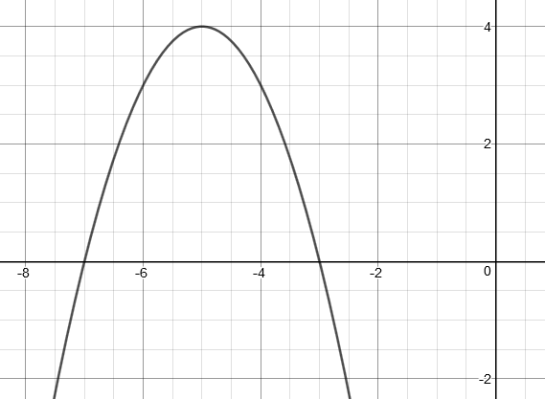
23. Determine the function of the graph:

Slide 25
24. Find the coordinates of the vertex:
f(x) = x² – 8x + 3

Slide 26
25. Find the vertex: f(x) = -3x² + 12x – 1

Slide 27
26. Given the functions f(x) = 5x – 2 and g(x) = x² + 1, determine (fºg)(x) and (gºf)(x).

Slide 28
27. Find the inverse of $f\left(x\right)=\frac{x−1}{x+4}$

Slide 29
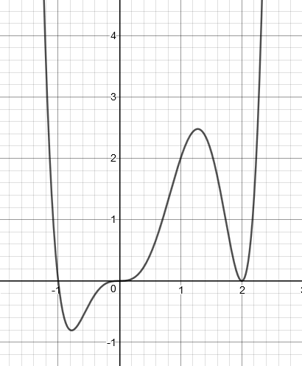
28. Determine the function for the graph:

Slide 30
29. Find the quotient and remainder:
$$\frac{2x^{3}+5x^{2}−3}{x^{2}+3}$$

Slide 31
30. Find the quotient and remainder:
$$\frac{3x^{3}+2x^{2}−3x+1}{x−2}$$

Slide 32
31. Find the zeros of the polynomial by factoring:
f(x) = x³ + 4x² + x – 6

Slide 33
32. For the graph: f(x) = 3 – 5^{x}
Determine the asymptote and the range.

Slide 34
33. What is the transformation of the key point (1,0) for the function: log₂(x + 3) + 5

Slide 35
34. Simplify: f(x) = log₃(¹/₈₁)

Slide 36
35. Solve for x: log₂(x + 5) = 0

Slide 37
36. Solve for x: ln(x²) = 3

Slide 38
37. Solve: log(x+2) + log(x-1) = log 18

Slide 39
38. Solve the following for x: $\frac{5}{3x}+\frac{6}{x}=\frac{23}{6}$

Slide 40
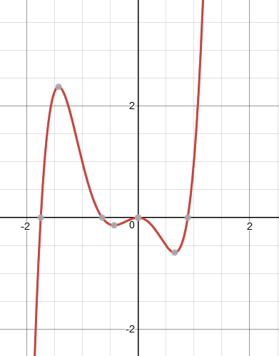
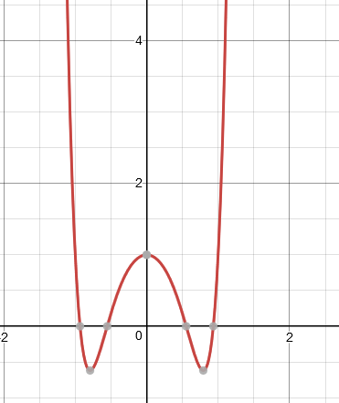
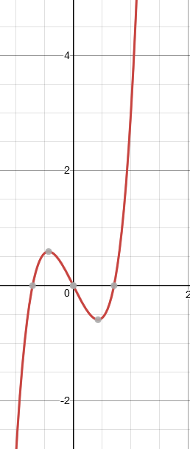
39. The function f(x)= ax⁷ + bx⁵ – cx³ + dx passes through the point (-2, 5). What other point must it pass through?
Which is a possible graph of this function:

Slide 41
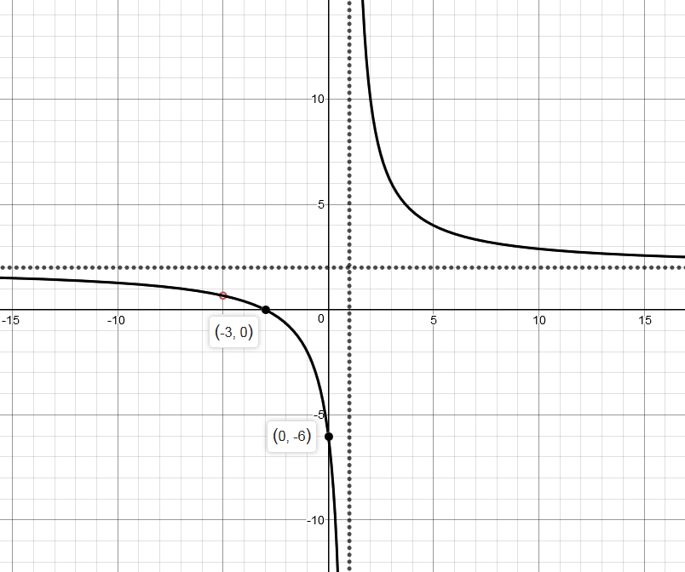
40. Determine the function of the following:
x = 1
y = 2

Slide 42
41. Solve the system: $\begin{matrix}y=2x+3 \\ x−3y=1\end{matrix}$

Slide 43
42. Now, solve this system: $\begin{matrix}6x−2y=5 \\ y=3x+4\end{matrix}$

Slide 44
43. Rewrite the equation of the parabola in standard form: y = 2x² + 20x + 46

Slide 45
44. Simplify: $\frac{\sqrt{−36}+3}{\sqrt{−4}∙\sqrt{−81}}$

Slide 46
45. Find all complex solutions to: 3x² = -27

Slide 47
46. Solve for x: $\sqrt{x+5}+x=1$

Slide 48
47. Solve the inequality: 5x² + 8x – 10 < 3x² + 2x – 2

Slide 49
48. Solve the inequality: $\frac{x^{2}+5x−36}{x−3}≥0$

Slide 50
49. Write the polynomial function with roots of 5i and 3, with a y-intercept of 150.

Slide 51
50. Find the vertical asymptotes, horizontal asymptotes, and hole of the following: $f\left(x\right)=\frac{x^{2}−2x−15}{x^{3}−25x}$

Slide 52
51. Expand the logarithmic expression: $$\log_{5}\left(\frac{\sqrt{x−1}∙{\left(x+2\right)}^{5}}{x^{2}}\right)$$

Slide 53
52. Simplify: $\log_{6}\left(54\right)−\log_{6}\left(9\right)$

