Slide 1
MATH 1330
Final Exam Review 1

Slide 2
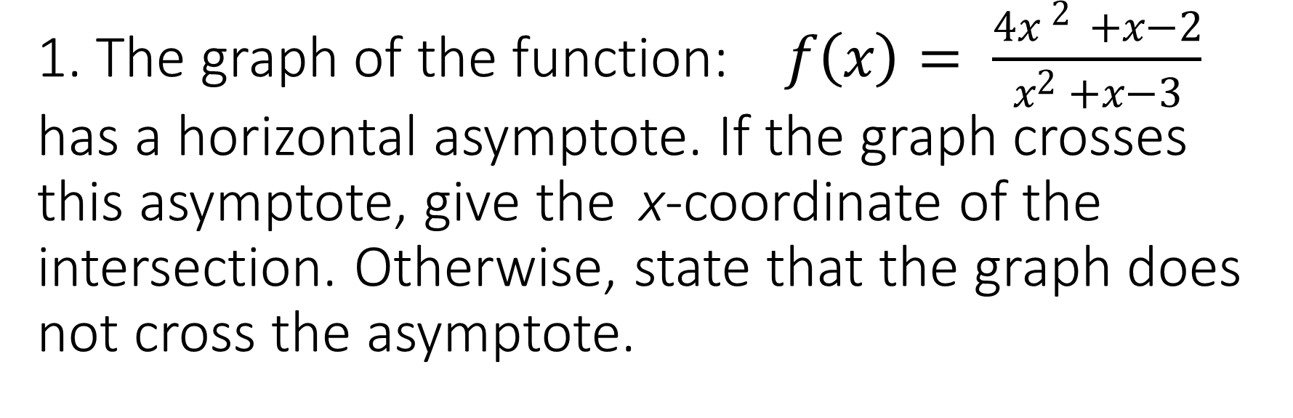
1. The graph of the function: $f\left(x\right)= \frac{4{x }^{2 }+x−2}{x^{2} +x−3}$ has a horizontal asymptote. If the graph crosses this asymptote, give the x-coordinate of the intersection. Otherwise, state that the graph does not cross the asymptote.

Slide 3
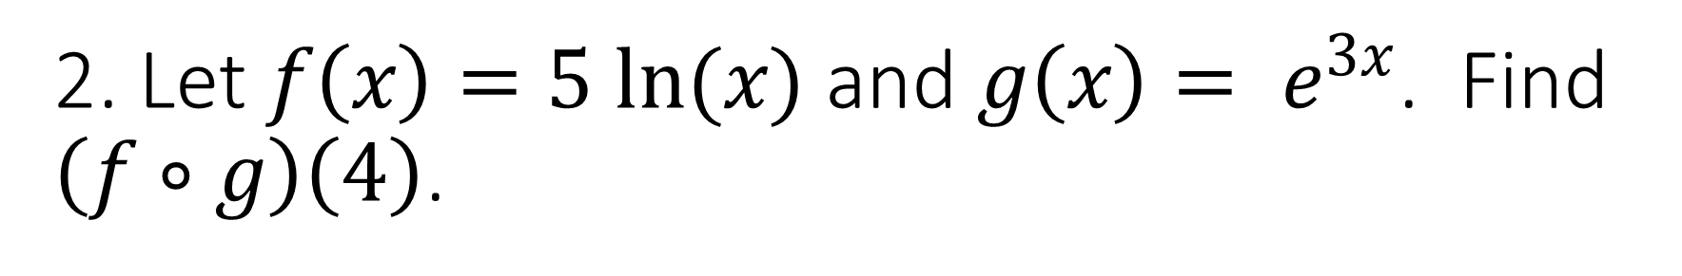
2. Let $f\left(x\right)=5 ln(x)$ and $g\left(x\right)= e^{3x}$. Find $\left(f∘g\right)\left(4\right)$.

Slide 4
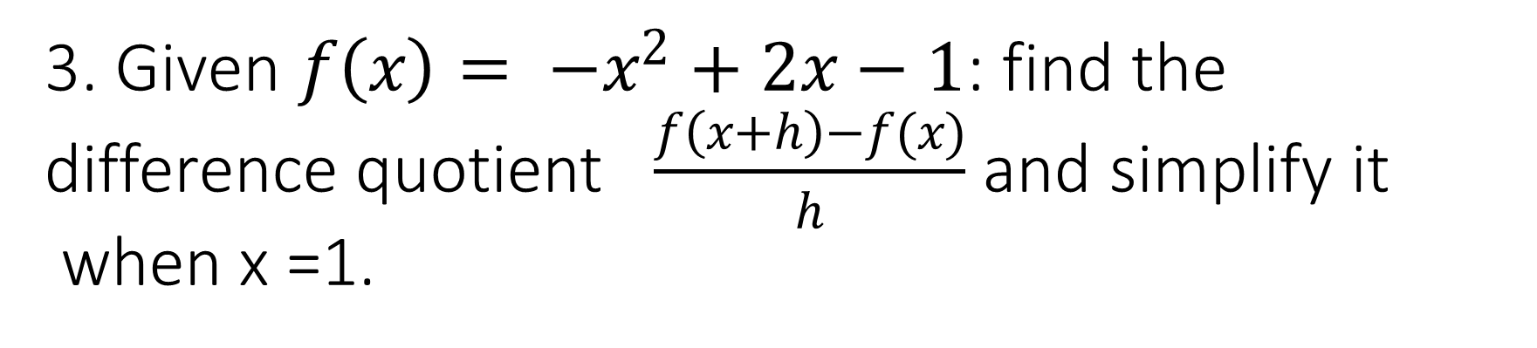
3. Given $f\left(x\right)= −x^{2}+2x−1$: find the difference quotient $\frac{f\left(x+h\right)−f(x)}{h}$ and simplify it when x =1.

Slide 5
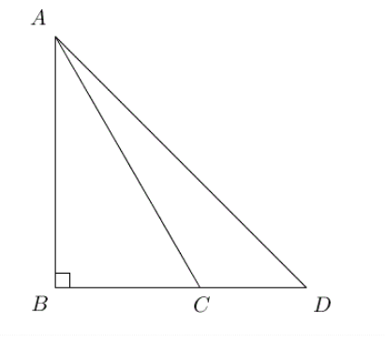
4. In the figure below, angle B is a right angle, m(D) = 45° and m(ACB) = 60°. If AC = 16, find the length of AD.

Slide 6
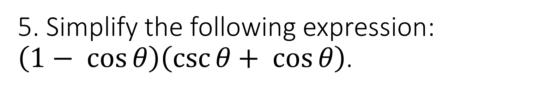
5. Simplify the following expression: $\left(1− \cos{θ}\right)\left(\csc{θ+ \cos{θ}}\right)$.

Slide 7
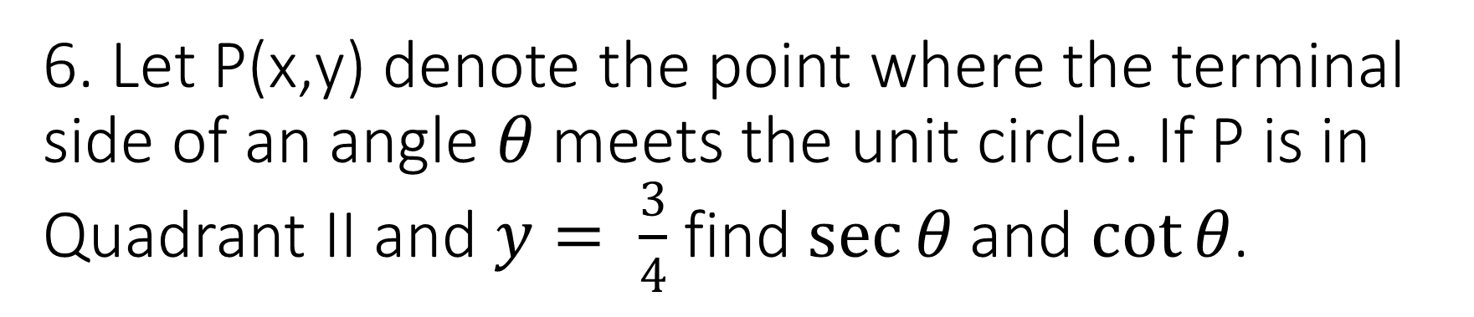
6. Let P(x,y) denote the point where the terminal side of an angle $θ$ meets the unit circle. If P is in Quadrant II and $y= \frac{3}{4}$ find $\sec{θ}$ and $\cot{θ}$.

Slide 8
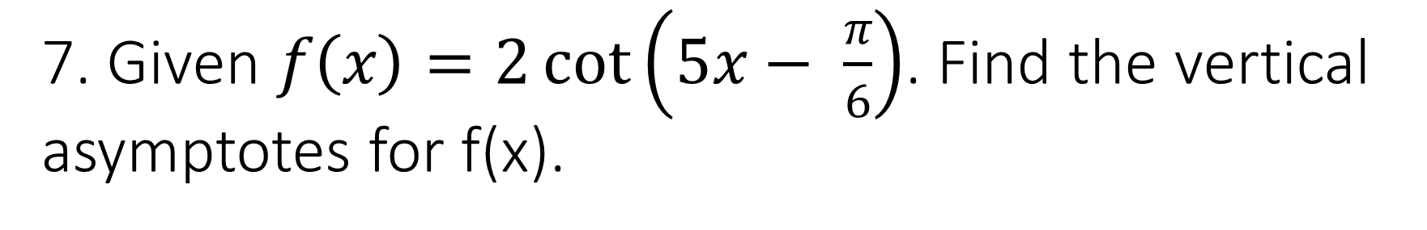
7. Given $f\left(x\right)=2\cot\left(5x− \frac{π}{6}\right)$. Find the vertical asymptotes for f(x).

Slide 9
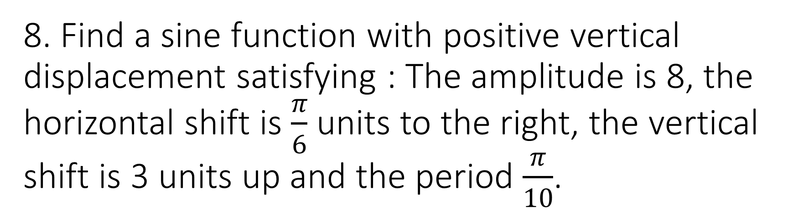
8. Find a sine function with positive vertical displacement satisfying : The amplitude is 8, the horizontal shift is $\frac{π}{6}$ units to the right, the vertical shift is 3 units up and the period $\frac{π}{10}$.

Slide 10
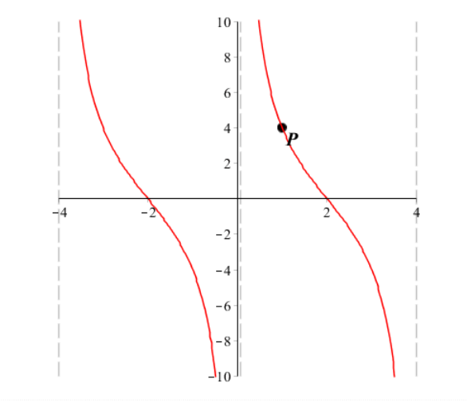
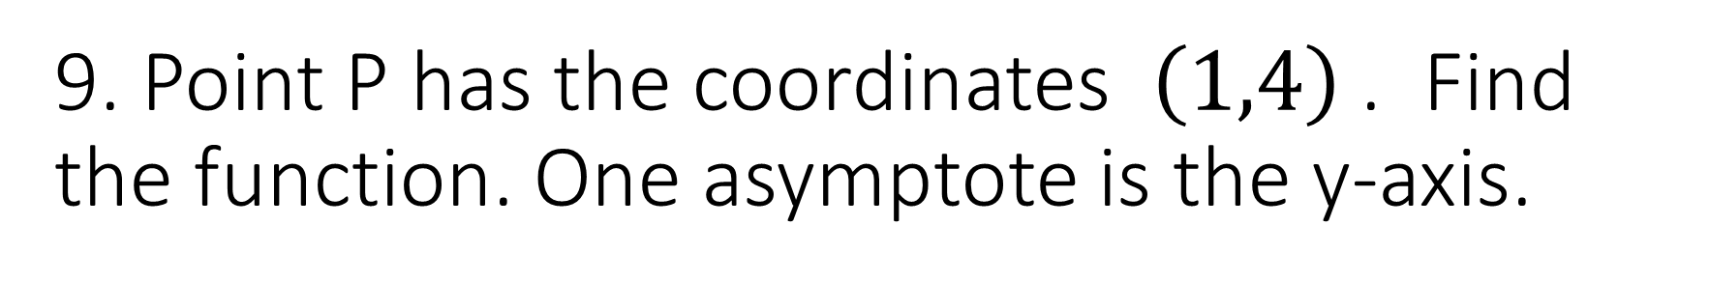
9. Point P has the coordinates $\left(1,4\right)$ . Find the function. One asymptote is the y-axis.

Slide 11

10. Simplify: $\frac{8\cos\left(−t\right)\sin{(−t)}}{\tan\left(−t\right) cot(t+3π)}$

Slide 12
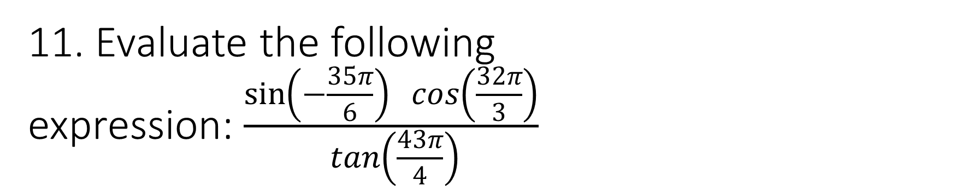
11. Evaluate the following expression:$\frac{\sin\left(−\frac{35π}{6}\right) cos\left(\frac{32π}{3}\right)}{ tan\left(\frac{43π}{4}\right)}$

Slide 13
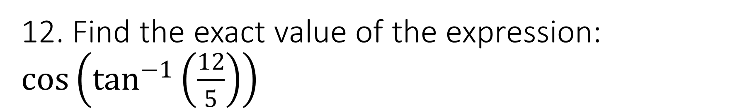
12. Find the exact value of the expression: $\cos\left(\tan^{−1}\left(\frac{12}{5}\right)\right)$

Slide 14
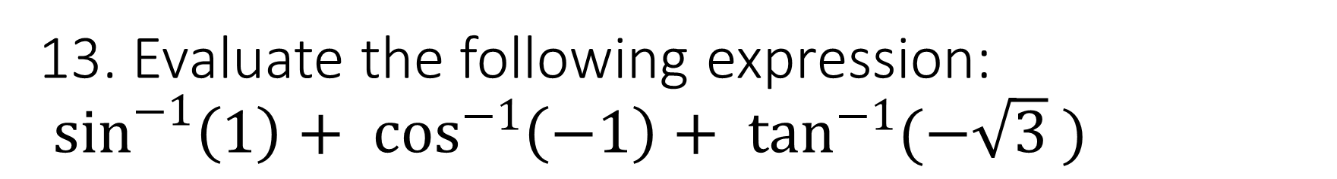
13. Evaluate the following expression:
$\sin^{−1}\left(1\right)+ \cos^{−1}\left(−1\right)+ \tan^{−1}{(−\sqrt{3} )}$

Slide 15
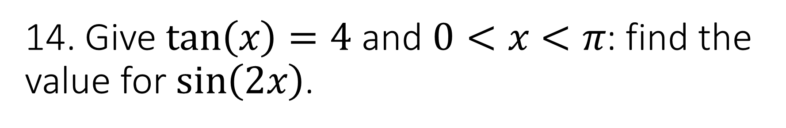
14. Give $\tan\left(x\right)=4$ and $0<x<π$: find the value for $\sin\left(2x\right)$.

Slide 16
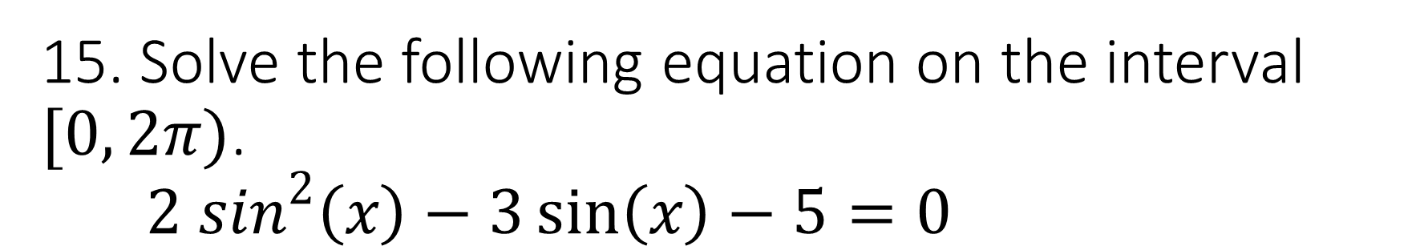
15. Solve the following equation on the interval $[0, 2π)$.
$2 \sin^{2}\left(x\right)−3\sin\left(x\right)−5=0$

Slide 17
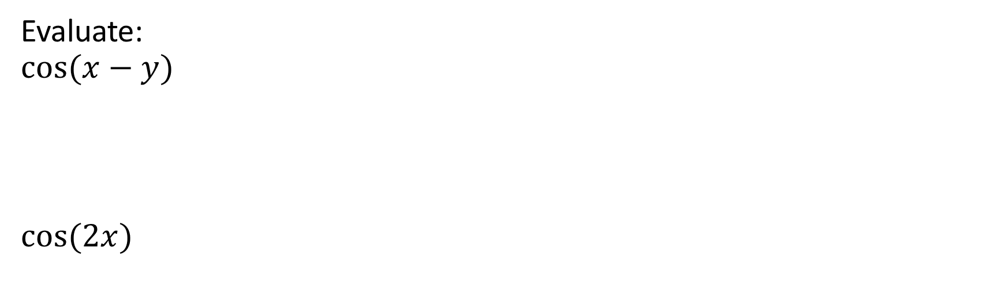
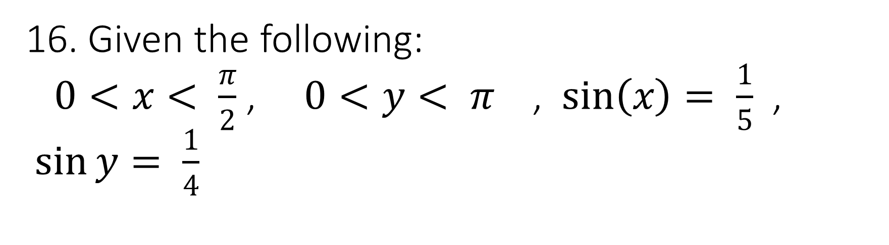
16. Given the following:
$0<x< \frac{π}{2}$ , $0<y< π$ , $\sin\left(x\right)= \frac{1}{5}$ , $\sin{y}= \frac{1}{4}$
Evaluate:
$$cos(x−y)$$
$$cos⁡(2x)$$

Slide 18
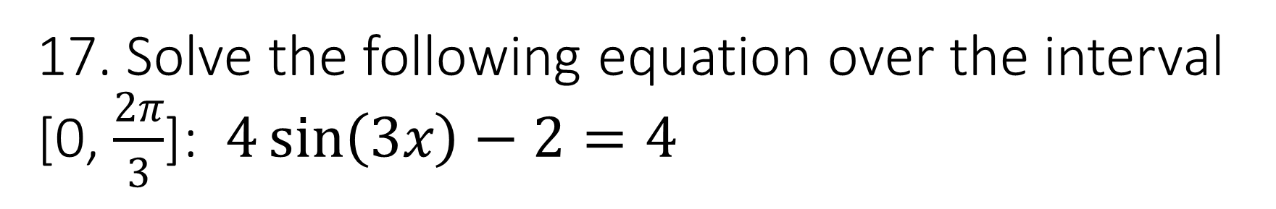
17. Solve the following equation over the interval [0, $\frac{2π}{3}$]: $4\sin\left(3x\right)−2=4$

Slide 19
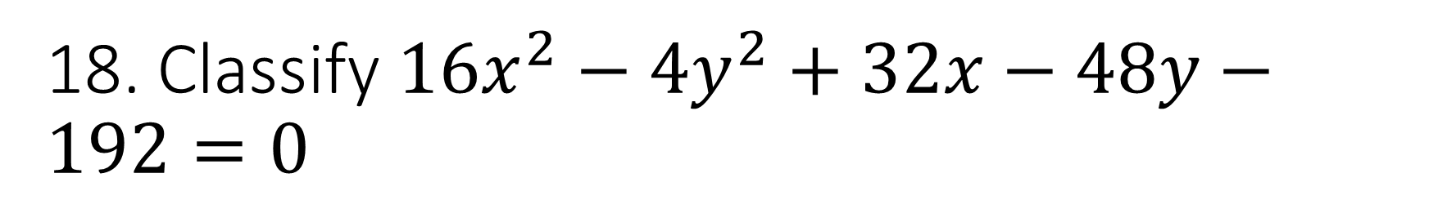
18. Classify ${16x}^{2}−{4y}^{2}+32x−48y−192=0$

Slide 20
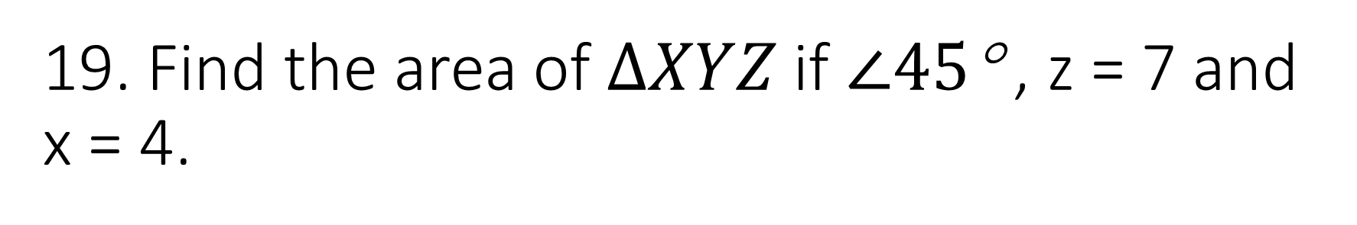
19. Find the area of $∆XYZ$ if $∠45$° , z = 7 and x = 4.

Slide 21
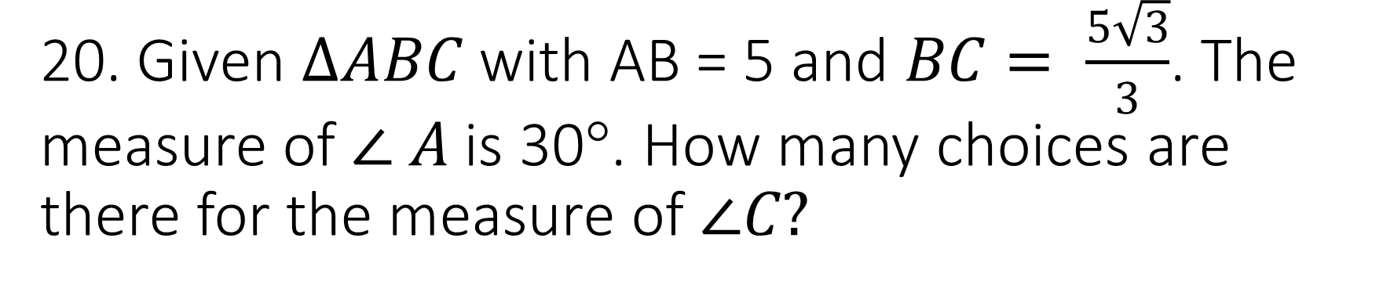
20. Given $∆ABC$ with AB = 5 and $BC= \frac{5\sqrt{3}}{3}$. The measure of $∠ A$is 30°. How many choices are there for the measure of $∠C?$

Slide 22
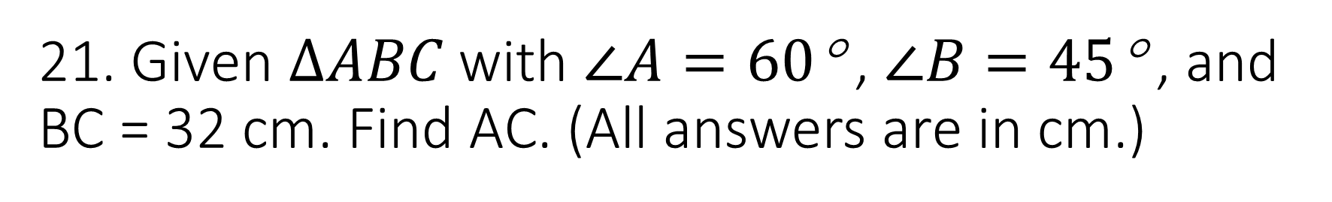
21. Given $∆ABC$ with $∠A=60$° , $∠B=45$° , and BC = 32 cm. Find AC. (All answers are in cm.)

Slide 23
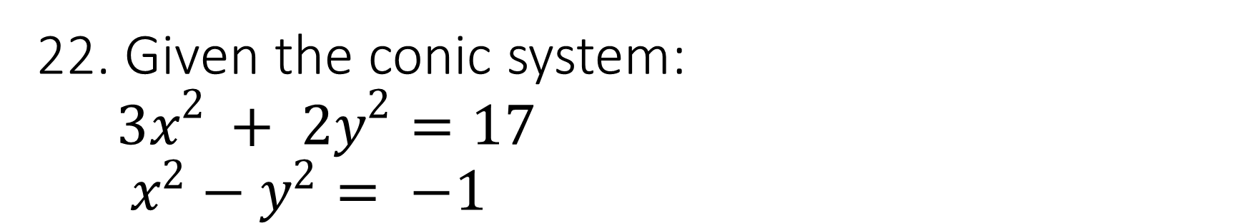
22. Given the conic system:
${3x}^{2 }+ {2y}^{2}=17$
$x^{2}−y^{2}= −1$
Identify the conic section represented by the first equation.
Identify the conic section represented by the second equation.
Find the point of intersection.

Slide 24
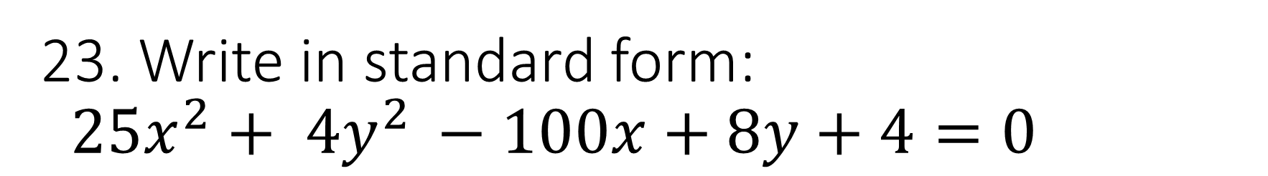
23. Write in standard form:
${25x}^{2}+ {4y}^{2 }−100x+8y+4=0$

Slide 25
24. Find the magnitude: v = 4 i − 4 j

Slide 26
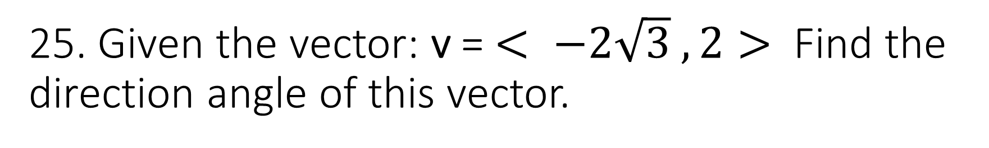
25. Given the vector: v = $< −2\sqrt{3} , 2>$ Find the direction angle of this vector.

Slide 27
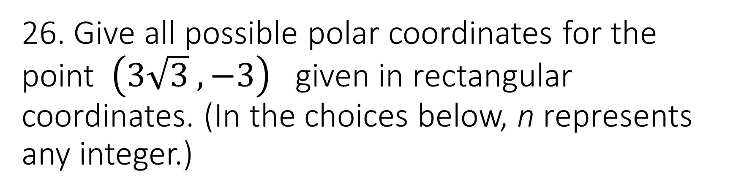
26. Give all possible polar coordinates for the point $\left(3\sqrt{3} , −3\right)$ given in rectangular coordinates. (In the choices below, n represents any integer.)

