Slide 1
MATH 1330
Polar Coordinates

Slide 2
Polar Coordinates
Polar coordinates define every point as a distance (r) from a central point (the pole), and an angle (θ) from a central line (the polar axis).
(r, θ)
r
θ

Slide 3
Multiple Representations
Since polar points are angular in their definition, one point can be represented in numerous ways.
(r, θ) = (r, θ + 2nπ)
(r, θ)
θ+2π
θ

Slide 4
Negative r - values
If the r – value is negative r – value, think of this:
If you are facing the angle of ^{π}/₃ and walk backwards a distance of 5, you be at the point:
(-5, ^{π}/₃)

Slide 5
Negative r - values

Slide 6
Multiple Representations
Since polar points are angular in their definition, one point can be represented in numerous ways.
(r, θ) = (r, θ + 2nπ)
(r, θ) = (-r, θ +[2n+1]π)
(r, θ)
θ+π
θ
-r

Slide 7
Determine which coordinate does not represent the same point as the others.
(5, π/3)
(5, 7π/3)
(-5, 4π/3)
(-5, 7π/3)

Slide 8
Determine which coordinate does not represent the same point as the others.
(5, π/3) = (r, θ)
(5, 7π/3) = (r, θ + 2π)
(-5, 4π/3) = (-r, θ + π)
(-5, 7π/3) = (-r, θ + 2π)

Slide 9
Determine which coordinate does not represent the same point as the others.
(5, π/3) = (r, θ)
(5, 7π/3) = (r, θ + 2π)
(-5, 4π/3) = (-r, θ + π)
(-5, 7π/3) = (-r, θ + 2π)
All the same point
Different point

Slide 10
Conversion between Rectangular and Polar Coordinates
x = r cos θ
y = r sin θ
θ = arctan ^{y}/_{x}
r² = x² + y²

Slide 11
Convert from Rectangular into Polar
(5, 2)
(-6, 1)

Slide 12
Convert from Polar into Rectangular
(3, π/6)
(-2, π/4)

Slide 13
Polar Graphs
Convert the following graphs into polar coordinates:
x² + y² = 16
(x-2)² + y² = 4
x² + (y-3)² = 9

Slide 14
Polar Graphs
Convert the following graphs into polar coordinates:
x² + y² = 16 r² = 16 r = 4
(x-2)² + y² = 4
x² + (y-3)² = 9

Slide 15
Polar Graphs
Convert the following graphs into polar coordinates:
x² + y² = 16 r² = 16 r = 4
(x-2)² + y² = 4 (rcosθ – 2)² + (rsinθ)² = 4
r²cos²θ – 4rcosθ + 4 + r²sin²θ=4
r² = 4rcosθ r = 4cos θ
x² + (y-3)² = 9

Slide 16
Polar Graphs
Convert the following graphs into polar coordinates:
x² + y² = 16 r² = 16 r = 4
(x-2)² + y² = 4 r = 4cos θ
x² + (y-3)² = 9 r = 6sin θ

Slide 17
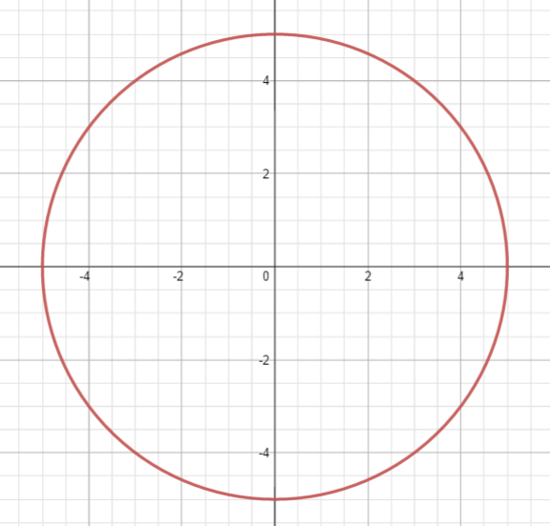
r = 5

Slide 18
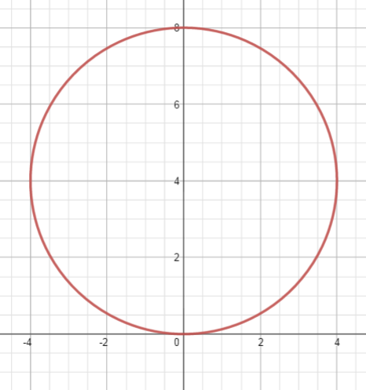
r = 8 sin θ

Slide 19
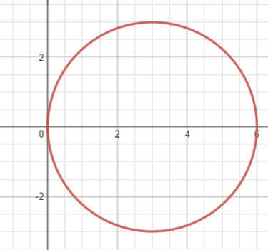
r = 6 cos θ

Slide 20
Lines
Convert the following into polar coordinates:
y = 6
x = 5
y = x
y = 2x + 3

Slide 21
Lines
Convert the following into polar coordinates:
y = 6 r sinθ = 6
x = 5
y = x
y = 2x + 3

Slide 22
Lines
Convert the following into polar coordinates:
y = 6 r sinθ = 6 r = 6 csc θ
x = 5
y = x
y = 2x + 3

Slide 23
Lines
Convert the following into polar coordinates:
y = 6 r = 6 csc θ
x = 5 r = 5 sec θ
y = x
y = 2x + 3

Slide 24
Lines
Convert the following into polar coordinates:
y = 6 r = 6 csc θ
x = 5 r = 5 sec θ
y = x ^{y}/_{x} = 1
y = 2x + 3

Slide 25
Lines
Convert the following into polar coordinates:
y = 6 r = 6 csc θ
x = 5 r = 5 sec θ
y = x ^{y}/_{x} = 1 arctan(^{y}/_{x})= arctan 1
y = 2x + 3

Slide 26
Lines
Convert the following into polar coordinates:
y = 6 r = 6 csc θ
x = 5 r = 5 sec θ
y = x ^{y}/_{x} = 1 arctan(^{y}/_{x})= arctan 1
θ = ^{π}/₄
y = 2x + 3

Slide 27
Lines
Convert the following into polar coordinates:
y = 6 r = 6 csc θ
x = 5 r = 5 sec θ
y = x θ = ^{π}/₄
y = 2x + 3

Slide 28
Lines
Convert the following into polar coordinates:
y = 6 r = 6 csc θ
x = 5 r = 5 sec θ
y = x θ = ^{π}/₄
y = 2x + 3 y – 2x = 3

Slide 29
Lines
Convert the following into polar coordinates:
y = 6 r = 6 csc θ
x = 5 r = 5 sec θ
y = x θ = ^{π}/₄
y = 2x + 3 y – 2x = 3 rsinθ – 2rcosθ = 3

Slide 30
Lines
Convert the following into polar coordinates:
y = 6 r = 6 csc θ
x = 5 r = 5 sec θ
y = x θ = ^{π}/₄
y = 2x + 3 y – 2x = 3 rsinθ – 2rcosθ = 3
r = ³/_{sinθ – 2cosθ}

Slide 31
Lines
Convert the following into polar coordinates:
y = 6 r = 6 csc θ
x = 5 r = 5 sec θ
y = x θ = ^{π}/₄
y = 2x + 3 r = ³/_{sinθ – 2cosθ}

Slide 32
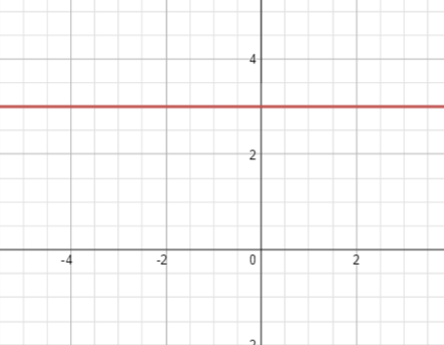
r = 3 csc θ

Slide 33
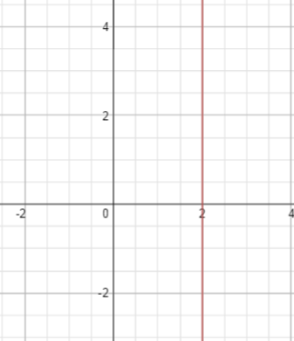
r = 2 sec θ

Slide 34
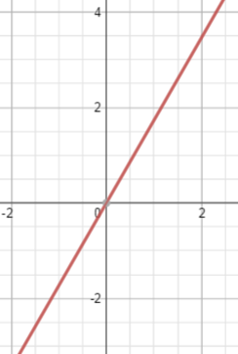
θ = ^{π}/₃

Slide 35
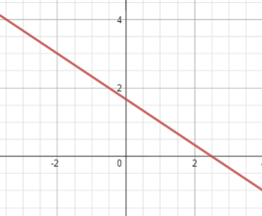
r = ⁵/_{2cosθ + 3sinθ}

Slide 36
Polar Graphs:
Rose Curves:
r = 5 sin (3θ) r = 2 cos (2θ)
Rose Curves are always of the form: r = a sin (nθ) or r = a cos (nθ). Based on your graphs, how can you determine the length of each petal of the rose-curve?
How can you determine the number of petal in the entire graph? (Hint: there are different rules for even n-values and odd n-values.)

Slide 37
Polar Graphs:
Lemiҫons:
This is pronounced Lee-Mah-Zon.
r = 3 + 2 sin θ r = 3 – 6 cos θ
r = 4 + 4 sin θ r = 5 + 2cos θ
Lemiҫons are always of the form r = a ± b sin θ or r = a ± b cos θ. They are categorized in four groups: convex, dimpled, cardioid, and with inner loop. The value of ^{b}/_{a} will determine which of these categories it fits into.

Slide 38
Lemiҫons
Based on your graphs and some vocabulary (such as cardio meaning heart-related) determine which of the above equations become which classifications. Then determine the value of ^{b}/_{a} that would create these graphs.
Convex: Example (from above): ^{b}/_{a} < ½
Dimpled: Example (from above): ½ < ^{b}/_{a} < 1
Cardioid: Example (from above): ^{b}/_{a} = 1
Inner Loop: Example (from above): ^{b}/_{a} > 1

Slide 39
Polar Graphs:
Lemnoscates:
r² = 16 sin (2θ) r² = 9 cos (2θ)
r² = -25sin(2θ) r² = -4 cos (2θ)
Remember, you are calculating and plotting r – values, not r² values. If r² is negative, then no point can be plotted.

Slide 40
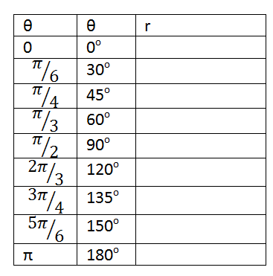
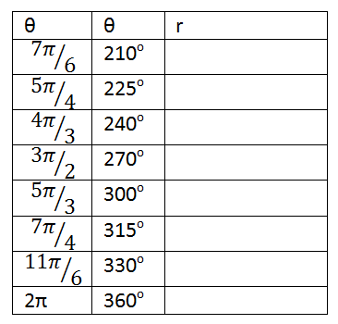
r = 2 + 4 sin θ

Slide 41
r = 2 + 4 sin θ
r = 2 + 4 sin 0

Slide 42
r = 2 + 4 sin θ
r = 2 + 4 sin 0
r = 2 + 0

Slide 43
r = 2 + 4 sin θ
r = 2 + 4 sin 0
r = 2 + 0
r = 2

Slide 44
r = 2 + 4 sin θ
r = 2 + 4 sin 0
r = 2 + 0
r = 2

Slide 45
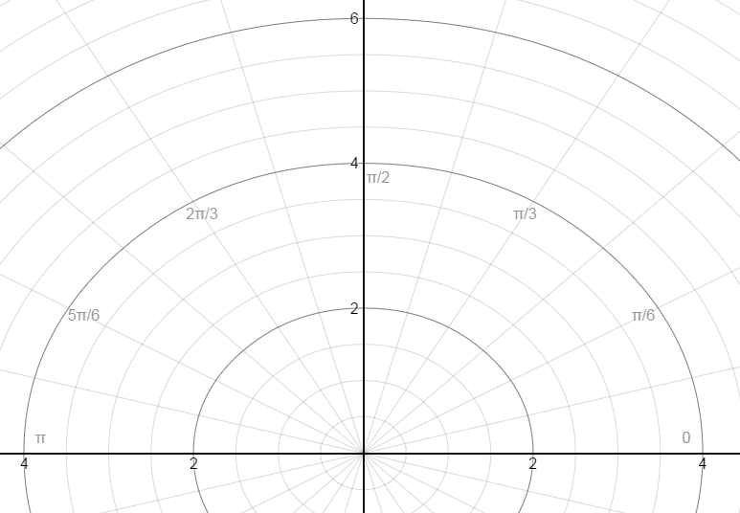
r = 2 + 4 sin θ

Slide 46
Animation of the graph:
https://www.desmos.com/calculator/a4i6rodk73

Slide 47
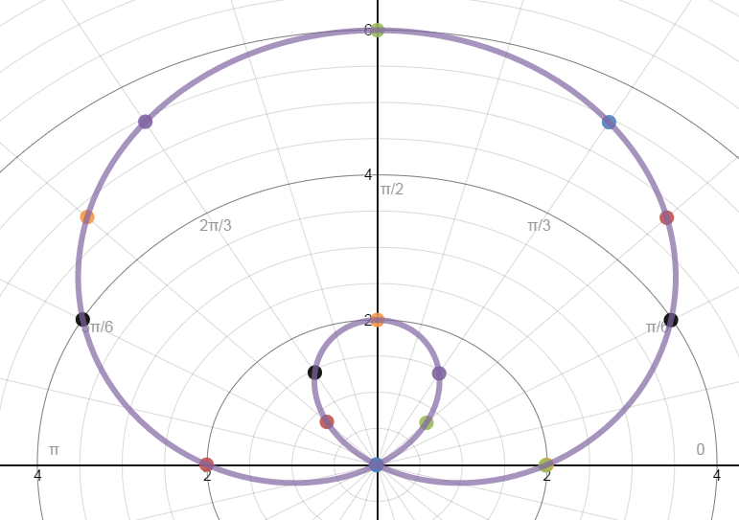
r = 2 + 4 sin θ

Slide 48
That is a Limiҫon with an Inner Loop

Slide 49
You can get all 4 kinds of Limiҫons based on the constants in the equation.
View the following animation:
https://www.desmos.com/calculator/vxzfq85gnd

Slide 50
Try These: r = 2 cos (2θ)

Slide 51
Try These: r² = -4 cos (2θ)

Slide 52
Conics in Polar Form:
All Conic Sections can be identified in Polar form with the following equations:
$$r=\frac{a}{1±esinθ}$$
$$r=\frac{a}{1±ecosθ}$$
where e is the eccentricity.

Slide 53
Identify the conic section:
$$r=\frac{9}{3−2sinθ}$$

