Slide 1
MATH 1330
Section 4.1

Slide 2
Special Triangles and Trigonometric Ratios
In this section, we’ll work with some special triangles before moving on to defining the six trigonometric functions.
Two special triangles 30 – 60 - 90 and 45 – 45 – 90 triangles. With additional information, you should be able to find the lengths of all sides of one of these special triangles.

Slide 3
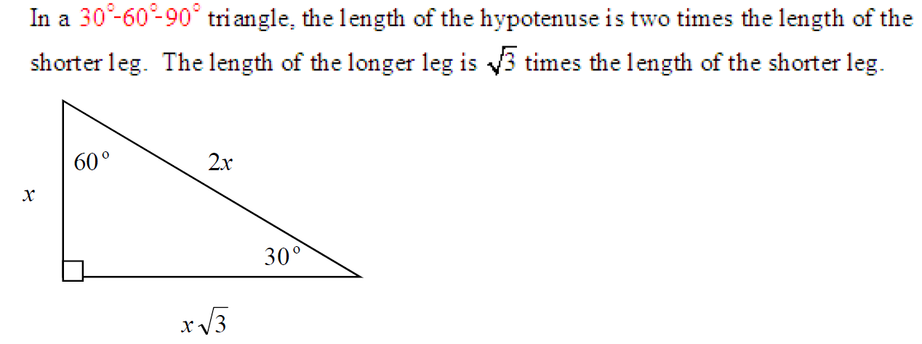
Important Triangles 30-60-90 triangles

Slide 4
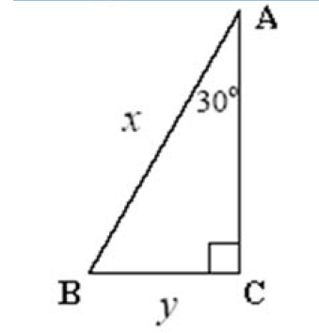
Example 1: Find x and y if AC = 4√2.

Slide 5
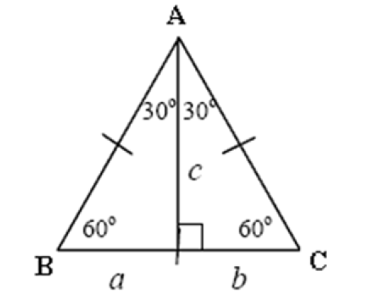
Example 2: In the figure below, an altitude is drawn to the base of equilateral triangle ABC. If AC = 8, find a, b and c.

Slide 6
45-45-90 triangles

Slide 7
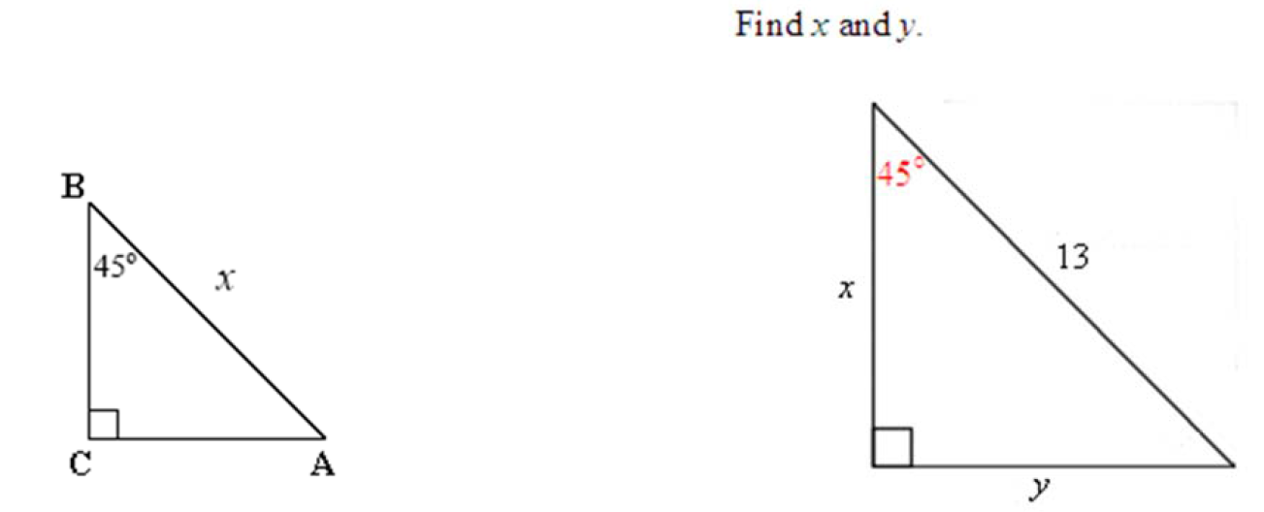
Example 3:
A. Find x if the side AC = 5√3. B.

Slide 8
The Six Trigonometric Ratios of an Angle
The word trigonometry comes from two Greek roots, trignon, meaning “having three sides,” and meter, meaning “measure.” We have already defined the six basic trigonometric functions in terms of a right triangle and the measure of three sides.
A trigonometric function is a ratio of the lengths of the sides of a triangle. If we fix an angle, then as to that angle, there are three sides, the adjacent side, the opposite side, and the hypotenuse. We have six different combinations of these three sides, so there are a total of six trigonometric functions. The inputs for the trigonometric functions are angles and the outputs are real numbers.

Slide 9
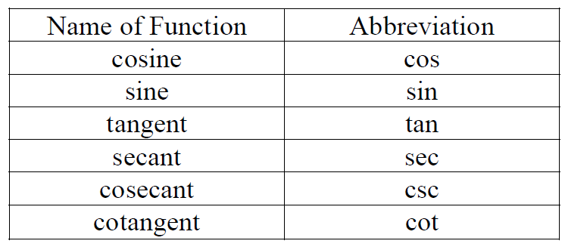
The names of the six trigonometric functions, along with their abbreviations, are as follows:

Slide 10
Defining the Sides of a Triangle

Slide 11
For ease of memorization

Slide 12
For ease of memorization

Slide 13
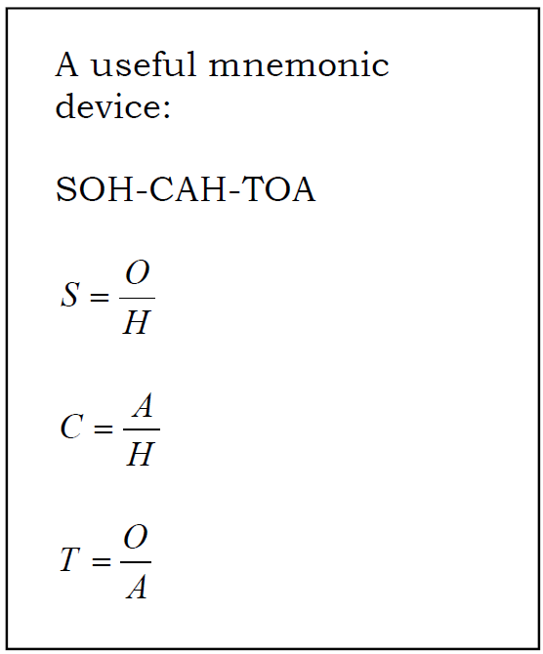
Note: For acute angles the values of the trigonometric functions are always positive since they are ratios of lengths.

Slide 14
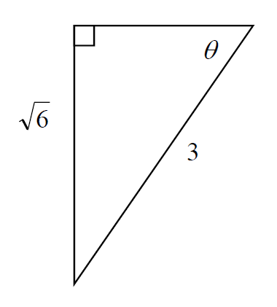
Popper 1: Find all six trigonometric ratios of θ.
1 . sin θ
a.
2. cos θ
b.
3. tan θ
c.
4. csc θ
d.
5. sec θ
e. None of these
6. cot θ
$$\frac{\sqrt{3}}{3}$$
$$\frac{3}{\sqrt{3}}$$
$$\frac{\sqrt{6}}{3}$$
$$\sqrt{2}$$

Slide 15
Example 5: Suppose a triangle ABC has C = 90º, AC = 7 and AB = 9. Find csc(A) and tan(B).

