Slide 1
MATH 1330
Section 4.2

Slide 2
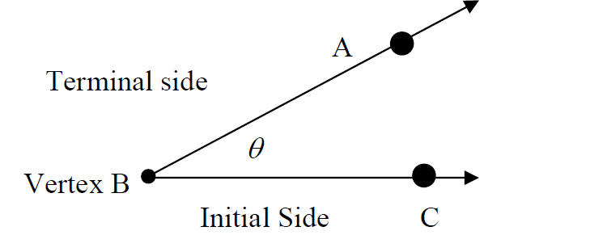
Parts of an angle
An angle is formed by two rays that have a common endpoint (vertex). One ray is the initial side and the other is the terminal side. We typically will draw angles in the coordinate plane with the initial side along the positive x axis.

Slide 3
Naming and Degree Measure of Angles

Slide 4
Common Angles

Slide 5
Radian Measure of an Angle
The second method is called radian measure. One complete revolution is 2π.
The problems in this section are worked in radians.
Radians are a unit free measurement. Suppose I draw a circle from the center and construct an angle by drawing rays from the center of the circle to two different points on the circle in such a way that the length of the arc intercepted by the two rays is the same as the radius of the circle. The measure of the central angle thus formed is one radian.

Slide 6
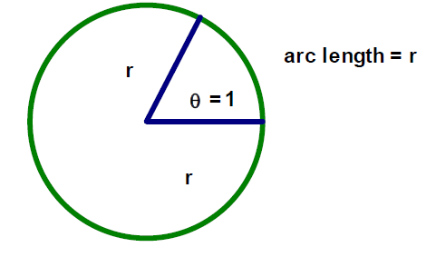
Measure of 1 Radian

Slide 7
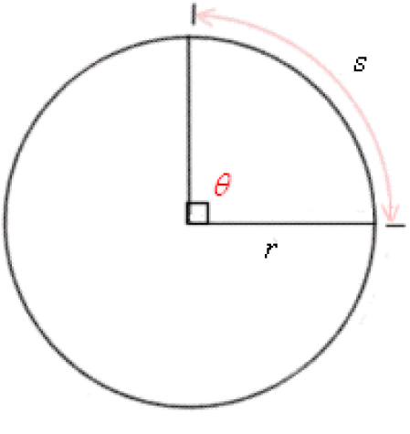
The Radian Measure of an Angle
Place the vertex of the angle at the center of a circle of radius r. Let s denote the length of the arc intercepted by the angle. The radian measure, θ, of the angle is the ratio of the arc length s to the radius r. In symbols, $θ=\frac{s}{r}$.
In this definition it is assumed that s and r have the same linear units. You can also solve the previous formula in the form s = θ r

Slide 8
Angle Measure Notations
One radian measure is the measure of the central angle (vertex of the angle is at the center of the circle) of a circle that intercepts an arc equal in length to the radius of the circle.
If an angle has a measure of 2.5 radians, we write θ= 2.5 radians or θ = 2.5. There should be no confusion as to whether radian or degree measure is being used. If θ has a degree measure of, say, 2.5 we must write θ = 2.5º and not θ = 2.5.

Slide 9
Example 1: A circle has radius12 inches. A central angle θ intercepts an arc of length 36 inches. What is the radian measure of the central angle?

Slide 11
Relationship between Degrees and Radians
How can we obtain a relationship between degrees and radians? We compare the number of degrees and the number of radians in one complete rotation in a circle. We know that 360º is all the way around a circle. The length of the intercepted arc is equal to the circumference of the circle. Therefore, the radian measure of this central angle is the circumference of the circle divided by the circle’s radius, r. The circumference of a circle of a radius r is 2πr.

Slide 12
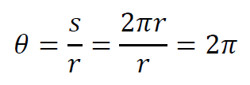
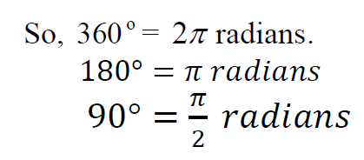
Conversion between Units
We use the formula for radian measure to find the radian measure of the360º angle. We know that the circumference of a circle is 2πr. So in this case, s = 2πr. So the radian measure of a central angle in the case of a complete a complete revolution:

Slide 13
Conversion between Degrees and Radians

Slide 14
Popper 2: Convert each angle in degrees to radians.
1. 150º
a. 3π/8 b. 2π/3 c. 5π/6 d. 3π/4
-135º
a. -3π/8 b. -2π/3 c. -5π/6 d. -3π/4

Slide 15
Popper 2: Convert each angle in radians to degrees
3. $\frac{π}{3}$
a. 30º b. 45º c. 60º d. 90º
4. $\frac{−11π}{6}$
a. -30º b. -260º c. -300º d. -330º

Slide 16
Common Radian Measures

Slide 17
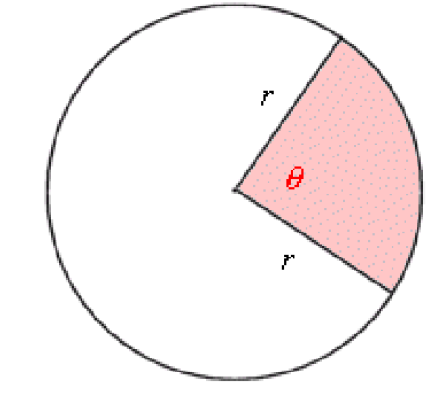
Sectors: A portion of a circle:
In a circle of radius r, the area A of a sector with central angle of radian measure θ is given by:
$$A=\frac{1}{2}r^{2}θ$$

Slide 18
Example 5:

Slide 19
Example 6: Find the perimeter of a sector with central angle 60º and radius 3 m.
To find the area of a sector of a circle, think of the sector as simply a fraction of the circle. If the central angle 360º defining the sector is given in degrees, then we can use the following formula: $A=\frac{θ}{360°}{πr}^{2}$

Slide 20
Example 7: Use the formula above to find the area of a sector, where θ = 315° and r = 4 cm.

Slide 21
Linear and Angular Velocity (Speed)
Consider a merry-go-round.
The ride travels in a circular motion.
Some of the horses are right along the edge of the merry-go-round, and some are closer to the center. If you are on one of the horses at the edge, you will travel farther than someone who is on a horse near the center. But the length of time that both people will be on the ride is the same. If you were on the edge, not only did you travel farther, you also traveled faster.
However, everyone on the merry-go-round travels through the same number of degrees (or radians).
There are two quantities we can measure from this, linear velocity and angular velocity.

Slide 22
Linear Versus Angular Velocity
The linear velocity of a point on the rotating object is the distance per unit of time that the point travels along its circular path. This distance will depend on how far the point is from the axis of rotation (for example, the center of the merry-go-round).
We denote linear velocity by v. Using the definition above, $v=\frac{s}{t}$, where s is the arclength (s = θ r).

Slide 23
Linear Versus Angular Velocity
The angular velocity of a point on a rotating object is the number of degrees (or radians or revolutions) per unit of time through with the point turns. This will be the same for all points on the rotating object.
We let the Greek letter ω (omega) represent angular velocity. Using the definition above, $ω=\frac{θ}{t}$.

Slide 24
Linear Speed in Terms of Angular Speed :
We can establish a relationship between the two kinds of speed by dividing both sides of the arc length formula, s = θ r, by t.
The linear velocity, v, of a point a distance r from the center of rotation is given by $v=rω$, where ω is the angular velocity in radians per unit of time.

Slide 25
Example 8:
If the speed of a revolving gear is 25 rpm (revolutions per minute),
Find the number of degrees per minute through which the gear turns.
b. Find the number of radians per minute through which the gear turns.

Slide 26
Popper 2 (Cont):
A car has wheels with a 10 inch radius. If each wheel’s rate of turn is 4 revolutions per second,
5. Find the angular speed in units of radians/second.
a. 2π b. 4π c. 8π d. 0.5 π
6. How fast (linear speed) is the car moving in units of inches/second?
a. 10π b. 80π c. 5/4π d. 2π

