Slide 1
MATH 1330
Section 4.3

Slide 2
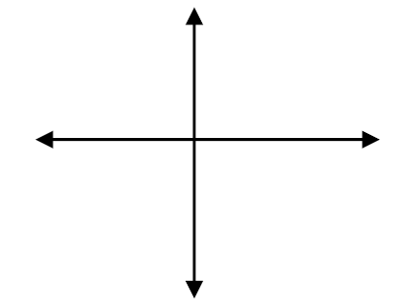
Unit Circle Trigonometry
An angle is in standard position if its vertex is at the origin and its initial side is along the positive x axis.
Positive angles are measured counterclockwise from the initial side. Negative angles are measured clockwise.
We will typically use the θ to denote an angle.

Slide 3
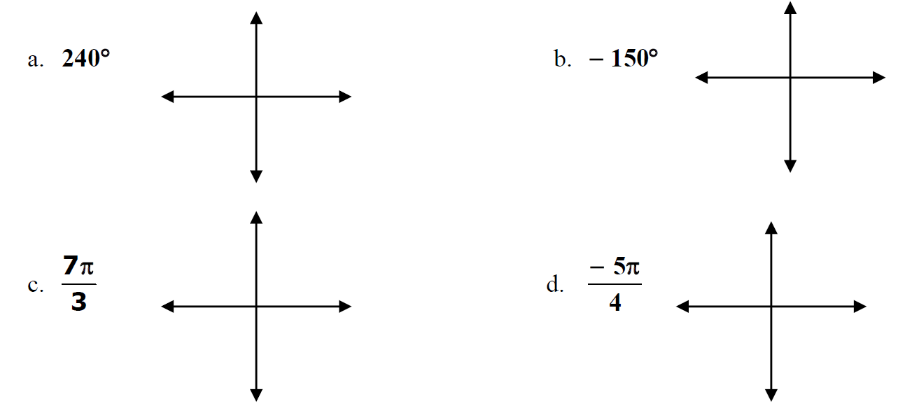
Example 1: Draw each angle in standard position.

Slide 4
Coterminal Angles
Angles that have the same terminal side are called co-terminal angles. Measures of co-terminal angles differ by a multiple of 360º if measured in degrees or by multiple of 2θ if measured in radians.

Slide 5
Calculating Coterminal Angles
Angles in standard position with the same terminal side are called coterminal angles. The measures of two coterminal angles differ by a factor corresponding to an integer number of complete revolutions.
The degree measure of coterminal angles differ by an integer multiple of 360º . For any angle θ measured in degrees, an angle coterminal with θ can be found by the formula θ + n(360º).

Slide 6
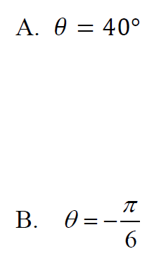
Example 2: Find three angles, two positive and one negative that are co-terminal with each angle.

Slide 7
Angle Directions
Positive angles are generated by counterclockwise rotation.
Negative angles are generated by clockwise rotation.

Slide 8
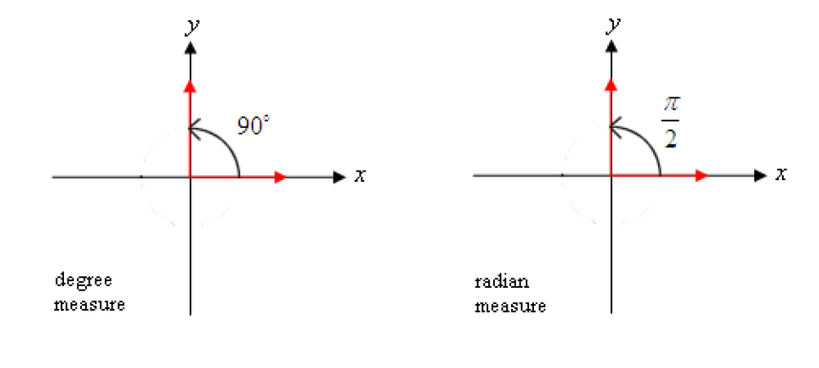
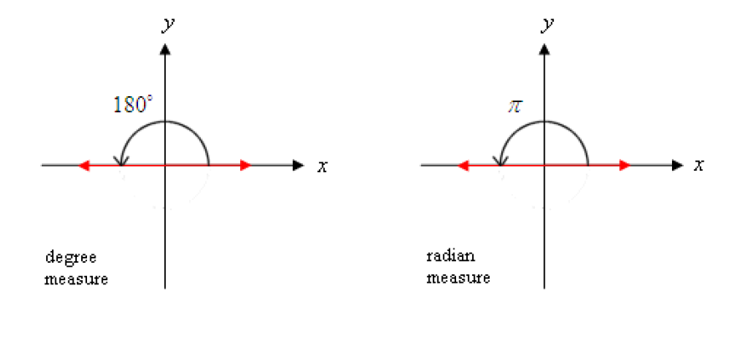
Quadrantal Angles
An angle where the terminal side falls on either the x- or y-axis is called a quadrantal angle.

Slide 9
The Reference Angle or Reference Number
Let θ be an angle in standard position. The reference angle associated with θ is the acute angle (with positive measure) formed by the x-axis and the terminal side of the angle θ . When radian measure is used, the reference angle is sometimes referred to as the reference number (because a radian angle measure is a real number).
π - θ = Ref Angle
θ = Ref Angle
180 - θ = Ref Angle
θ = Ref Angle
θ - π = Ref Angle
2π - θ = Ref Angle
θ - 180 = Ref Angle
360 - θ = Ref Angle

Slide 10
Popper 3: Specify the reference angle.
θ = 405º
45º b. 225º c. 35º d. 95º
2. θ = 330º
a. 45º b. 60º c. 30º d. 150º

Slide 11
Popper 3: Specify the reference angle.
3. $θ=−\frac{2π}{3}$
a. $\frac{4π}{3}$ b. $\frac{π}{3}$ c. $\frac{2π}{3}$ d. $\frac{π}{6}$
4. $θ=\frac{4π}{5}$
a. $\frac{π}{5}$ b. $5π$ c. $π$ d. $0$

Slide 12
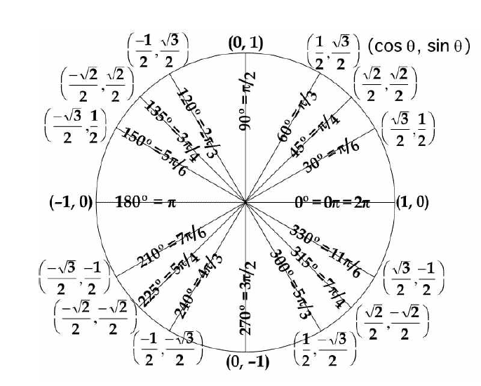
Unit Circle
We previously defined the six trigonometry functions of an angle as ratios of the length of the sides of a right triangle. Now we will look at them using a circle centered at the origin in the coordinate plane. This circle will have the equation x² + y² = r². If we select a point P(x, y) on the circle and draw a ray from the origin though the point, we have created an angle in standard position.

Slide 13
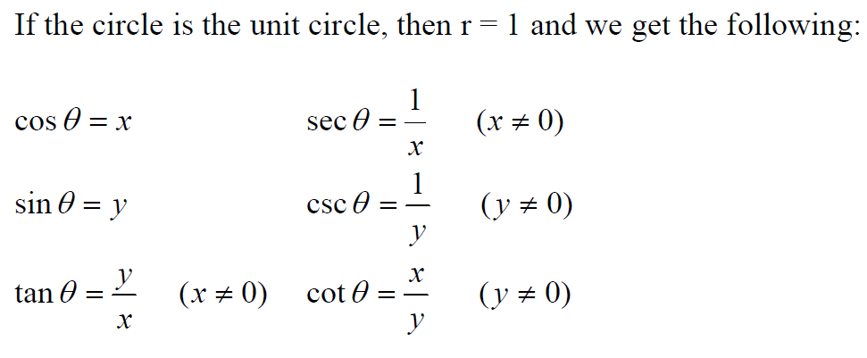
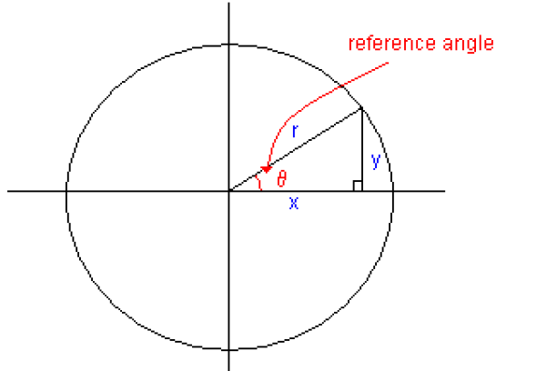
Trigonometric Functions of Angles

Slide 15
Example 4: For each quadrantal angle, give the coordinates of the point where the terminal side of the angle interests the unit circle.
-180º , then find sine and cotangent, if possible, of the angle.
b. $\frac{3π}{2}$ , then find tangent and cosecant, if possible, of the angle.

Slide 16
Signs in Certain Quadrants

Slide 17
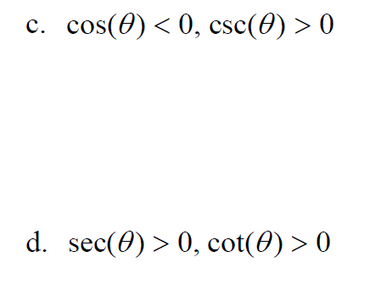
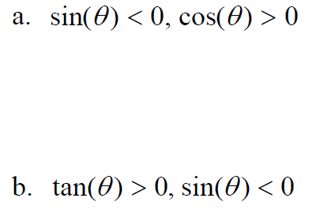
Example 5: Name the quadrant in which the given conditions are satisfied:

Slide 18
Example 6: Rewrite each expression in terms of its reference angle, deciding on the appropriate sign (positive or negative).

Slide 20
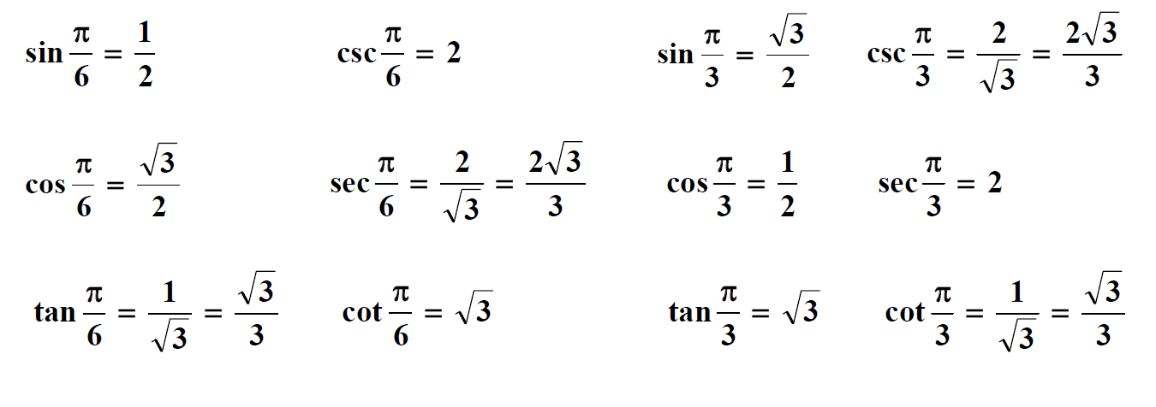

Slide 22
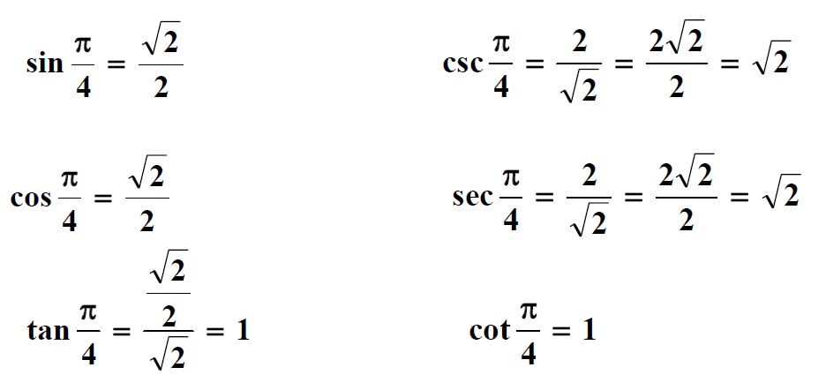

Slide 23
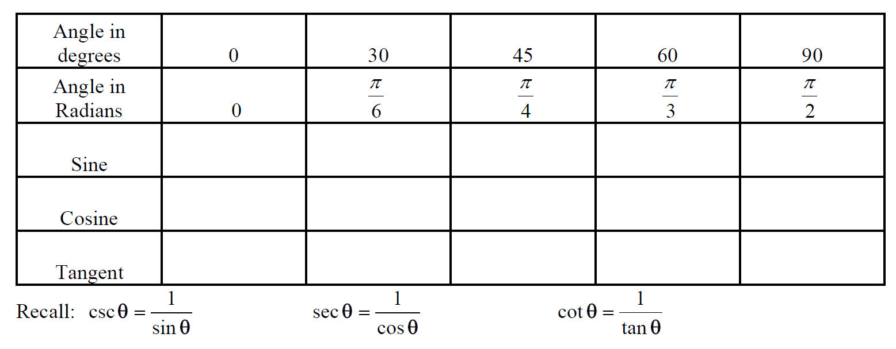
Trig Value Chart:

Slide 26
Evaluating Using Reference Angles
1. Determine the reference angle associated with the given angle.
2. Evaluate the given trigonometric function of the reference angle.
3. Affix the appropriate sign determined by the quadrant of the terminal side of the angle in standard position

Slide 27
Popper 3: Determine the Value of the Trigonometric Function
5.
8.
a. $\frac{\sqrt{3}}{2}$ b. $\frac{−\sqrt{3}}{2}$ c. $\frac{1}{2}$ d. $\frac{−1}{2}$ e. $\frac{−\sqrt{2}}{2}$
a. $\frac{\sqrt{3}}{2}$ b. $\frac{−\sqrt{3}}{2}$ c. $\frac{1}{2}$ d. $\frac{−1}{2}$ e. $\frac{−\sqrt{2}}{2}$
6.
a. $\frac{\sqrt{3}}{2}$ b. $\frac{−\sqrt{3}}{2}$ c. $\frac{1}{2}$ d. $\frac{−1}{2}$ e. $\frac{−\sqrt{2}}{2}$
7.
9.
a. $\frac{2}{\sqrt{3}}$ b. $\frac{−1}{\sqrt{2}}$ c. $\frac{−2}{\sqrt{2}}$ d. $\frac{−1}{2}$ e. $\frac{\sqrt{2}}{2}$
a. $\frac{\sqrt{3}}{2}$ b. $\frac{−\sqrt{3}}{2}$ c. $\frac{1}{2}$ d. $\frac{−1}{2}$ e. $\frac{−\sqrt{2}}{2}$

