Slide 1
MATH 1330
Section 4.4

Slide 2
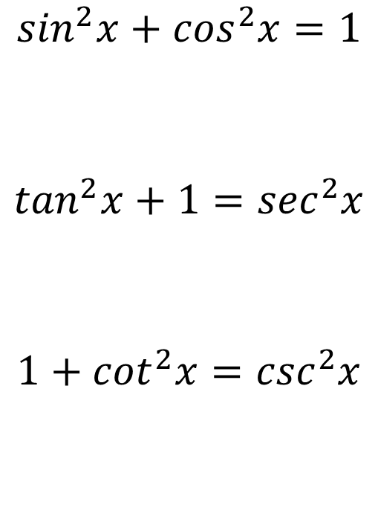
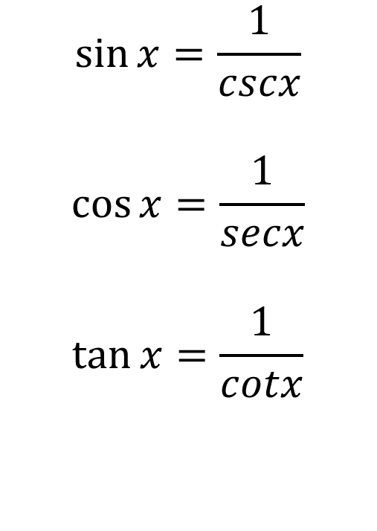
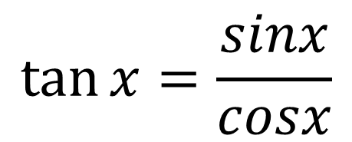
Major Trigonometric Identities (Must Know)
$$\sin{x}=\frac{1}{cscx}$$
$$\cos{x}=\frac{1}{secx}$$
$$\tan{x}=\frac{1}{cotx}$$
$$\sin^{2}x+\cos^{2}x=1$$
$$\tan^{2}x+1=\sec^{2}x$$
$$1+\cot^{2}x=\csc^{2}x$$
$$\tan{x}=\frac{sinx}{cosx}$$

Slide 4
Trigonometric Expressions and Identities

Slide 5


Slide 6
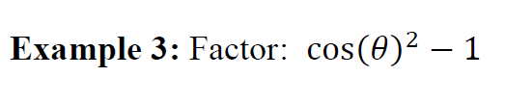

Slide 7


Slide 8


Slide 9
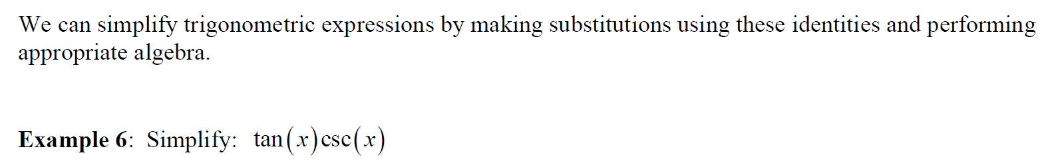

Slide 10
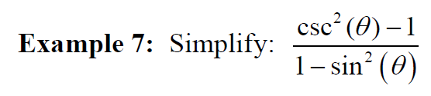

Slide 12
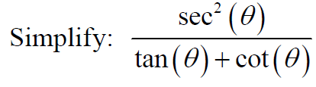
Popper 4: Question 1:
a. sec θ b. cot θ c. sin θ d. tanθ

Slide 13
Popper 4: Question 1:

Slide 14
Verifying Trigonometric Identities:
At times, you will be asked to verify identities. To do this, you’ll use the identities and algebraic operations to show that the left-hand side of the problem equals the right-hand side of the problem.
Here are some pointers for helping you verify identities:
1. Remember that your task is to show that the two sides of the equation are equal. You may not assume that they are equal.
2. Choose one side of the problem to work with and leave the other one alone. You’ll use identities and algebra to convert one side so that it is identical to the side you left alone. You’ll work with the “ugly” or more complicated side.
3. If is often helpful to convert all trig functions into sine and cosine. This is usually very helpful! (Unless it makes things worse!!)
4. Find common denominators, if appropriate.
5. Don’t try to do too much in one step. Take it one step at a time!
6. If working with one side doesn’t get you anywhere, try working with the other side instead.

Slide 15
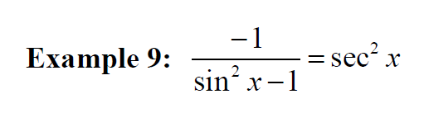

Slide 16
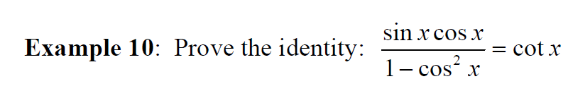

Slide 17


Slide 18
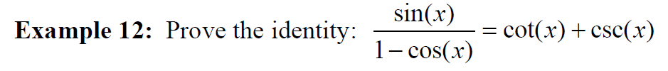

Slide 19
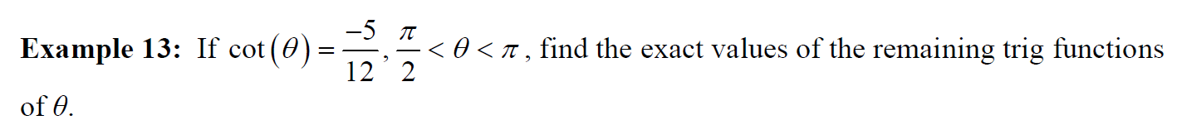
Popper 4:

