Slide 1
MATH 1330
Section 5.2

Slide 2
Graphs of Sine and Cosine Functions
A Periodic Function and Its Period
A non-constant function f is said to be periodic if there is a number p > 0 such that f(x + p) = f(x) for all x in the domain of f. The smallest such number p is called the period of f.
The graphs of periodic functions display patterns that repeat themselves at regular intervals.

Slide 3

Amplitude
Let f be a periodic function and let m and M denote, respectively, the minimum and maximum values of the function. Then the amplitude of f is the number
In other words the amplitude is half the height.

Slide 4
Example 1:

Slide 5
Now let’s talk about the graphs of the sine and cosine functions
This means that after going around the unit circle once ( 2π radians), both functions repeat. So the period of both sine and cosine is 2 π .
Hence, we can find the whole number line wrapped around the unit circle.
Since the period of the sine function is 2π , we will graph the function on the interval
[0, 2π ]. The rest of the graph is made up of repetitions of this portion.
Since the period of the cosine function is 2π , we will graph the function on the interval
[0, 2π ]. The rest of the graph is made up of repetitions of this portion.

Slide 6
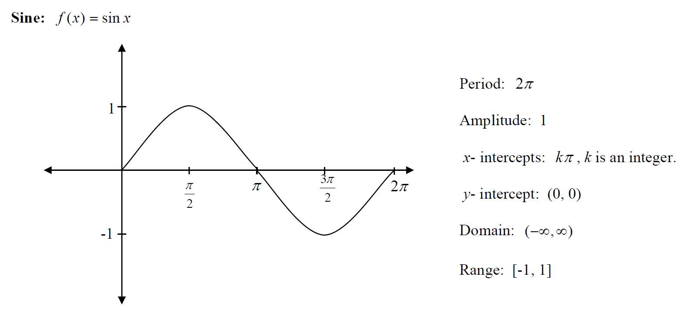
The previous information leads us to the graphs of sine and cosine…

Slide 7
Big picture:

Slide 8
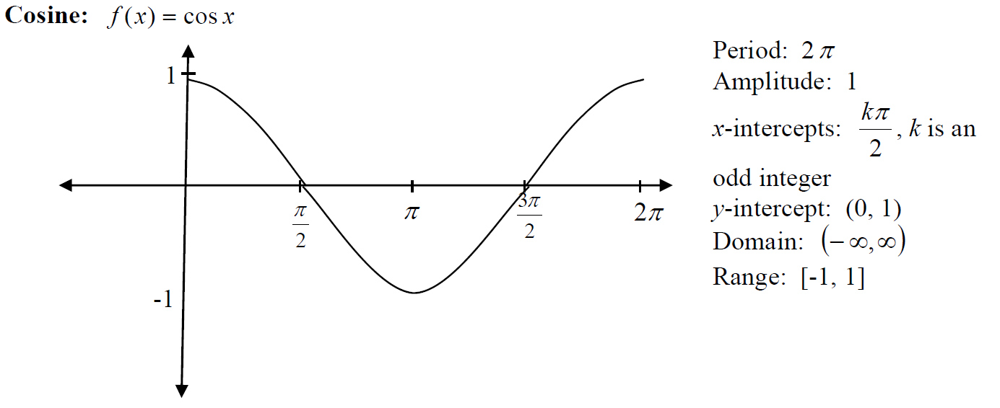

Slide 9
Big picture:

Slide 10
Relating Sine and Cosine

Slide 11
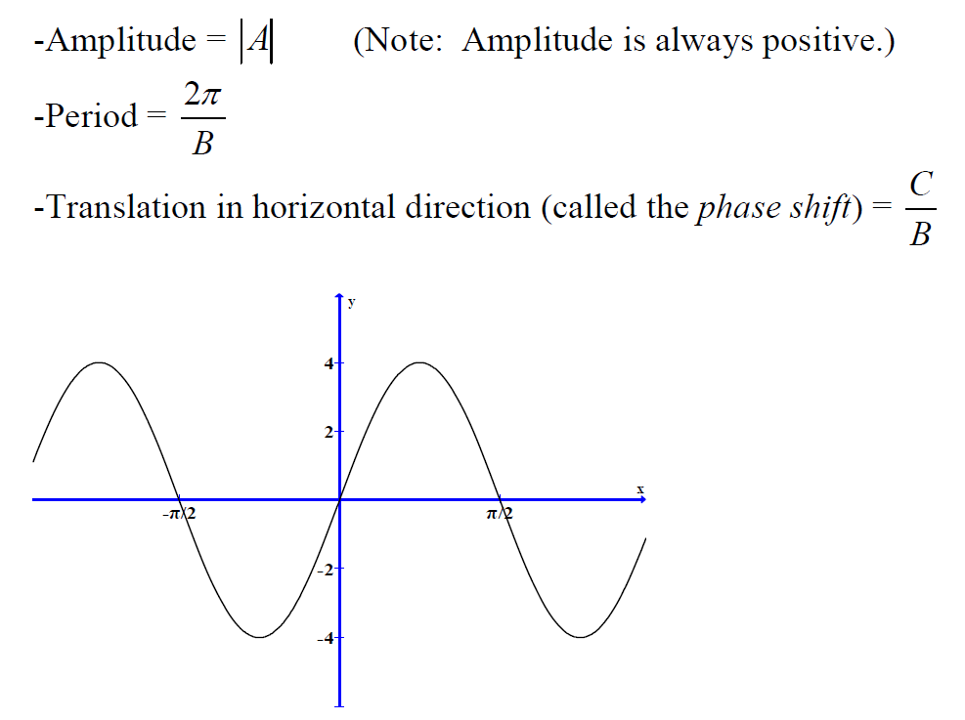
For the following functions: y = Asin(Bx - C) and y = Acos(Bx - C)
Note that amplitude vertically stretches or shrinks the graph. So if A is between 0 and1 then the graph will
vertically shrink. If A is >1 then the graph will stretch vertically. The period horizontally stretches and shrinks
the same graph. So if B >1 means the graph will shrink horizontally and if 0 and1 then the graph will stretch horizontally.

Slide 12
One Full Cycle of the Graph
One complete cycle of the sine curve includes three x-intercepts, one maximum point and one minimum point.
The graph has x-intercepts at the beginning, middle, and end of its full period. Key points in graphing sine functions are obtained by dividing the period into four equal parts.

Slide 13
One Full Cycle of the Graph
One complete cycle of the cosine curve includes two x-intercepts, two maximum points and one minimum point. The graph has x-intercepts at the second and fourth points of its full period. Key points in graphing cosine functions are obtained by dividing the period into four equal parts.

Slide 14
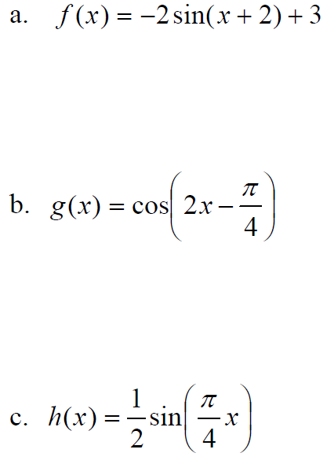
Example 2: State the transformations for:

Slide 15


Slide 16
Popper 7: Question 1: Graph f (x) = 3sin(2x)

Slide 17
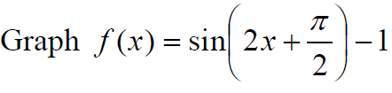
Popper 7: Question 2:

