Slide 1
MATH 1330
Section 5.3

Slide 2
Graphs of the Cosecant and Secant Functions

Slide 3
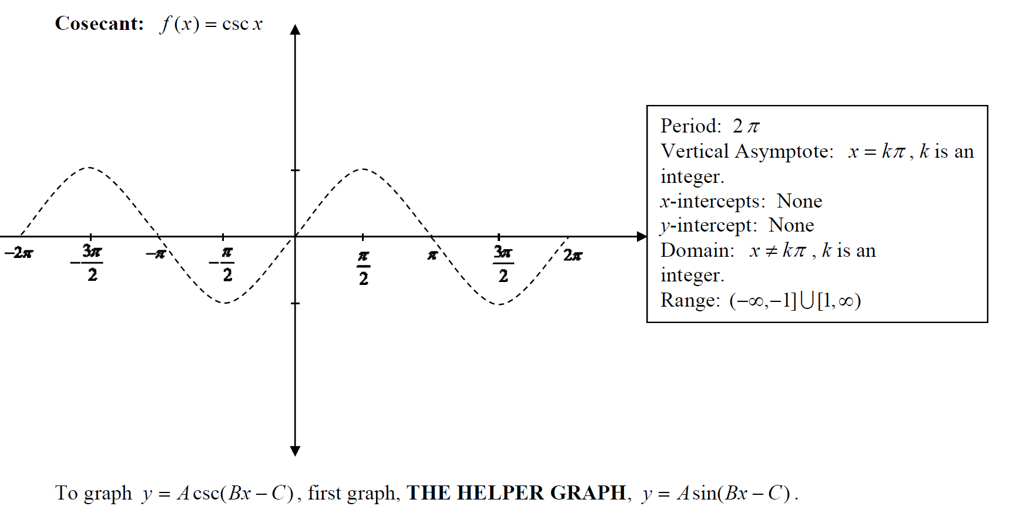
Graphs of the Cosecant and Secant Functions

Slide 4
Graphs of the Cosecant and Secant Functions

Slide 5
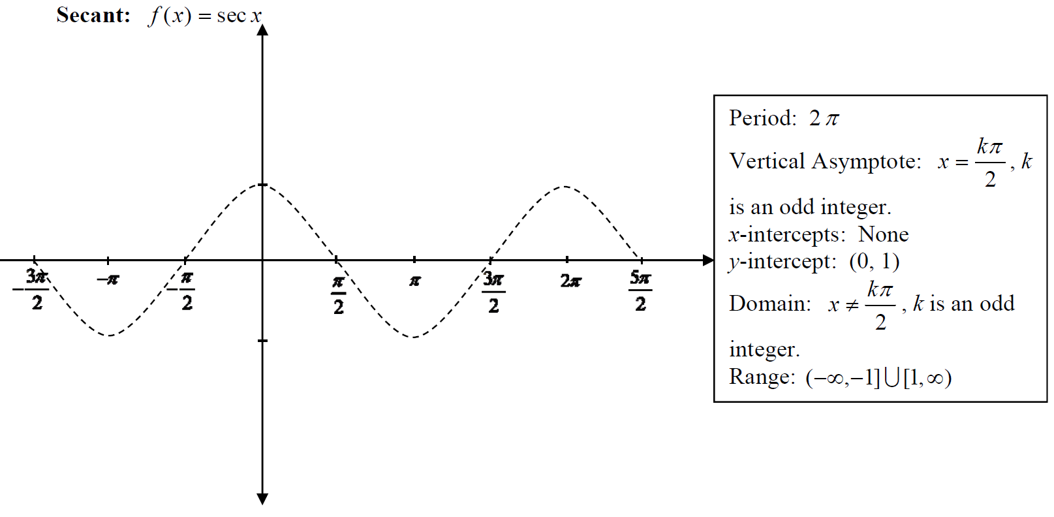
Graphs of the Cosecant and Secant Functions

Slide 8
Popper 8
1.
a. $\frac{π}{4}+$ $\frac{nπ}{2}$ b. $\frac{nπ}{4}$ c. $\frac{π}{8}+$ $\frac{nπ}{4}$ d. $\frac{π}{4}+nπ$
2.
a. $\frac{π}{2}+$ $\frac{nπ}{2}$ b. (2n+1) c. $2n$ d. $\frac{π}{2}+$ $2n$

Slide 9
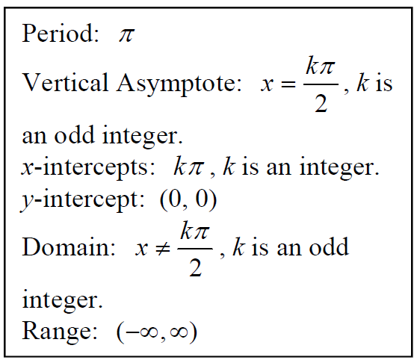
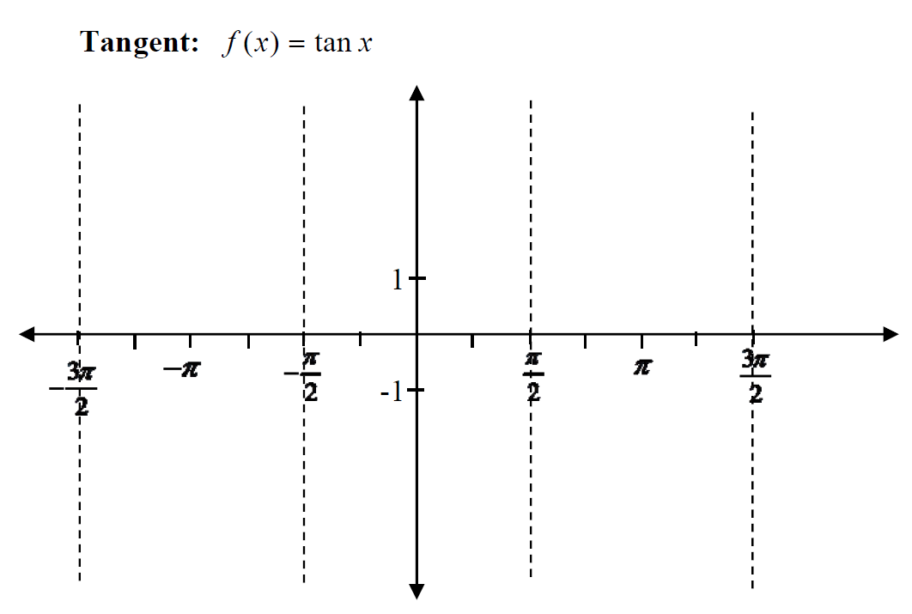
Graph of the Tangent Function

Slide 10
How to Graph a Tangent Function

Slide 13
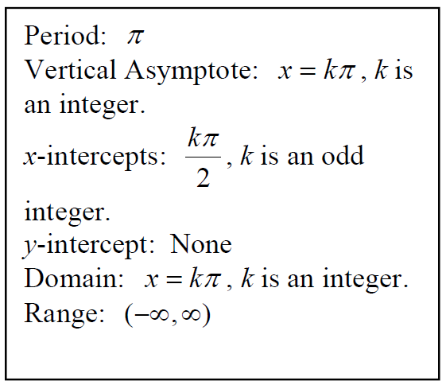
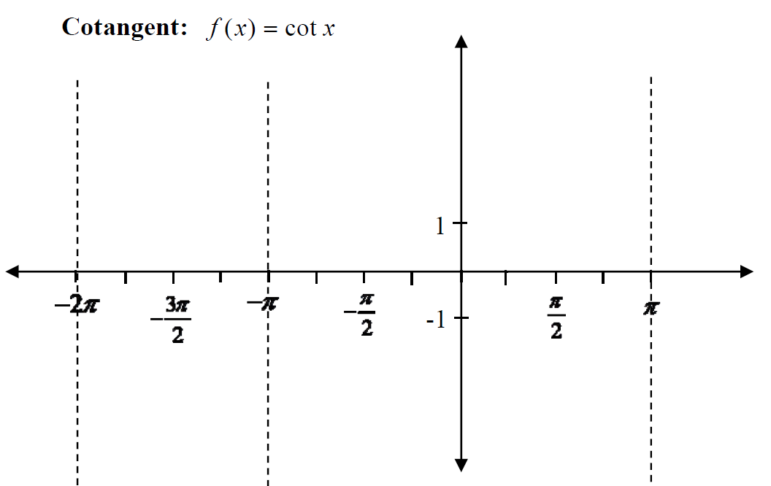
Graph of the Cotangent Function

Slide 14
How to Graph a Cotangent Function

Slide 16
Popper 8:
3. Determine the period of the function:
a. 8 b. 4 c. $\frac{π}{4}$ d. 2
4. Determine one asymptote of the function
a. 0 b. -2 c. 2 d. 1
5. Determine a second asymptote of the function
a. 6 b. 3 c. 4 d. 5
6. Determine the x-intercept of the function
a. 0 b. 1 c. 2 d. 3
7. Determine an additional two points of the function
a. (1, 2); (3, 2) b. (1,2); (3,-2) c. (-1,-2),(1,2) d. (1, -2); (3, 2)

