Slide 1
MATH 1330
Section 5.4

Slide 2
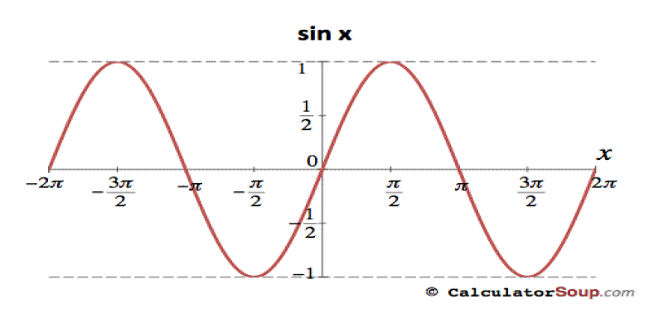
Inverse Trigonometric Functions
The function sin(x) is graphed below. Notice that this graph does not pass the horizontal line test; therefore, it does not have an inverse.

Slide 3
Restricted Sine Function and It’s Inverse

Slide 5
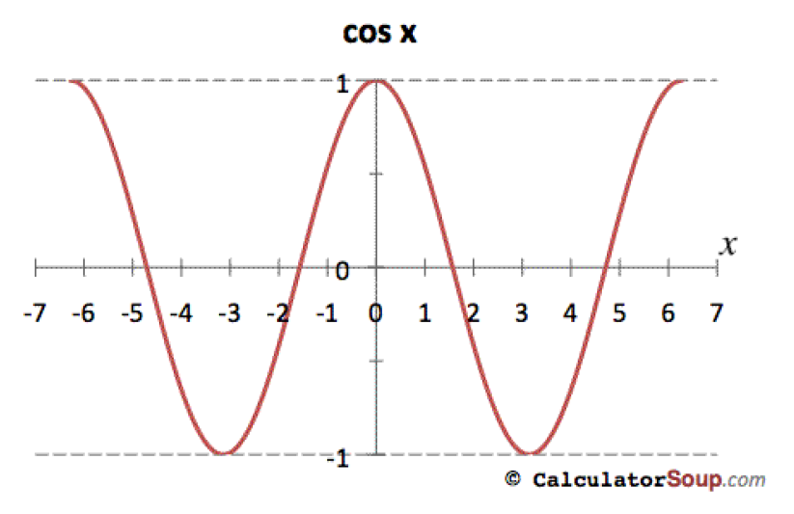
Restricted Cosine Function and It’s Inverse
The function cos(x) is graphed below. Notice that this graph does not pass the horizontal line test; therefore, it does not have an inverse.

Slide 7
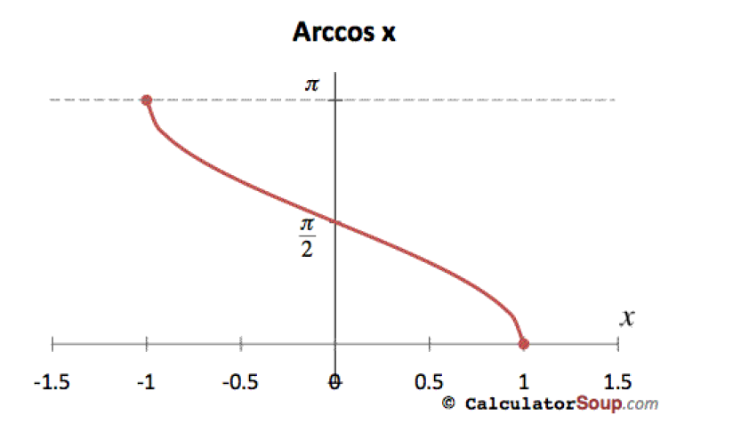
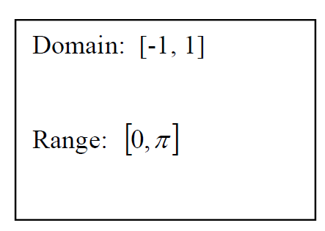

Slide 8
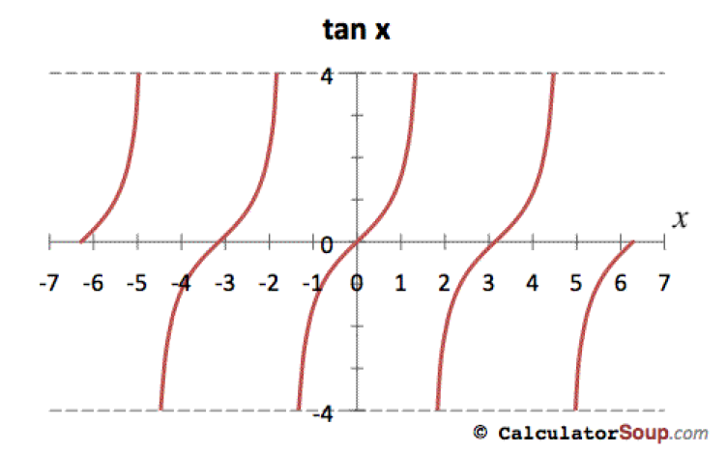
Restricted Tangent Function and It’s Inverse
The function tan(x) is graphed below. Notice that this graph does not pass the horizontal line test; therefore, it does not have an inverse.

Slide 9
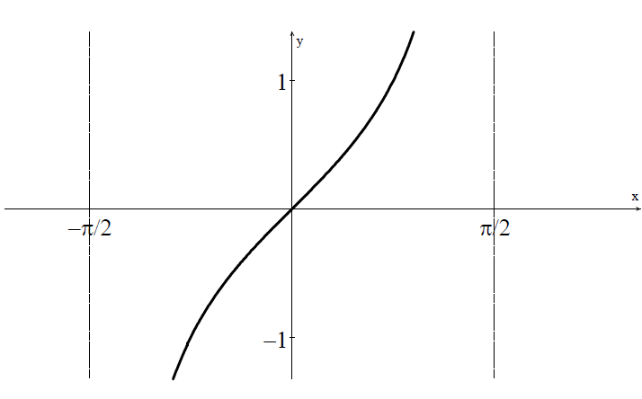
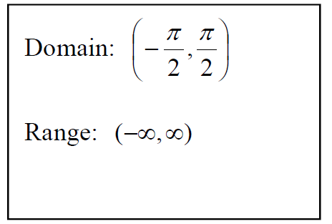

Slide 10
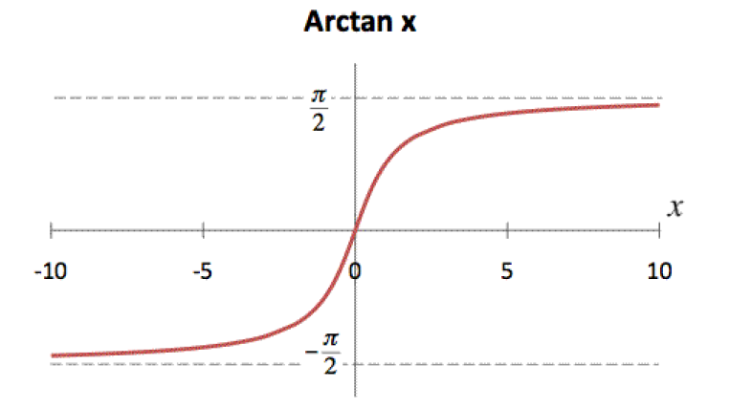
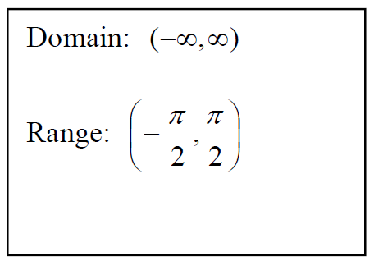

Slide 12
We now want to evaluate inverse trig functions. With these problems, instead of giving you the angle and asking you for the value, you’ll be given the value and ask be asked what angle gives you that value.

Slide 13
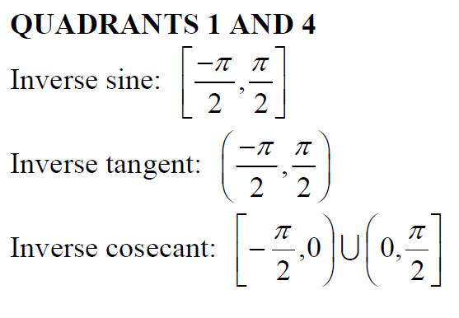
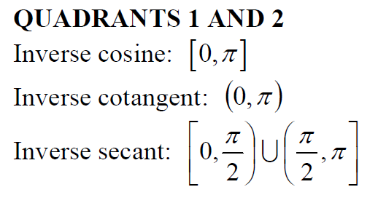
When we covered the unit circle, we saw that there were two angles that had the same value for most of our angles. With inverse trig, we can’t have that. We need a unique answer, because of our need for 1-to-1 functions. We’ll have one quadrant in which the values are positive and one value where the values are negative. The restricted graphs we looked at can help us know where these values lie. We’ll only state the values that lie in these intervals (same as the intervals for our graphs):

Slide 14
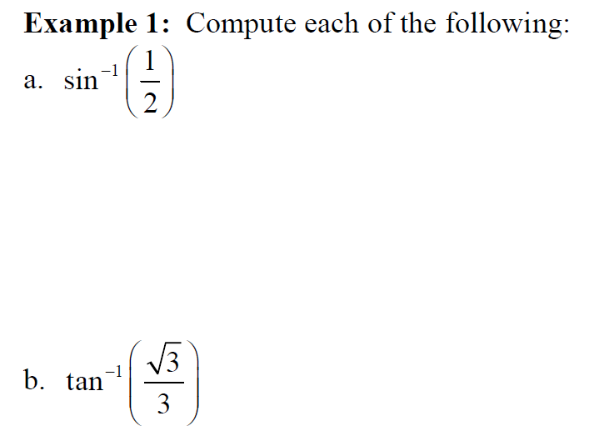

Slide 16
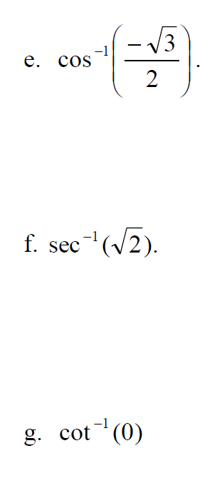
Example 1 Continued:

Slide 17
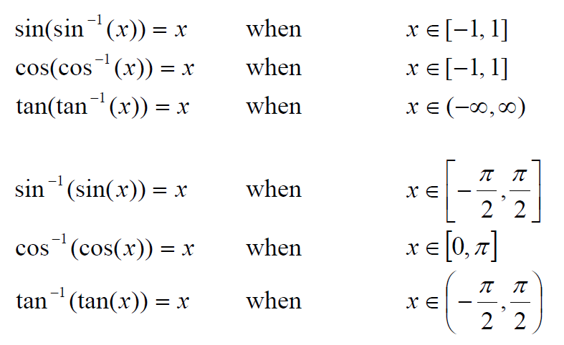
Evaluating composite functions and their inverses:
Here is a summary of properties that maybe helpful when evaluating inverse trigonometric functions:

Slide 19
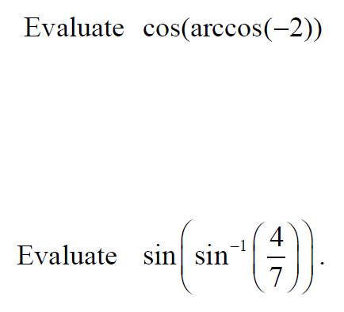
Popper 9
3.
1.
4.
2.
5.

Slide 20
Inverse Trigonometric Functions and Models

Slide 23
Popper 9: Question 6:
a. $\frac{7}{4}$
b. $\frac{\sqrt{33}}{4}$
c. $\frac{4\sqrt{33}}{33}$
d. $\frac{4}{7}$

Slide 24
Popper 9: Question 7:
a. $\frac{12}{13}$
b. $\frac{5}{13}$
c. $\frac{12}{5}$
d. $\frac{5}{12}$

Slide 25
Models
As we know, trigonometric functions repeat their behavior. Breathing normally, brain waves during deep sleep are just a couple of examples that can be described using a sine function.

Slide 27
Popper 9:
8.
9.

Slide 28
Popper 9:
10. Amplitude
11. Period
12. Equation

