Slide 1
MATH 1330
Section 6.1

Slide 2
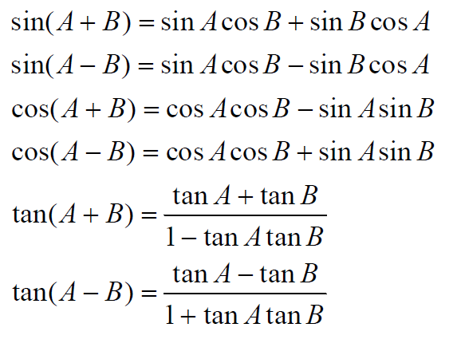
Sum and Difference Formulas for Sine, Cosine and Tangent

Slide 3
These six formulas will be provided for you on the final exam. You do not need to memorize them.
You will need to know how to use them. The following examples will show the types of problems we can solve using these formulas.

Slide 4
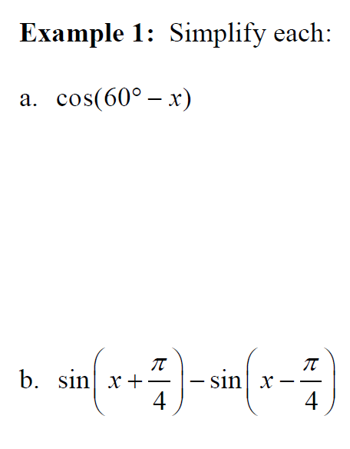

Slide 5
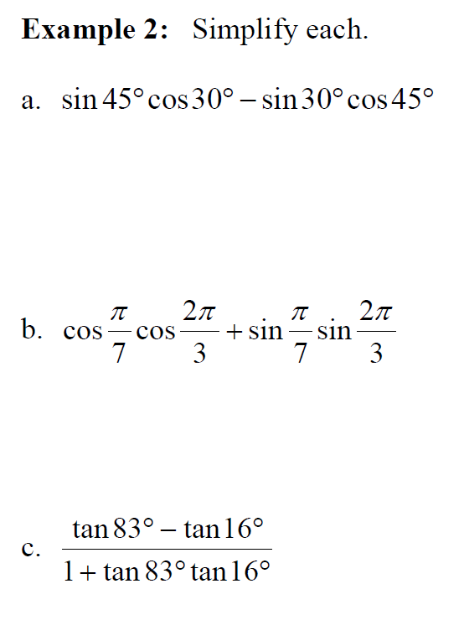

Slide 6
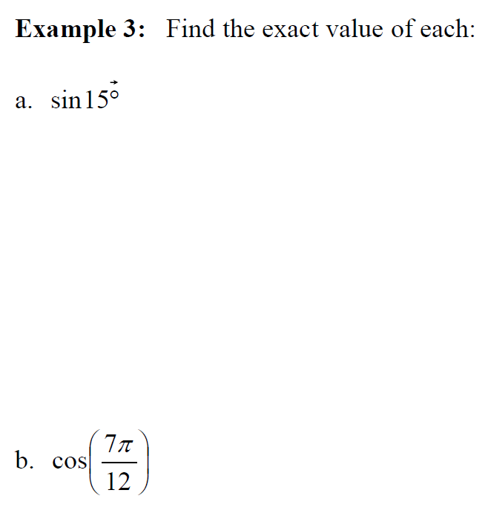

Slide 7
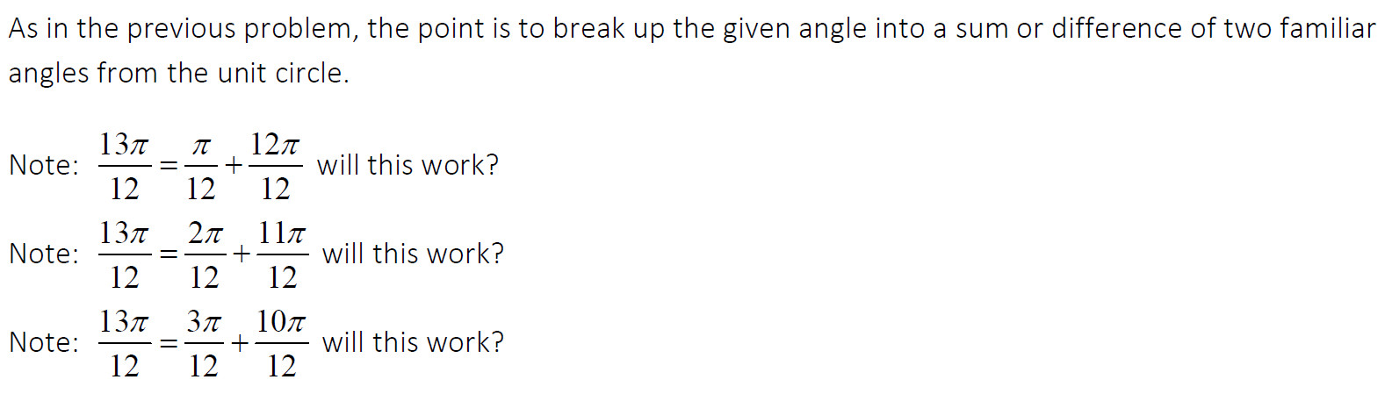
Fraction Issues:

Slide 8
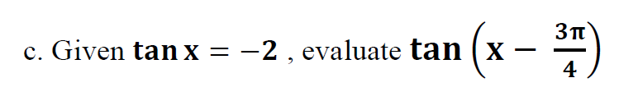

Slide 9

Popper 10:
Determine the value of cos α.
  a. 2/5 b. ${\sqrt{5}}/5$ c. 4/5 d.12/13
Determine the value of sin β.
  a. ${\sqrt{5}}/{13}$ b. 12/13 c. 8/13 d. ${\sqrt{12}}/{13}$
Determine the value of sin (α + β).
  a. -33/65 b. -48/65 c. 9/5 d. 63/65
Determine the value of cos(α – β).
  a. 56/65 b. -16/65 c. -33/65 d. 0

