Slide 1
MATH 1330
Section 7.1

Slide 2
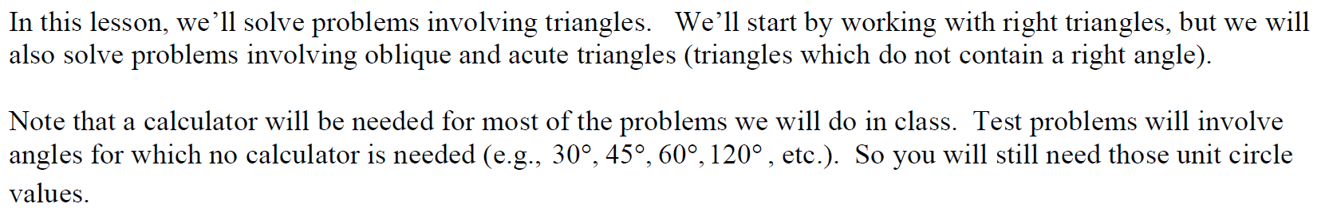
Solving Triangles
Most smartphone-based calculators will also allow these operations to be completed by turning the phone horizontally.

Slide 3
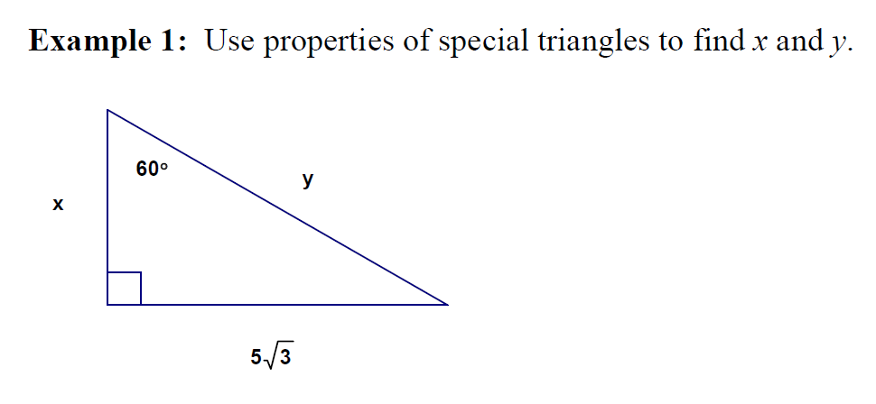

Slide 4
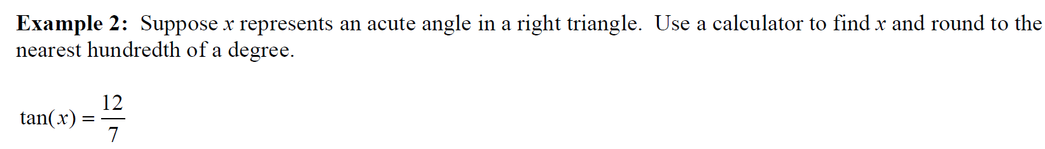

Slide 8
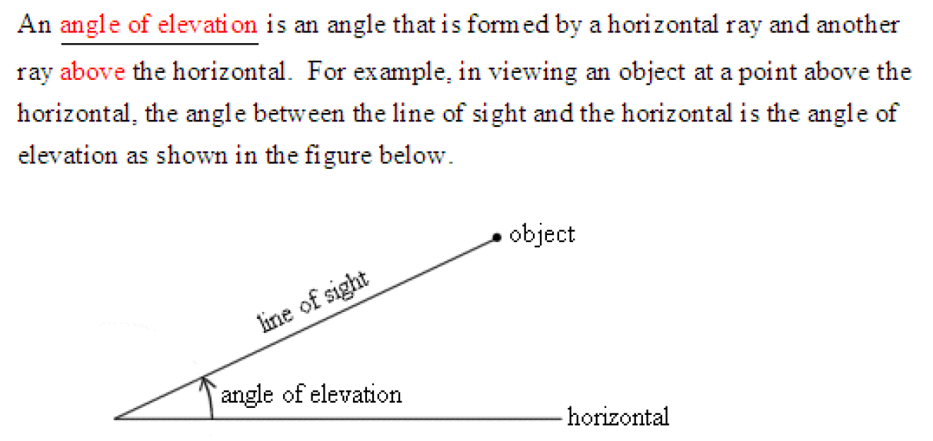
Angle of Elevation:

Slide 10
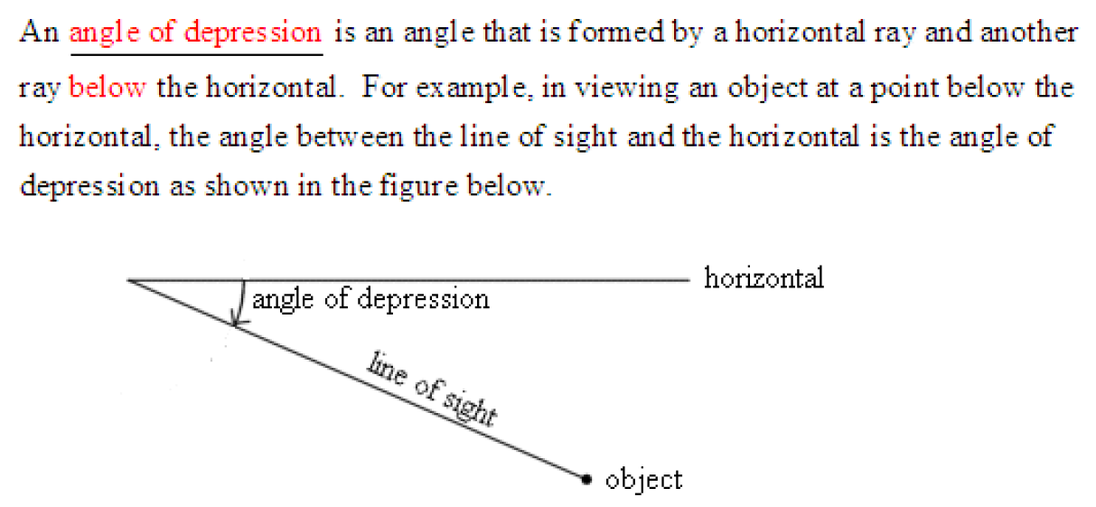
Angle of Depression

Slide 11
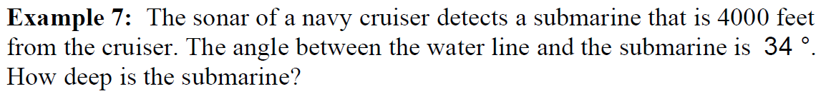

Slide 12
Popper 13:
You have tied a balloon string, with a length of 12 feet, to the ground. Due to the wind blowing, the string is making an angle of 35º to the ground.
Determine the altitude of the balloon.
  a. 9.83 feet b. 6.88 feet c. 8.40 feet d. 32.88feet
Determine the horizontal distance of the balloon.
  a. 9.83 feet b. 6.88 feet c. 8.40 feet d. 32.88feet
  3. A right triangle has legs measuring 8 inches and 12 inches. Determine all angles.
  a. 33.7, 56.3, 90 b. 41.8, 48.2, 90
  c. 39.8, 50.2, 90 d. Cannot be determined

