Slide 1
MATH 1330
Section 7.2

Slide 2
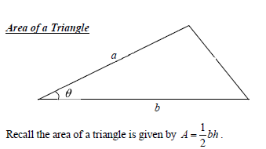
Area of a Triangle

Slide 3
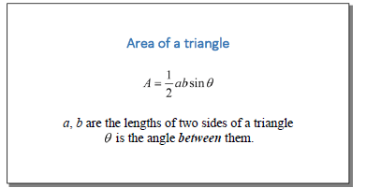
“New” Area of a Triangle

Slide 4
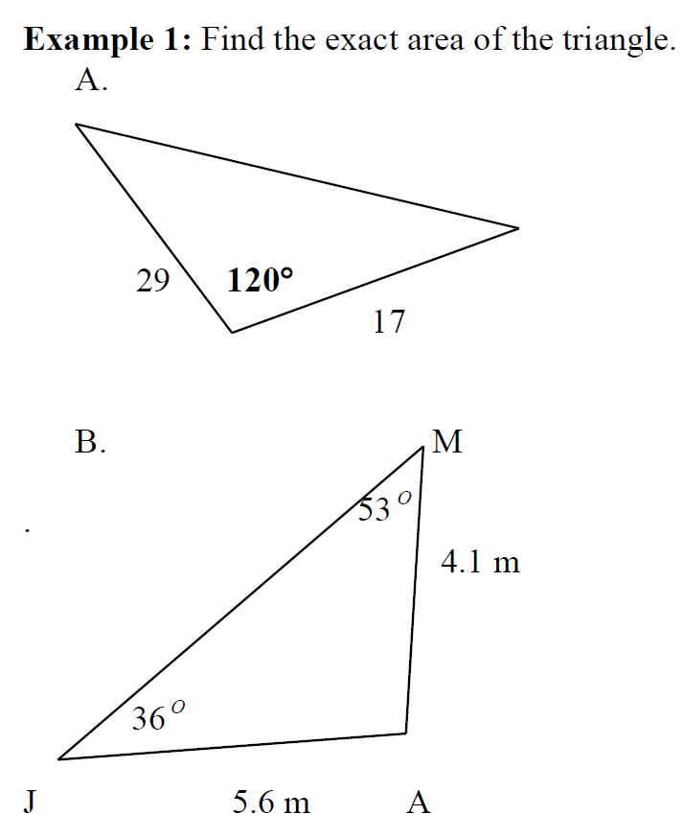

Slide 7
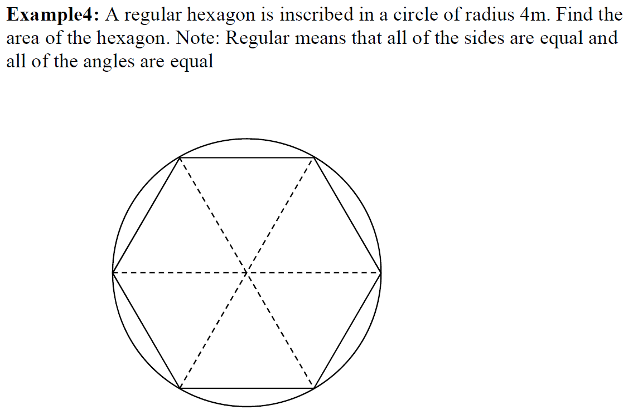

Slide 9
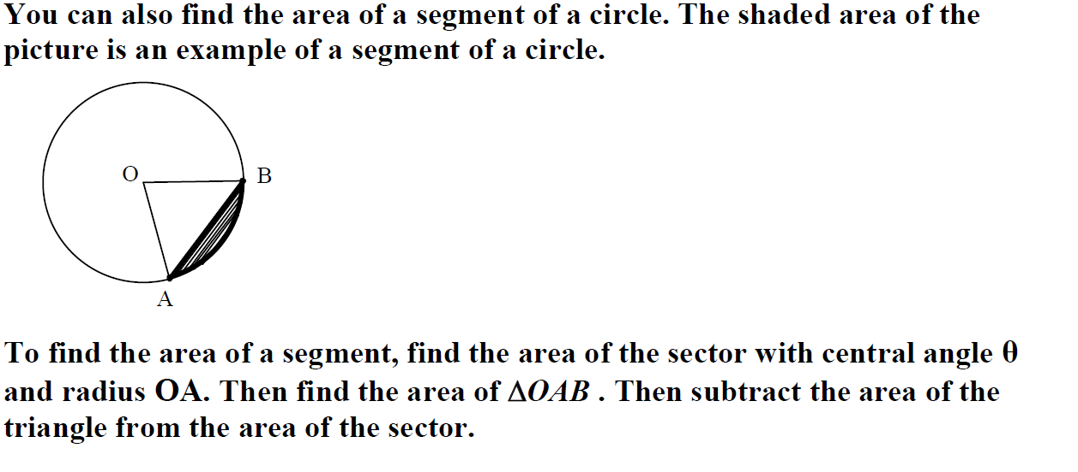
Area of a Segment of a Circle

Slide 11
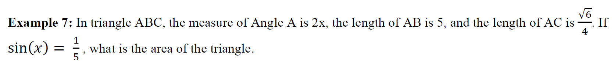
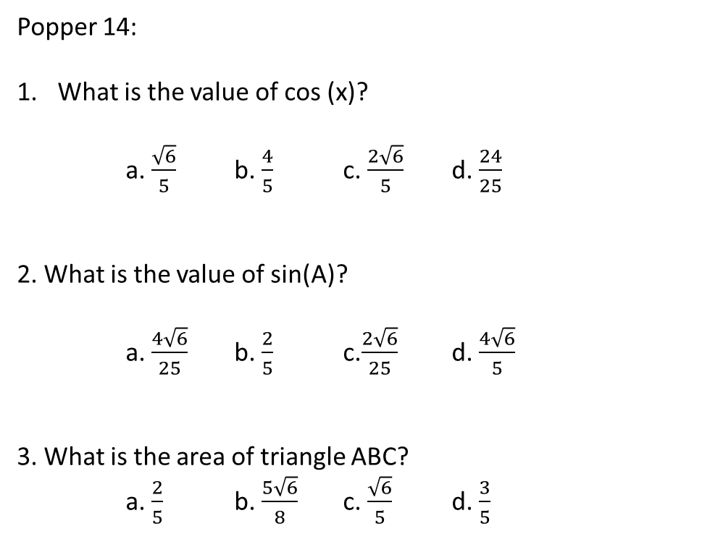
Popper 14:
What is the value of cos (x)?
a. $\frac{\sqrt{6}}{5}$ b. $\frac{4}{5}$ c. $\frac{2\sqrt{6}}{5}$ d. $\frac{24}{25}$
2. What is the value of sin(A)?
a. $\frac{4\sqrt{6}}{25}$ b. $\frac{2}{5}$ c.$\frac{2\sqrt{6}}{25}$ d. $\frac{4\sqrt{6}}{5}$
3. What is the area of triangle ABC?
a. $\frac{2}{5}$ b. $\frac{5\sqrt{6}}{8}$ c. $\frac{\sqrt{6}}{5}$ d. $\frac{3}{5}$

