Slide 1
MATH 1330
Section 7.3

Slide 2
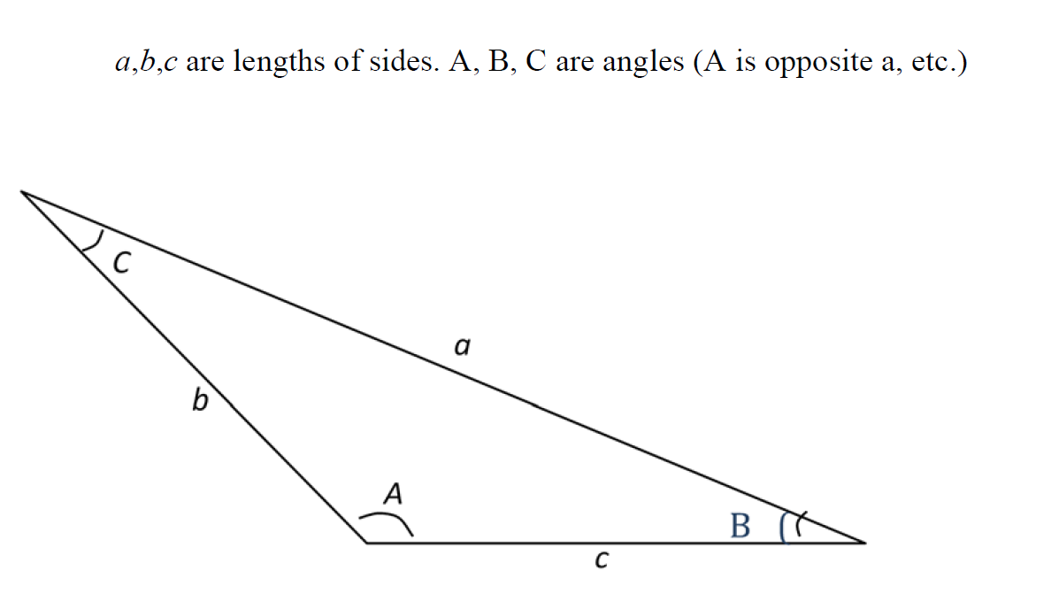
Law of Sines and Cosines

Slide 3
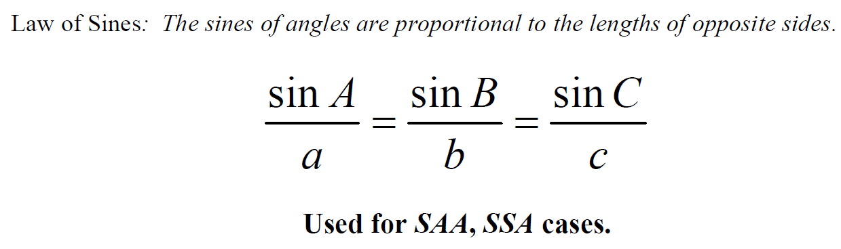

Slide 4
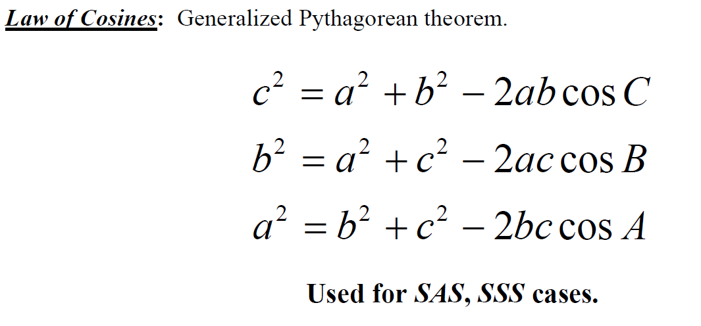

Slide 5
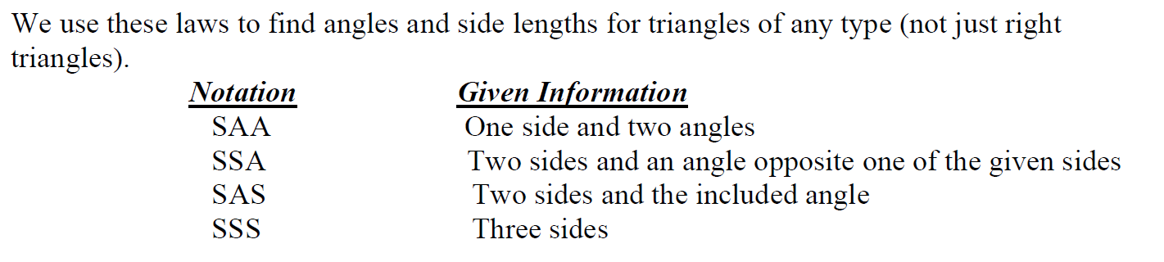

Slide 6
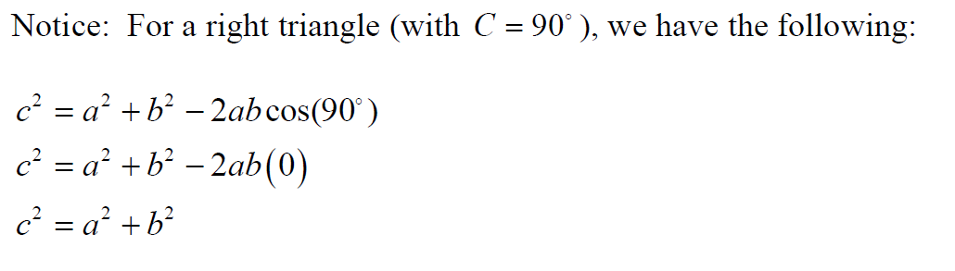
Law of Cosines and Pythagorean Theorem

Slide 7
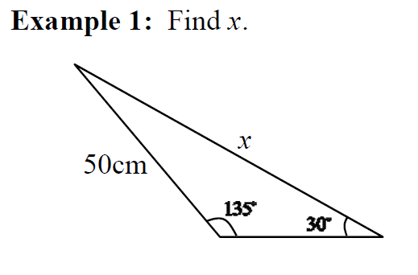

Slide 8
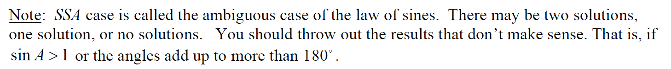
The Ambiguous Case of Law of Sines

Slide 9
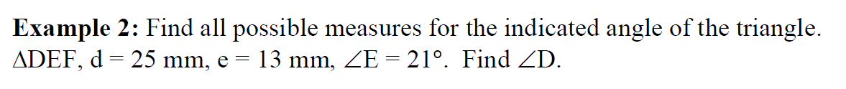

Slide 14
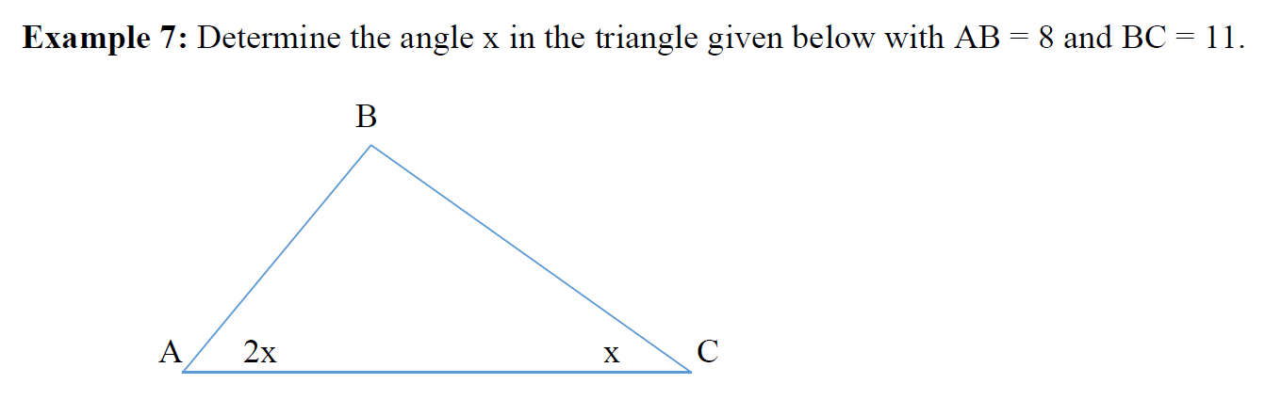

Slide 16
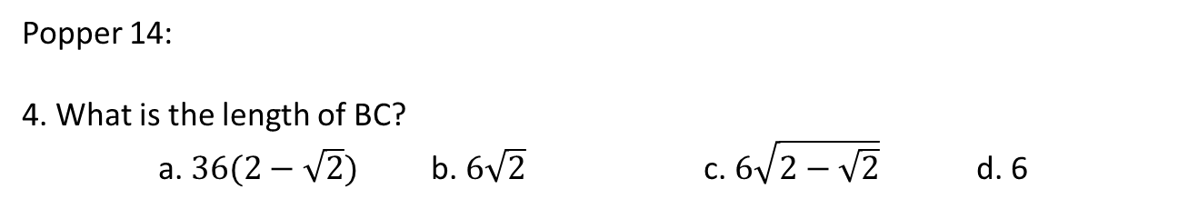
Popper 14:
4. What is the length of BC?
a. $36(2−\sqrt{2})$ b. $6\sqrt{2}$ c. $6\sqrt{2−\sqrt{2}}$ d. 6

