Slide 1
MATH 1330
Section 8.1

Slide 2
Parabolas
We previously studied parabolas as the graphs of quadratic functions. Now we will look at them as conic sections. There are a few differences. For example, when we studied quadratic functions, we saw that the graphs of the functions could open up or down. As we look at conic sections, we’ll see that the graphs of these second degree equations can also open left or right. So, not every parabola we’ll look at in this section will be a function.

Slide 3
Formal Definition
A parabola is the set of all points equally distant from a fixed line and a fixed point not on the line. The fixed line is called the directrix. The fixed point is called the focus.
The axis, or axis of symmetry, runs through the focus and is perpendicular to the directrix. The vertex is the point halfway between the focus and the directrix.

Slide 4
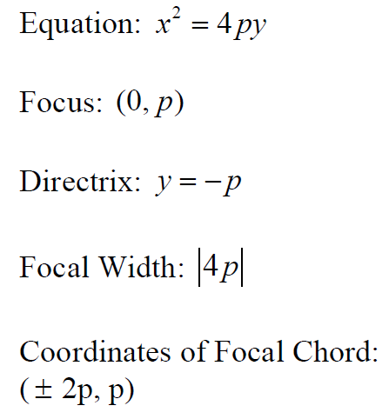
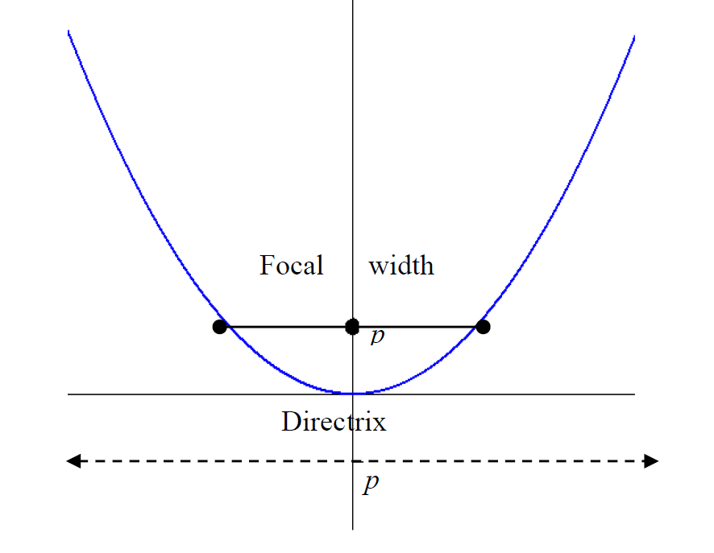
The Basic Vertical Parabola

Slide 5
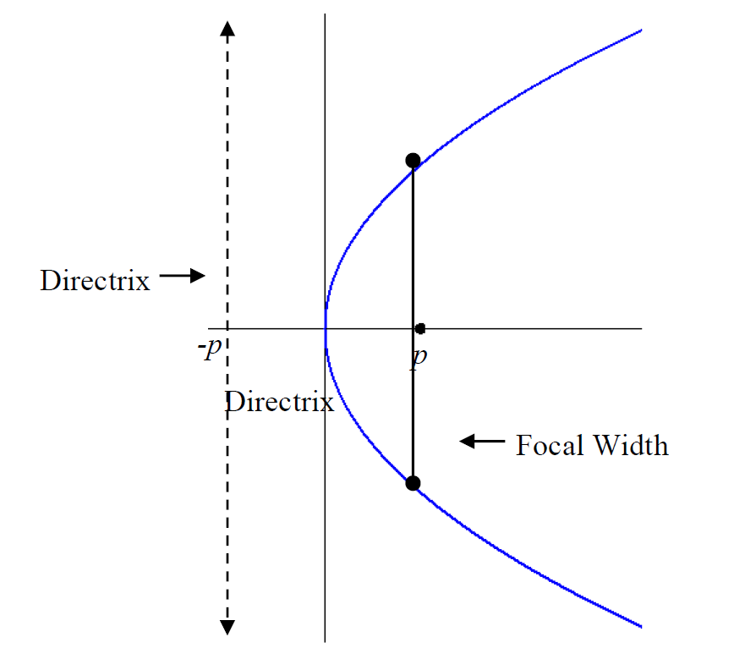
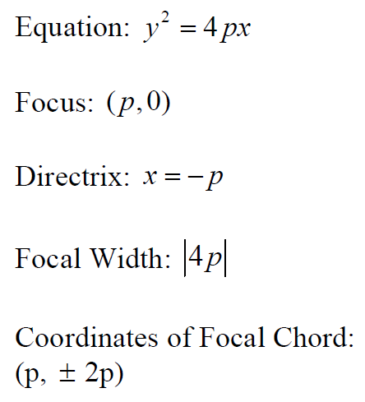
The Basic Horizontal Parabola

Slide 6
Graphing Parabolas with Vertex at the Origin

Slide 7
Graphing Parabolas with Vertex Not at Origin

Slide 12
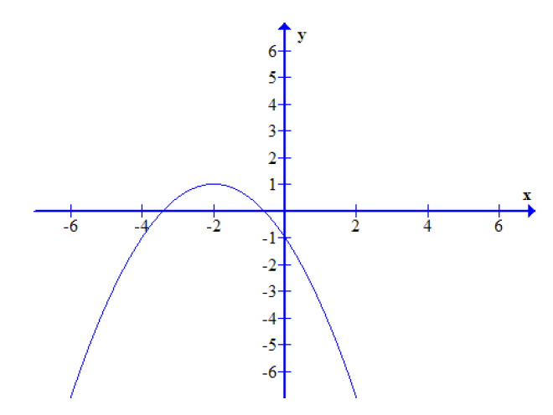
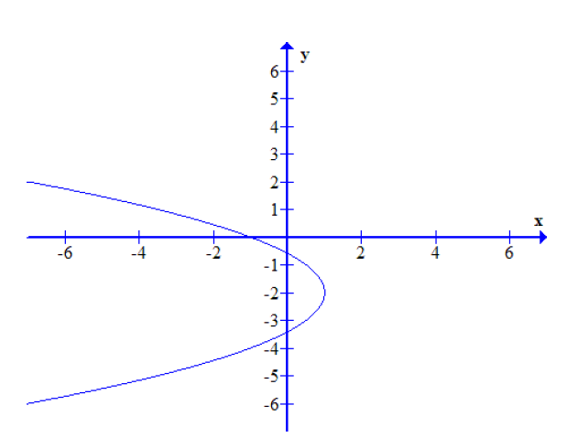
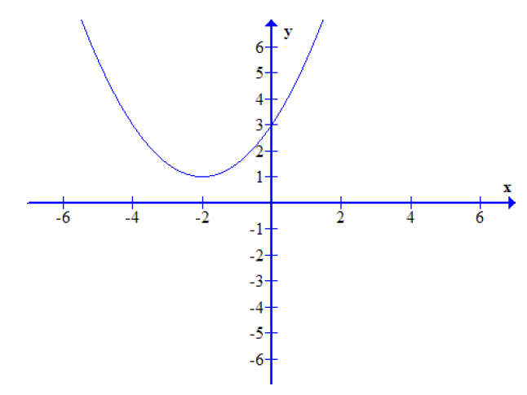
Popper #15
1. 2. 3.

