Slide 1
MATH 1330
Section 8.2

Slide 2
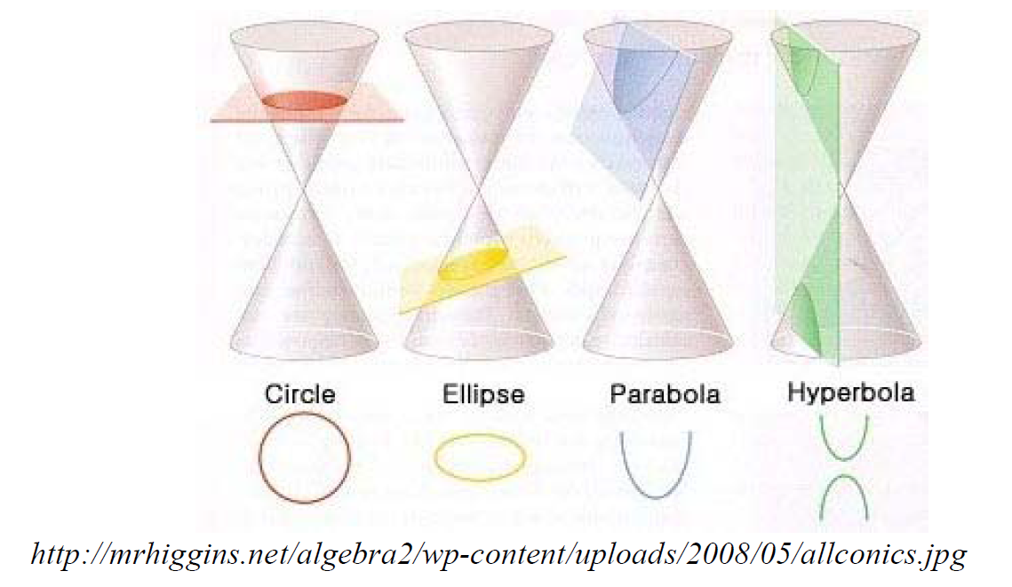
Circles & Conic Sections
To form a conic section, we’ll take this double cone and slice it with a plane. When we do this, we’ll get one of several different results.
A circle, an ellipse, a parabola, or a hyperbola.

Slide 3
Interactive Conic Section Slicer
http://www.intmath.com/plane-analytic-geometry/conic-sections-summary-interactive.php

Slide 4
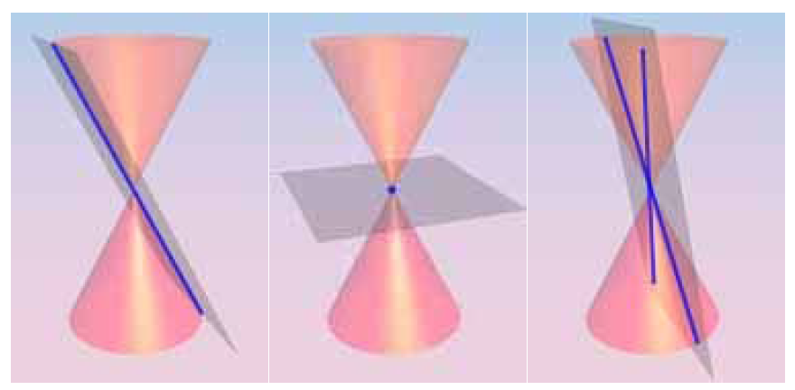
You may also get what are called degenerate conic sections.
Line
Point
Intersecting Lines

Slide 6
The Circle
A circle is the set of all points that are equidistant from a fixed point. The fixed point is called the center and the distance from the center to any point on the circle is called the radius.

Slide 8
Sometimes the equation will be given in the general form, and your first step will be to rewrite the equation in the standard form. You’ll need to complete the square to do this.

Slide 10
Popper 16 Question 1:

Slide 11
We can also write the equation of a circle, given appropriate information. Popper 16 Question 2:
${\left(x−5\right)}^{2}+{\left(y+2\right)}^{2}=3\sqrt{5}$
${\left(x+5\right)}^{2}+{\left(y−2\right)}^{2}=3\sqrt{5}$
${\left(x+5\right)}^{2}+{\left(y−2\right)}^{2}=45$
${\left(x−5\right)}^{2}+{\left(y+2\right)}^{2}=45$

Slide 13
Example 6: Write an equation of a circle if the endpoints of the diameter of the circle are (6, -3) and (-4, 7).

Slide 14
Ellipses
An ellipse is the set of all points, the sum of whose distances from two fixed points is constant. Each fixed point is called a focus (plural = foci).

Slide 15
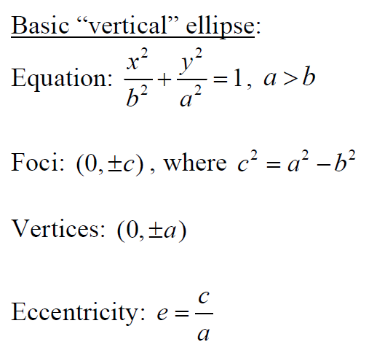
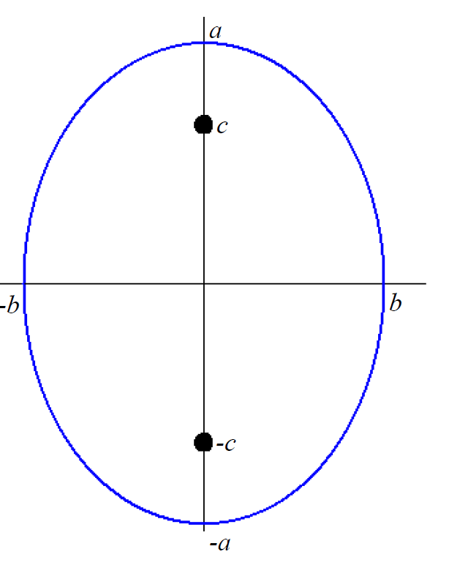
Basic “Vertical” Ellipse (centers at origin):

Slide 16
Eccentricity
The eccentricity provides a numerical measure of how much the ellipse deviates from being a circle. The eccentricity e is a number between 0 and 1.

Slide 17
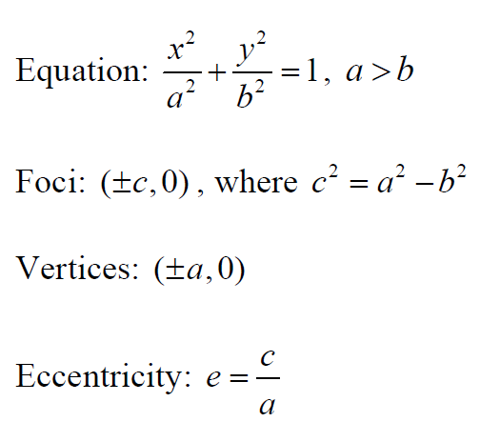
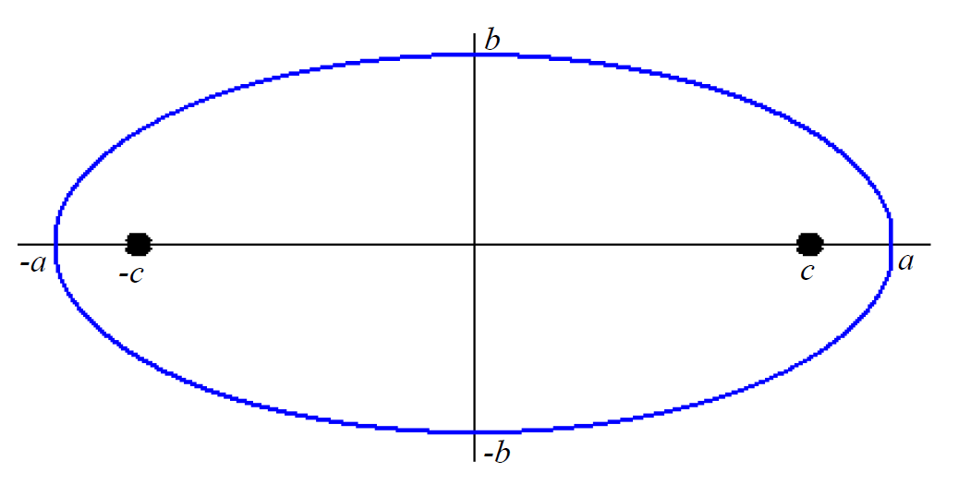
Basic “Horizontal” Ellipse:

Slide 18
“Diameters” in an Ellipse
For ellipses, the line segment joining the vertices is called the Major Axis (length 2a) and the line segment through the center and perpendicular to the major axis with endpoints on the ellipse is called the Minor Axis (length 2b).
Major Axis
Minor Axis

Slide 19
Graphing Ellipses
To graph an ellipse with center at the origin:

Slide 20
To graph an ellipse with center not at the origin

Slide 27
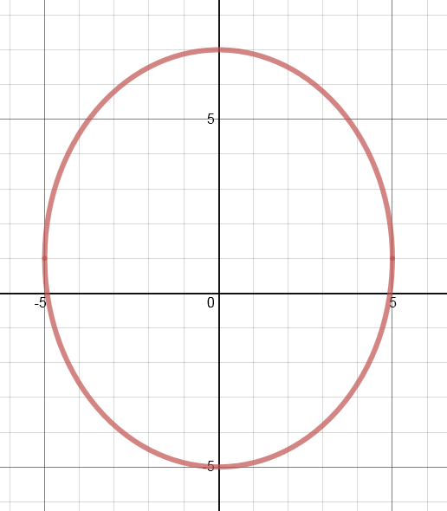
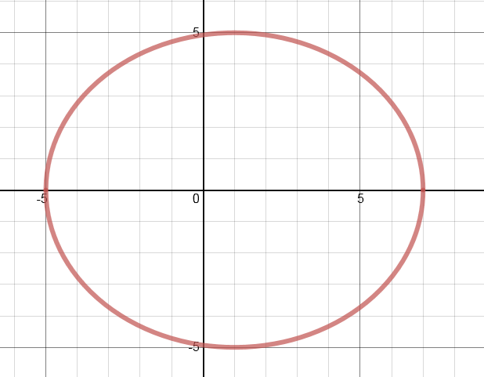
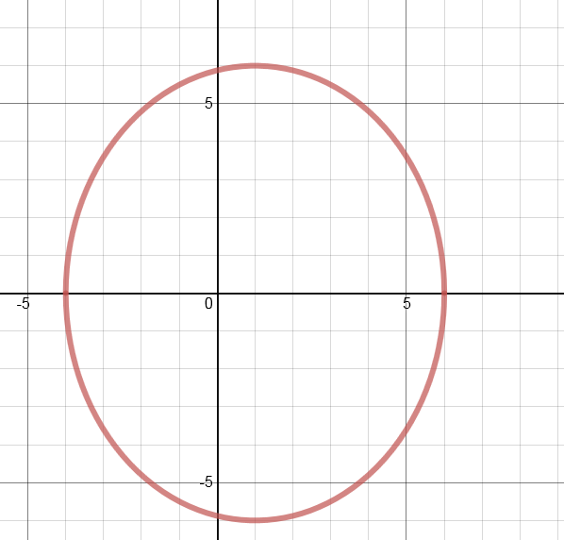
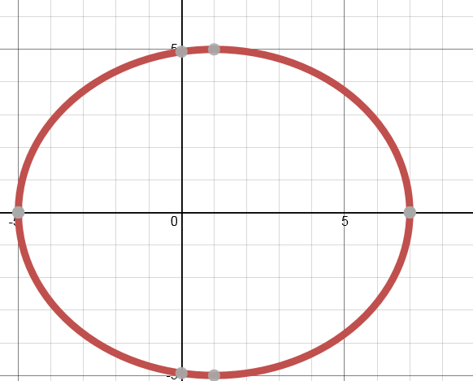
Popper 16: Question 3:
Determine which graph corresponds to the equation below:
C
D
A
B

Slide 28
Applications of Ellipses
Planetary Motion (Kepler’s Laws) https://www.desmos.com/calculator/e1egjpx21a
Cancer Treatment/Kidney Stone Treatment
Architecture (and espionage!)

