Slide 1
MATH 1330
Section 8.3

Slide 2
Quiz Example: Find the value of x:
8
15
2x
x

Slide 3
Hyperbolas
A hyperbola is the set of all points, the difference of whose distances from two fixed points is constant. Each fixed point is called a focus (plural = foci).
The focal axis is the line passing through the foci.

Slide 4
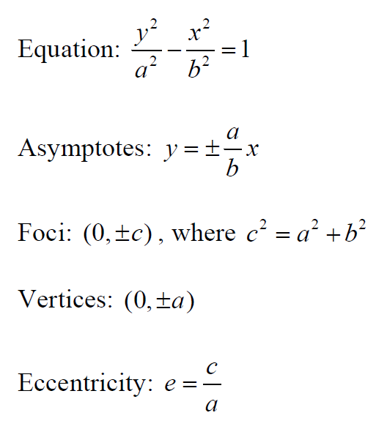
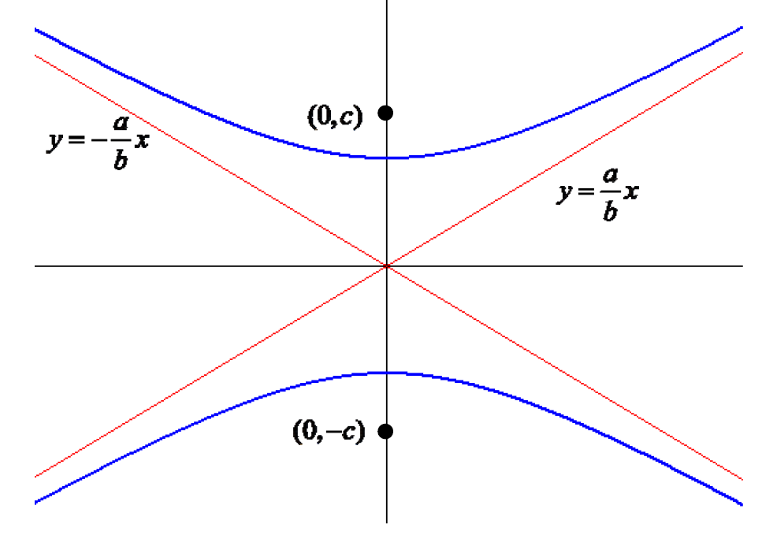
Basic “Vertical” Hyperbola:

Slide 5
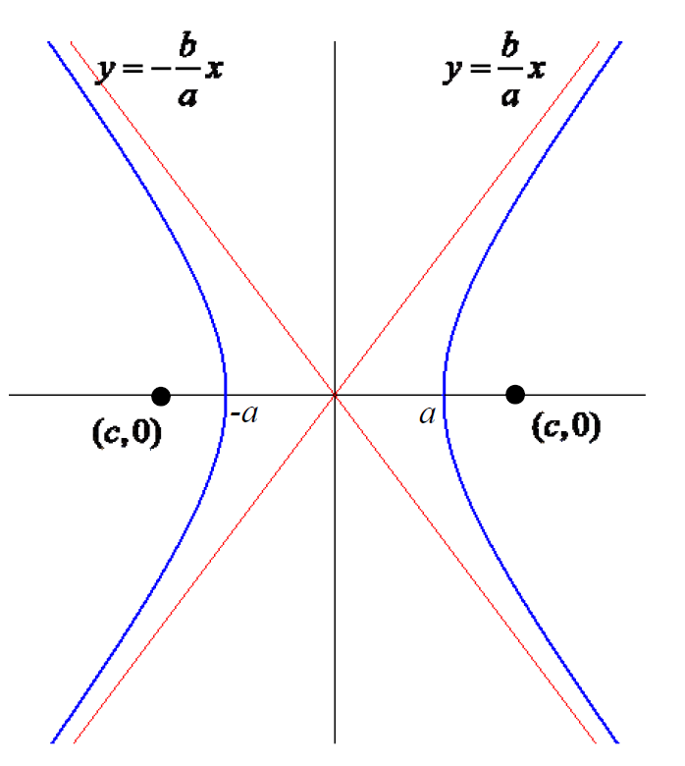
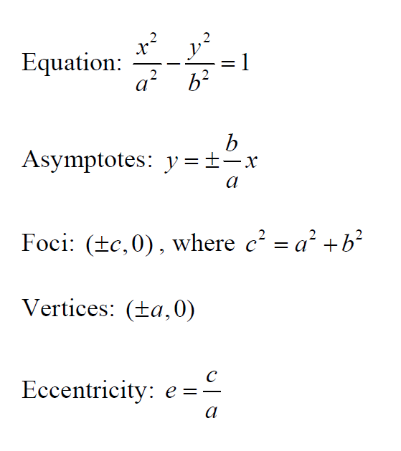
Basic “Horizontal” Hyperbola

Slide 6
Transverse Axis
The transverse axis (length 2a) is the line segment joining the two vertices. The conjugate axis (length 2b) is the line segment perpendicular to the transverse axis, passing through the center and extending a distance b on either side of the center.

Slide 7
Graphing Hyperbolas: To graph a hyperbola with center at the origin:

Slide 8
To graph a hyperbola with center not at the origin

Slide 12
Determine the equation of the hyperbola that has asymptotes of y = 2x + 2 and y = -2x + 6, with one vertex at (2, 4).

Slide 13
Popper 17: Question 1
a.
b.
c.
d.

Slide 14
Popper 17: Question 2
a.
b.
c.
d.

