Slide 1
MATH 1330
Systems: Identifying Equations, Points of Intersections of Equations

Slide 2
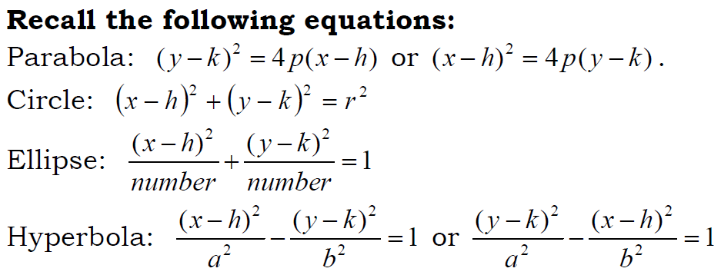
Classifications of Second Degree Equations

Slide 3
Sometimes equations that look like they should be conic sections do not behave very well.
For example,

Slide 6
These are all examples of degenerate conic sections. You will not see these very often, but you should be aware of them.

Slide 7
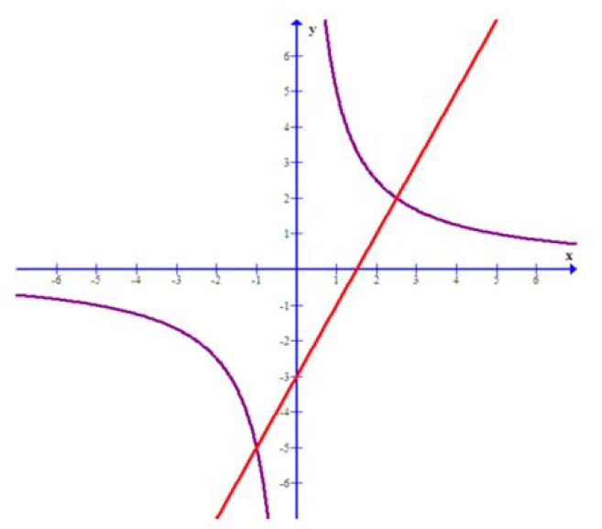
Systems of Second Degree Equations
When we graph two conic sections or a conic section and a line on the same coordinate planes, their graphs may contain points of intersection. The graph below shows a hyperbola and a line and contains two points of intersection.

Slide 8
Solving Systems
We want to be able to find the points of intersection. To do this, we will solve a system of equations, but now one or both of the equations will be second degree equations.
Determining the points of intersection graphically is difficult, so we will do these algebraically.

Slide 9
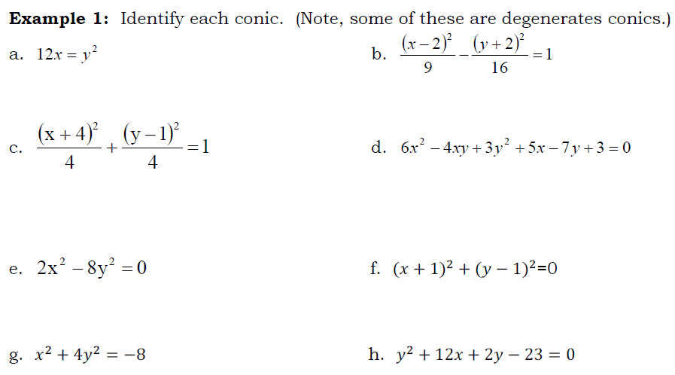
Popper 18: (a) Parabola (b) Ellipse (c) Circle (d) Hyperbola (e) Degenerate Section or No Graph
1.
2.
3.
4.
5.
6.
7.
8.

Slide 11
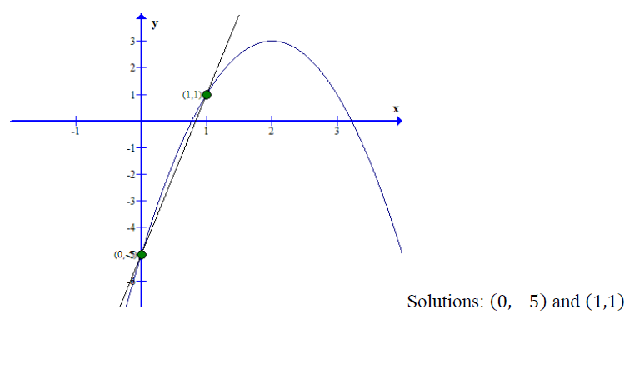

Slide 13
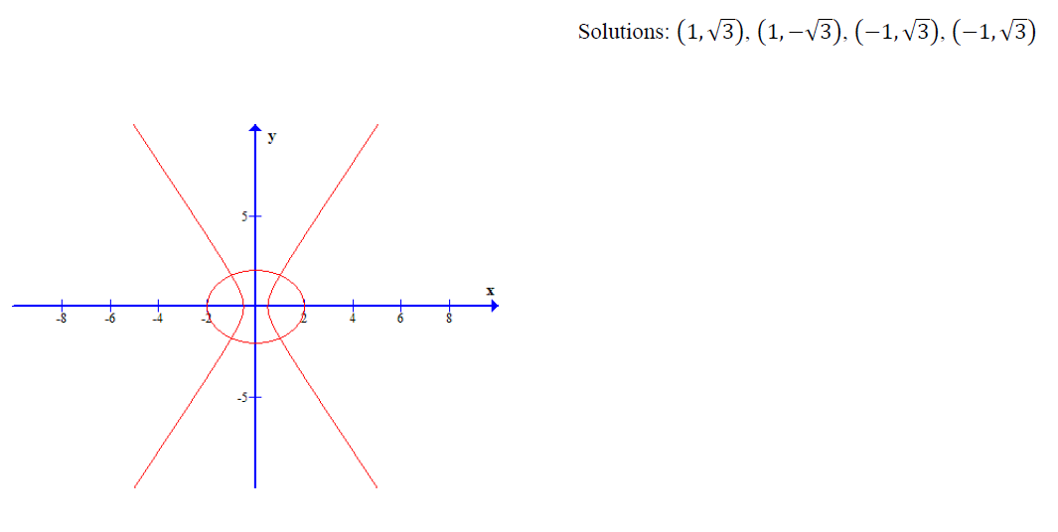

Slide 14
Be Sure to Check your Answers!!

Slide 16
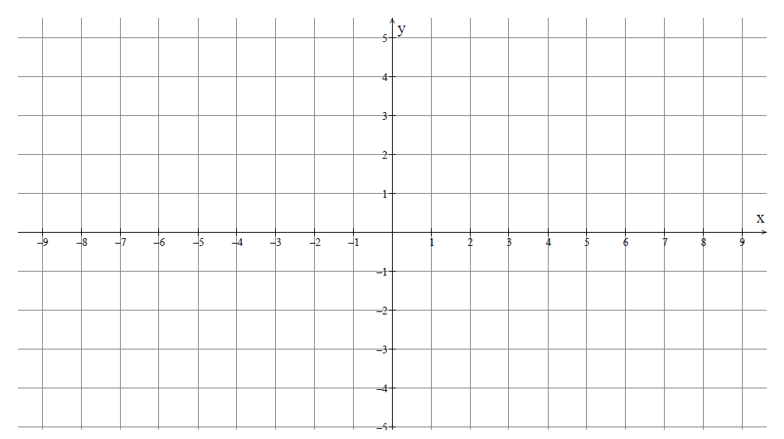
Popper 18: Question 9
0
1
2
3
4

Slide 17
Popper 18: Question 10
a) $\left(\sqrt{10},\sqrt{3}\right)$
b) $\left(−\sqrt{10},−\sqrt{3}\right)$
c) $\left(±\sqrt{10},±\sqrt{3}\right)$
d) $\left(±\sqrt{10}, \sqrt{3}\right)$
e) No Point of Intersection

