Slide 1
MATH 1330
Section 5.1a

Slide 2
Trigonometric Functions of Real Numbers
In this section there is nothing new as far as evaluating trigonometric functions. The difference is that the inputs are real numbers rather than angles.
Identities: Recall: An identity is an equation that is true for all value(s) of the variable. Sometimes, you can use trig identities to help you simplify trig expressions.

Slide 3
Trigonometric Identities
Quotient Identities:
Reciprocal Identities:
Pythagorean Identities:

Slide 4
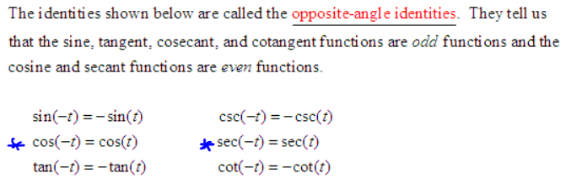
Trigonometric Identities
Opposite Angle Identities:

Slide 5
Example 1: Use the opposite-angle identities to evaluate the following.

Slide 7
Example 3: Given that $\tan{t}=−\frac{2\sqrt{10}}{3}$ and $\frac{3π}{2}<t<2π$, find sec(t)

Slide 8
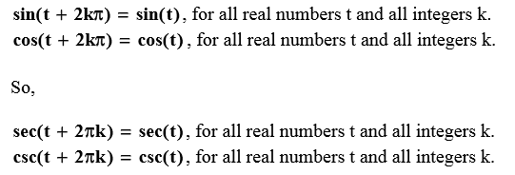
Periodicity
The circumference of the unit circle is 2π. Thus, if we start with a point P on the unit circle and travel a distance of 2π units, we arrive back at the same point P. That means that the arc lengths of t and t + 2π as measured form the point (1, 0) give the same terminal point on the unit circle. Thus, we have the following identities.

Slide 9
Periodicity
Like the sine and cosine functions, the tangent and cotangent functions also repeat themselves at intervals of lengths 2π. In addition, the tangent and cotangent functions also repeat themselves at intervals of shorter length, namely π. This, we have the following identities.

Slide 10
Example 4:Evaluate.

Slide 11
