Slide 1
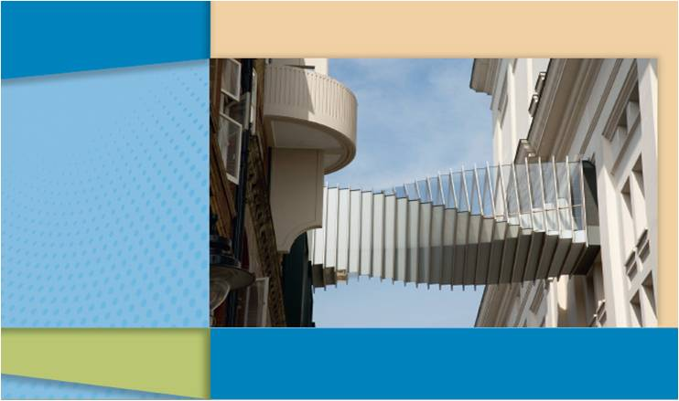
Line and Angle Relationships
1
Chapter
Line and Angle Relationships
Copyright © Cengage Learning. All rights reserved.

Slide 2

1.2
Informal Geometry and Measurement
Copyright © Cengage Learning. All rights reserved.

Slide 3
Informal Geometry and Measurement
In geometry, the terms point, line, and plane are described but not defined.
Other concepts that are accepted intuitively, but never defined, include the straightness of a line, the flatness of
a plane, the notion that a point on a line lies between two other points on the line, and the notion that a point lies in the interior or exterior of an angle.

Slide 4
Informal Geometry and Measurement
The following are descriptions of some of the undefined terms.
A point, which is represented by a dot, has location but not size; that is, a point has no dimensions. An uppercase italic letter is used to name a point.
Figure 1.8 shows points A, B, and C.
Figure 1.8

Slide 5
Informal Geometry and Measurement
The second undefined geometric term is line. A line is an infinite set of points. Given any two points on a line, there is always a point that lies between them on that line.
Lines have a quality of “straightness” that is not defined but assumed. Given several points on a line, these points form a straight path.
Whereas a point has no dimensions, a line is one-dimensional; that is, the distance between any two points on a given line can be measured.

Slide 6

Informal Geometry and Measurement
Line AB, represented symbolically by extends infinitely far in opposite directions, as suggested by the arrows on the line. A line may also be represented by a single lowercase letter.
Figures 1.9(a) and (b) show the
lines AB and m.
When a lowercase letter is used to
name a line, the line symbol is
omitted; that is, and m can name
the same line.
Figure 1.9

Slide 7
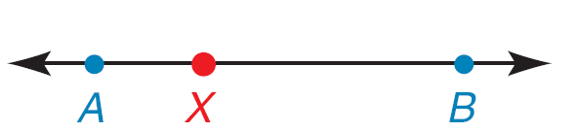
Informal Geometry and Measurement
Note the position of point X on in Figure 1.9(c).
When three points such as A, X, and B are on the same line, they are said to be collinear.
In the order shown, which is symbolized A-X-B or B-X-A, point X is said to be between A and B.
Figure 1.9 (c)

Slide 8
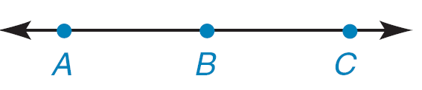
Informal Geometry and Measurement
When a drawing is not provided, the notation A-B-C means that these points are collinear, with B between A and C.
When a drawing is provided, we assume that all points in the drawing that appear to be collinear are collinear, unless otherwise stated.
Figure 1.9(d) shows that A, B, and C are collinear, in
Figure 1.8, points A, B, and C are noncollinear.
Figure 1.9 (d)
Figure 1.8

Slide 9
Informal Geometry and Measurement
At this time, we informally introduce some terms that will be formally defined later.
You have probably encountered the terms angle, triangle, and rectangle many times. An example of each is shown in Figure 1.10.
Angle ABC
(a)
Triangle DEF
(b)
Rectangle WXYZ
(c)
Figure 1.10

Slide 10

Informal Geometry and Measurement
Using symbols, we refer to Figures 1.10(a), (b), and (c) as
ABC, DEF, and WXYZ, respectively.
Some caution must be used in naming figures; although the angle in Figure 1.10(a) can be called CBA, it is incorrect to describe the angle as ACB because that order implies a path from point A to point C to point B . . . a different angle!
Angle ABC
(a)
Figure 1.10

Slide 11
Informal Geometry and Measurement
In ABC, the point B at which the sides meet is called the
vertex of the angle. Because there is no confusion regarding the angle described, ABC is also known as B (using only the vertex) or as 1.
The points D, E, and F at which the sides of DEF (also called DFE, EFD, etc.) meet are called the vertices (plural of vertex) of the triangle.
Similarly, W, X, Y, and Z are the vertices of the rectangle; the vertices are named in an order that traces the rectangle.

Slide 12
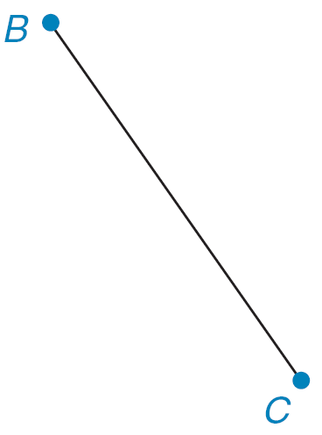
Informal Geometry and Measurement
A line segment is part of a line. It consists of two distinct points on the line and all points between them.
(See Figure 1.11.)
Using symbols, we indicate the line
segment by note that is a set
of points but is not a number.
We use BC (omitting the segment symbol)
to indicate the length of this line segment;
thus, BC is a number. The sides of a triangle or rectangle are line segments.
Figure 1.11

Slide 13
Example 1
Can the rectangle in Figure 1.10(c) be named
a) XYZW?
b) WYXZ?
Solution:
a) Yes, because the points taken in this order trace the figure.
b) No; for example, is not a side of the rectangle.
Figure 1.10 (c)

Slide 14
MEASURING LINE SEGMENTS

Slide 15
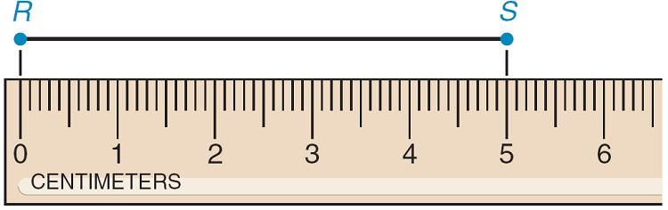
Measuring Line Segments
The instrument used to measure a line segment is a scaled straightedge such as a ruler, a yardstick, or a meter stick.
Line segment RS ( in symbols) in Figure 1.12 measures 5 centimeters. Because we express the length of by RS (with no bar), we write RS = 5 cm.
Figure 1.12

Slide 16
Measuring Line Segments
To find the length of a line segment using a ruler:
1. Place the ruler so that “0” corresponds to one endpoint
of the line segment.
2. Read the length of the line segment by reading the
number at the remaining endpoint of the line segment.
Because manufactured measuring devices such as the ruler, yardstick, and meter stick may lack perfection or be misread, there is a margin of error each time one is used.

Slide 17
Measuring Line Segments
In Figure 1.12, for instance, RS may actually measure
5.02 cm (and that could be rounded from 5.023 cm, etc.). Measurements are approximate, not perfect.
Figure 1.12

Slide 18
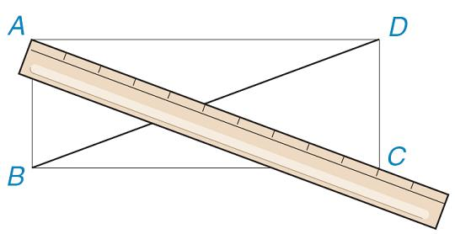
Measuring Line Segments
In Example 2, a ruler (not drawn to scale) is shown in Figure 1.13. In the drawing, the distance between consecutive marks on the ruler corresponds to 1 inch. The measure of a line segment is known as linear measure.
Figure 1.13

Slide 19
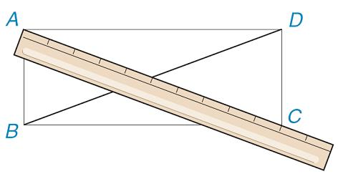


Example 2
In rectangle ABCD of Figure 1.13,
the line segments and shown
are the diagonals of the rectangle.
How do the lengths of the diagonals
compare?
Solution:
As shown on the ruler, AC = 10”. As intuition suggests, the lengths of the diagonals are the same, so it follows that
BD = 10”.
Note: In linear measure, 10” means 10 inches, and 10’ means 10 feet.
Figure 1.13

Slide 20


Measuring Line Segments
In Figure 1.14, point B lies between A and C on If
AB = BC, then B is the midpoint of
When AB = BC, the geometric figures and are said to be congruent. Numerical lengths may be equal, but the actual line segments (geometric figures) are congruent.
The symbol for congruence is ≅; thus, ≅ if B is the
midpoint of
Figure 1.14

Slide 21
MEASURING ANGLES

Slide 22
Measuring Angles
An angle’s measure depends not on the lengths of its sides but on the amount of opening between its sides.
In Figure 1.16, the arrows on the angles’ sides suggest that
the sides extend indefinitely.
(a)
(b)
Figure 1.16

Slide 23
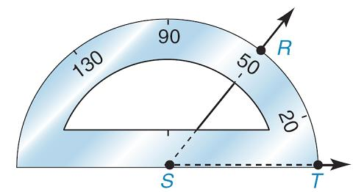
Measuring Angles
The instrument shown in Figure 1.17 (and used in the measurement of angles) is a protractor.
For example, you would express
the measure of RST by writing
m RST = 50°; this statement is
read, “The measure of RST is
50 degrees.”
Measuring the angles in Figure 1.16 with a protractor,
we find that m B = 55° and m 1 = 90°.
Figure 1.17

Slide 24
Measuring Angles
If the degree symbol is missing, the measure is understood
to be in degrees; thus m 1 = 90.
In practice, the protractor shown will measure an angle that is greater than 0° but less than or equal to 180°.

Slide 25
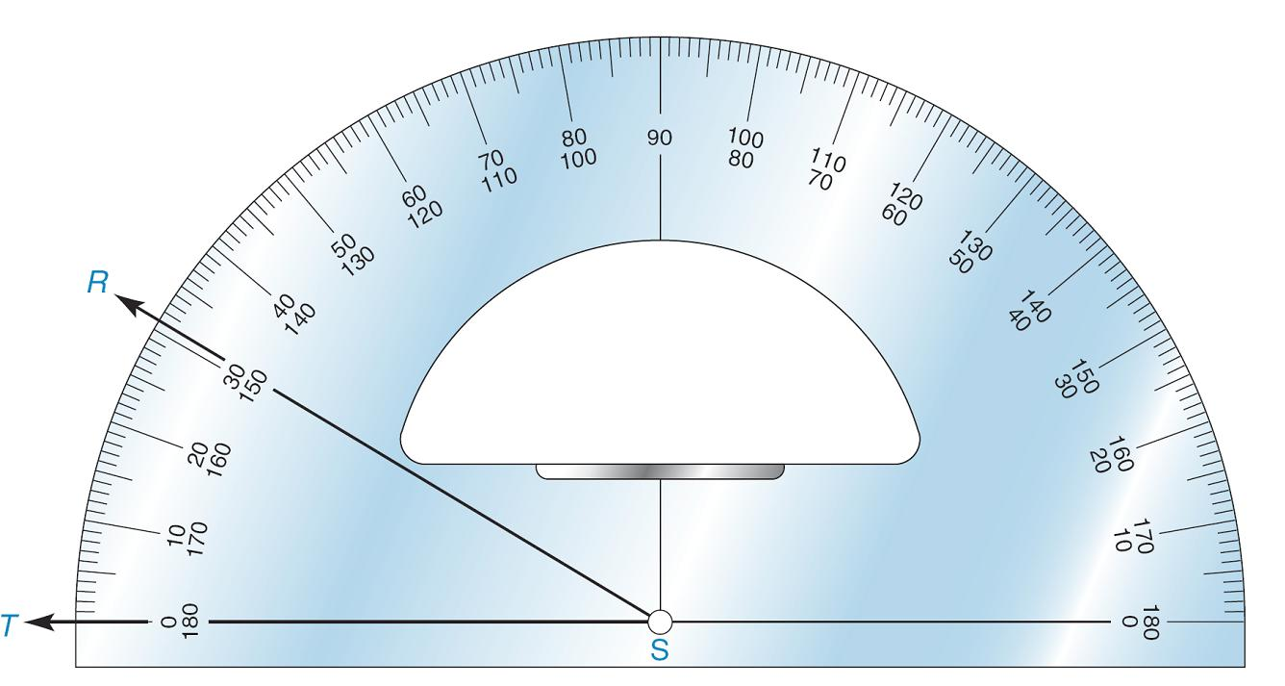
Measuring Angles
To find the degree measure of an angle using a protractor:
1. Place the notch of the protractor at the point where the
sides of the angle meet (the vertex of the angle).
See point S in Figure 1.18.
Figure 1.18

Slide 26
Measuring Angles
2. Place the edge of the protractor along a side of the angle
so that the scale reads “0.” See point T in Figure 1.18
where we use “0” on the outer scale.
3. Using the same (outer) scale, read the angle size by
reading the degree measure that corresponds to the
second side of the angle.

Slide 27
Example 4
For Figure 1.18, find the measure of RST.
Solution:
Using the protractor, we find that the measure of angle RST is 31°. (In symbols, m RST = 31° or m RST = 31.)
Figure 1.18

Slide 28
Measuring Angles
Some protractors show a full 360°; such a protractor is used to measure an angle whose measure is between 0° and 360°. An angle whose measure is between 180° and 360° is known as a reflex angle.
Just as measurement with a ruler is not perfect, neither is measurement with a protractor.

Slide 29
Measuring Angles
The lines on a sheet of paper in a notebook are parallel.
Informally, parallel lines lie on the same page and will not cross over each other even if they are extended indefinitely.
We say that lines ℓ and m
in Figure 1.19(a) are parallel;
note here the use of a
lowercase letter to name a line.
Figure 1.19 (a)

Slide 30



Measuring Angles
We say that line segments are parallel if they are parts
of parallel lines; if is parallel to then is parallel to
in Figure 1.19(b).
For A = {1, 2, 3} and B = {6, 8, 10}, there are no common elements; for this reason, we say that the intersection of A and B is the empty set (symbol is ∅). Just as A ∩ B = ∅, the parallel lines in Figure 1.19(a) are characterized by ℓ ∩ m = ∅.
Figure 1.19 (b)

Slide 31

Example 5
In Figure 1.20 the sides of angles ABC and DEF are parallel to and to Use a protractor to decide whether these angles have equal measures.
Solution:
The angles have equal measures. Both measure 44°.
Figure 1.20

Slide 32
Measuring Angles
Two angles with equal measures are said to be congruent. In Figure 1.20, we see that ABC ≅ DEF.
In Figure 1.21, ABC ≅ CBD.
In Figure 1.21, angle ABD has been
separated into smaller angles ABC
and CBD; if the two smaller angles
are congruent (have equal
measures), then angle ABD has
been bisected.
In general, the word bisect means to separate a line segment (or an angle) into two parts of equal measure.
Figure 1.21

Slide 33
Measuring Angles
Any angle having a 180° measure
is called a straight angle, an angle
whose sides are in opposite
directions. See straight angle RST
in Figure 1.22(a).
When a straight angle is bisected,
as shown in Figure 1.22(b), the two
angles formed are right angles
(each measures 90°).
Figure 1.22

Slide 34
Measuring Angles
When two lines have a point in common, as in Figure 1.23, they are said to intersect.
When two lines intersect and form congruent adjacent angles, they are said to be perpendicular.
Figure 1.23

Slide 35
CONSTRUCTIONS

Slide 36
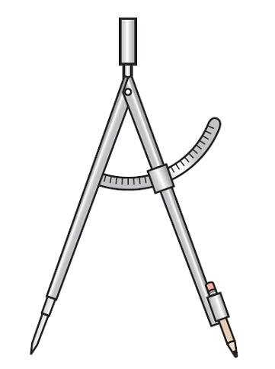
Constructions
Another tool used in geometry is the compass. This instrument, shown in Figure 1.24, is used to draw circles and parts of circles known as arcs.
The ancient Greeks insisted that only two
tools (a compass and a straightedge) be
used for geometric constructions,
which were idealized drawings assuming
perfection in the use of these tools.
Figure 1.24

Slide 37
Constructions
The compass was used to create “perfect” circles and for marking off segments of “equal” length.
The straightedge could be used to draw a straight line through two designated points.
A circle is the set of all points in a plane that are at a given distance from a particular point (known as the “center” of the circle).
The part of a circle between any two of its points is known as an arc.

Slide 38
Constructions
Any line segment joining the center to a point on the circle is a radius (plural: radii) of the circle. See Figure 1.25.
Construction 1, which follows, is
quite basic and depends only on
using arcs of the same radius
length to construct line segments
of the same length.
The arcs are created by using
a compass.
Figure 1.25

Slide 39
Constructions
Construction 1
To construct a segment congruent to a given segment.
Given: in Figure 1.26(a).
Construct: on line m so that (or CD = AB)
Figure 1.26 (a)

Slide 40
Constructions
Construction:
With your compass open to the length of place the stationary point of the compass at C and mark off a length equal to AB at point D, as shown in Figure 1.26(b).
Then CD = AB.
Figure 1.26 (b)

Slide 41
Constructions
Construction 2
To construct the midpoint M of a given line segment AB.
Given: in Figure 1.27(a).
Construct: M on so that AM = MB
Figure 1.27 (a)

Slide 42
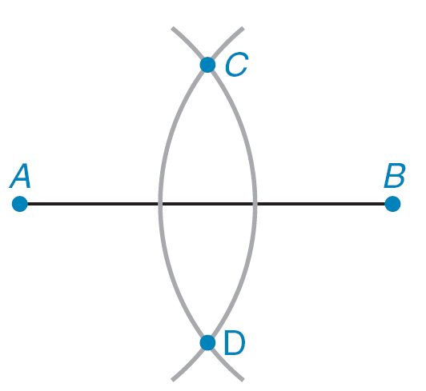
Constructions
Construction:
Figure 1.27(a): Open your compass to a length greater
than one-half of .
Figure 1.27(b): Using A as the
center of the arc, mark off an
arc that extends both above
and below segment AB.
Figure 1.27 (b)

Slide 43
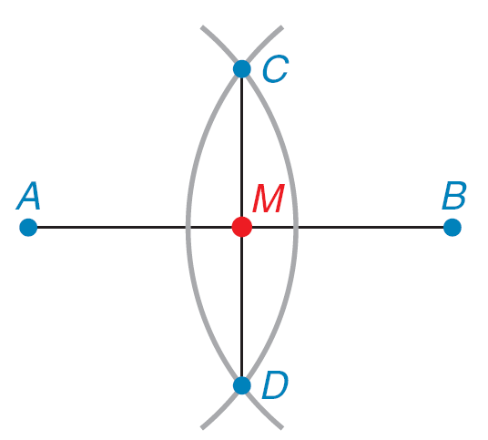


Constructions
With B as the center and keeping the same length of radius, mark off an arc that extends above and below
so that two points (C and D) are determined where the
arcs cross.
Figure 1.27(c): Now draw
The point where crosses
is the midpoint M.
Figure 1.27 (c)

Slide 44

Example 7
In Figure 1.28, M is the midpoint of
a) Find AM if AB = 15.
b) Find AB if AM = 4.3.
c) Find AB if AM = 2x + 1.
Solution:
a) AM is one-half of AB, so AM =
b) AB is twice AM, so AB = 2(4.3) or AB = 8.6.
c) AB is twice AM, so AB = 2(2x + 1) or AB = 4x + 2.
Figure 1.28

