Slide 1
Online Multiple Kernel Classification
Steven C.H. Hoi, Rong Jin, Peilin Zhao, Tianbao Yang
Machine Learning (2013)
Presented by Audrey Cheong
Electrical & Computer Engineering
MATH 6397: Data Mining

Slide 2
Background - Online
Online learning
Learns one instance at a time and predicts labels for future instances
Learner is given an instance
Learner refines its prediction mechanism
Learner predicts the label of the instance
Learner is given the correct label

Slide 3
Background – Multiple Kernel
Composed of two online learning algorithms:
Perceptron algorithm (Rosenblatt 1958)
Type of linear classifier
Learns a classifier for a given kernel
Hedge algorithm (Freund and Schapire 1997)
Combines classifiers by linear weights
Perceptron
Perceptron
Perceptron
$f_{1}$: Classifier 1
$f_{2}$: Classifier 2
$f_{3}$: Classifier 3
$\sum_{k}{w_{k}{sign(f}_{k})}$ where $\sum_{k}{w_{k}}=1$
Hedge

Slide 4
Perceptron algorithm
Input vector : $x=\left(x_{1},x_{2},…,x_{n}\right)$
Output vector : $y=(y_{1},y_{2},…,y_{n})$; $y∈\{−1,1\}$
Weights : $α=(α_{1},α_{2},…,α_{n})$
Threshold : $θ$
Arithmetic test :
$$α⋅x≥θ$$
Minimize :
$\min_{w}{\frac{1}{n}\sum_{i=1}^{n}{\left|{\hat{y_{i}}−y}_{i}\right|}}$
$$\hat{y_{i}}=\left\{\begin{matrix}−1 ifα⋅x_{i}<θ \\ 1 ifα⋅x_{i}≥θ\end{matrix}\right.$$

Slide 5
Hedge algorithm
Distribute weight $W$ among $m$ classifiers
$$W=\sum_{i=1}^{m}{w_{i}^{}}$$
Setting new weights : $w_{k}≔w_{k}β^{z_{k}}$ for discount weight $β∈\left[0,1\right]$
$z_{k}=1$ if the prediction is incorrect and $z_{k}=0$ if correct

Slide 6
Notations
$t$ : trial
$W_{t}=\sum_{i=1}^{m}{w_{i}^{t}}$
$θ_{i}^{t}=\frac{w_{i}^{t}}{W_{t}}$ : mixture of kernel classifiers
$z_{i}^{t}=I(y_{t}f_{i}^{t}(x_{t})≤0)$ : indicates if training instance $(x_{t},y_{t})$ is misclassified by the $i^{th}$ kernel classifier at trial t
$I\left(a\right)=\left\{\begin{matrix}1 if a is true \\ 0 otherwise\end{matrix}\right.$ : indicator function
${\hat{y}}_{t}=sign\left(\sum_{i=1}^{m}{θ_{i}^{t}sign\left(f_{i}^{t}\left(x_{t}\right)\right)}\right)$ : prediction from combination of m kernel classifiers
$f_{i}^{t}\left(x\right)=α_{i}y_{t}κ_{i}\left(x_{t},x\right)$ : classifier function

Slide 7
Proposed framework
We define the optimal margin classification error for the kernel ${\text{к}}_{i}(⋅,⋅)$ with respect to a collection of training examples $𝓛=\left\{\left(x_{t},y_{t}\right),t=1,…, T\right\}$ as
$$F\left({\text{к}}_{i},l,D\right)=\min_{f∈H_{{\text{к}}_{i}}}\left({\left|f\right|}_{H_{{\text{к}}_{i}}}^{2}+C\sum_{t=1}^{T}{l\left(y_{t},f\left(x_{t}\right)\right)}\right)$$
where $l\left(y_{t},f\left(x_{t}\right)\right)=max\left(0,1−y_{t}f\left(x_{t}\right)\right)$

Slide 8
Algorithms
Combination
Deterministic
Stochastic
Update
Deterministic
Stochastic
Deterministic approach: all kernels are used
Stochastic approach: a subset of kernels are used

Slide 9
OMKC_{(D,D)}
Combination
Deterministic
Stochastic
Training sample $x$
Update
Deterministic
Stochastic
Deterministic update
Kernel
classifiers :
$$f_{1}(x)$$
$$f_{2}(x)$$
…
$$f_{m}(x)$$
Prediction:
$$z_{1}$$
$$z_{2}$$
$$…$$
$$z_{m}$$
Reduce $w_{1}$ if $z_{1}\text{≠}\text{y}$
Reduce $w_{2}$ if $z_{2}\text{≠}\text{y}$
…
Reduce $w_{m}$ if $z_{m}\text{≠}\text{y}$
Deterministic combination
$$\hat{y}(x)=\sum_{i=1}^{m}{w_{i}z_{i}}$$
Combined Prediction:
$$f_{i}^{}≔f_{i}^{}\left(x\right)+z_{i}^{}y_{t}κ_{i}\left(x_{t},x\right)$$
$$w_{i}≔w_{i}β^{z_{i}}$$
$$z_{i},\hat{y}∈\left\{−1, +1\right\}$$
$$f_{i}^{t+1}=f_{i}^{t}\left(x\right)+z_{i}^{t}y_{t}κ_{i}\left(x_{t},x\right)$$

Slide 10
OMKC_{(S,S)}
Combination
Deterministic
Stochastic
Training sample $x$
Update
Deterministic
Stochastic
Stochastic update
Kernel
classifiers :
$$f_{1}(x)$$
$$f_{2}(x)$$
…
$$f_{m}(x)$$
Prediction:
$$z_{1}$$
$$z_{2}$$
$$…$$
$$z_{m}$$
Reduce $w_{1}$ if $z_{1}\text{≠}\text{y}$
…
$$w_{1}≠0$$
$$w_{2}=0$$
$$…$$
$$w_{m}=0$$
Stochastic combination
$$\hat{y}(x)=\sum_{i=1}^{m}{w_{i}z_{i}}$$
Combined Prediction:
$$f_{i}^{}≔f_{i}^{}\left(x\right)+m_{i}z_{i}^{}y_{t}κ_{i}\left(x_{t},x\right)$$
$$w_{i}≔w_{i}β^{z_{i}m_{i}}$$
$$z_{i},\hat{y}∈\left\{−1, +1\right\}$$

Slide 11
Experimental setup
binary datasets

Slide 12
Experimental setup
15 diverse datasets obtained from LIBSVM and UCI machine learning repository
Predefine 16 kernel functions
3 polynomial kernels (i.e. $k\left(x_{i},x_{j}\right)={\left(x_{i}^{T}x_{j}\right)}^{p}, p=1, 2 and 3$)
13 Gaussian kernels (i.e.$k\left(x_{i},x_{j}\right)=\exp\left({−{\left\|x_{i}−x_{j}\right\|}^{2}}/{2σ^{2}}\right), σ=2^{−6},2^{−5},…,2^{6}$)
Fix discount weight $β=0.8$
Results are averaged over 20 runs

Slide 13
Evaluation of the deterministic OMKC algorithm
Comparison of the deterministic OMKC algorithm with three Perceptron based algorithms
Perceptron : the well-known Perceptron baseline algorithm with a linear kernel (Rosenblatt 1958; Freund and Schapire 1999)
Perceptron(u) : another Perceptron baseline algorithm with an unbiased/uniform combination of all the kernels
Perceptron(*): an online validation procedure to search for the best kernel among the pool of kernels (using the first 10 % training examples), and then apply the Perceptron algorithm with the best kernel
OM-2: a state-of-the-art online learning algorithm for multiple kernel learning (Jie et al. 2010; Orabona et al. 2010)

Slide 14
Evaluation of the deterministic OMKC algorithm
>
<
<

Slide 15
Average mistake rate (20 runs)

Slide 16
Number of support vectors (20 runs)

Slide 17
Kernel weights

Slide 18
Effect of $β$
$$optimal β=\frac{\sqrt{T}}{\sqrt{T}+\sqrt{\ln{m}}};\begin{matrix}T :\text{training} \text{examples} \\ m\text{ : \# }\text{of} \text{kernels} \end{matrix}$$
$w_{k}≔w_{k}β^{z_{k}}$

Slide 19
Time Efficiency
Decreases as size increases

Slide 20
Conclusion
All the OMKC algorithms usually perform better than
the regular Perceptron algorithm with an unbiased linear combination of multiple kernels
the Perceptron algorithm with the best kernel found by validation
the state-of-the-art online MKL algorithm
The deterministic combination strategy usually performs better
Stochastic updating strategy improves computational efficiency without decreasing the accuracy significantly

Slide 21
Questions?
How many kernel classifiers were used in the stochastic combination?
How was the number of support vectors determined? Should the support vectors be given in terms of the number of support vectors per kernel classifier? Did support vectors overlap between kernel classifiers?

Slide 22
References
Hoi, S. C. H., Jin, R., Zhao, P., & Yang, T. (2012). Online Multiple Kernel Classification. Machine Learning, 90(2), 289–316. doi:10.1007/s10994-012-5319-2

Slide 23
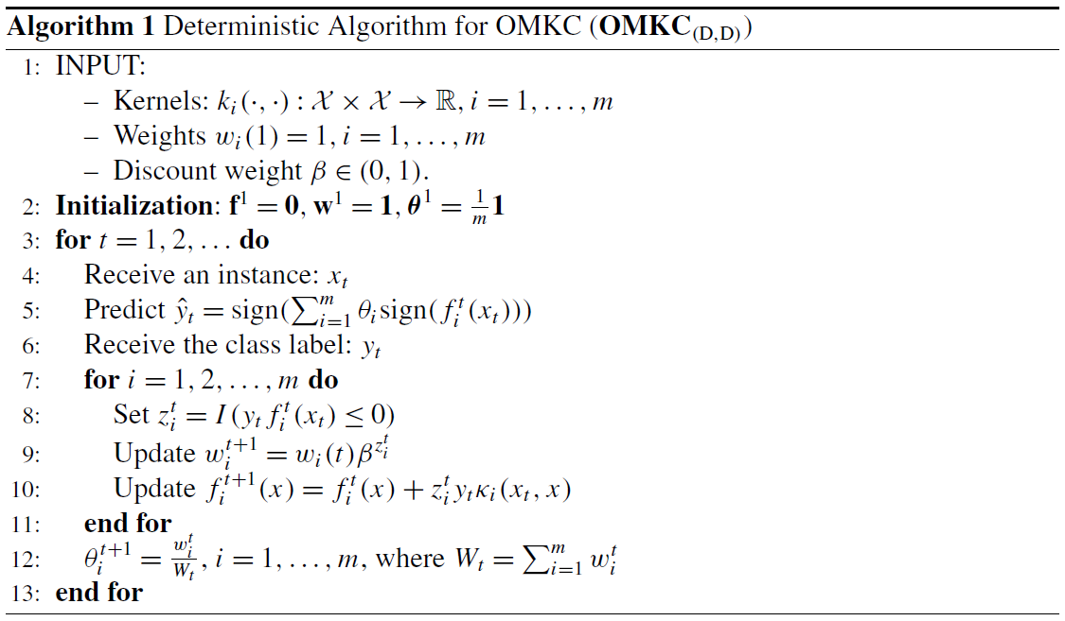
Algorithm 1
Combination
Deterministic
Stochastic
Update
Deterministic
Stochastic
All kernels are used
$f_{i}^{t}$ : Represent the classifier at trial t
$θ_{i}$ : combination of m kernel classifiers
Combination
Update
Normalize the weights

Slide 24
Algorithm 1 → 2
Combination
Deterministic
Stochastic
Update
Deterministic
Stochastic
$f_{i}^{t}$ : Represent the classifier at trial t
$θ_{i}$ : combination of m kernel classifiers
Stochastic combination
Deterministic update
17:

Slide 25
Algorithm 2 → 3
Combination
Deterministic
Stochastic
Update
Deterministic
Stochastic

Slide 26
Algorithm 2 → 3
Combination
Deterministic
Stochastic
Update
Deterministic
Stochastic
Deterministic combination
Guaranteeds that each kernel will be selected with at least probability $δ/m$
Tradeoff between exploration and exploitation (Auer et al. 2003)
Stochastic update

Slide 27
Algorithm 4
Combination
Deterministic
Stochastic
Update
Deterministic
Stochastic
Stochastic combination
Stochastic update

