Slide 1
Multi-class Support Vector Machines
Technical report by J. Weston, C. Watkins
Presented by Viktoria Muravina

Slide 2
Introduction
Solution to binary classification problem using Support Vectors (SV) is well developed
Multi-Class pattern recognition (k>2 classes) are usually solved using a voting scheme methods based on combining many binary classification functions
The paper proposes two methods to solve k-class problems is one step
Direct generalization of binary SV method
Solving a linear program instead of a quadratic one
Notes:
Solving a linear program instead of a quadratic one

Slide 3
What is k-class Pattern Recognition Problem
We need to construct a decision function given $l$ independent identically distributed samples of an unknown function
$$\left(x_{1},y_{1}\right), …,\left(x_{l},y_{l}\right)$$
where $x_{i}, i=1, …,l$ is a vector of length $d$and $y_{i}∈\{1,…, k\}$ represents class of the sample
Decision function $f(x,α)$ which classifies a point $x$, is chosen from a set of functions defined by parameter $α$
It is assumed that the set of functions is chosen before hand
The goal is to choose the parameter $α$ that minimizes $\sum_{i=1}^{l}{L(y_{i},f\left(x_{i},α\right))}$ where
$$L\left(y,f\left(x,α\right)\right)=\left\{ \begin{matrix}0 \text{if} f\left(x,α\right)=y \\ 1 \text{otherwise}\end{matrix}\right.$$
Notes:
The goal is to choose the parameter $α$ that minimizes $\sum_{i=1}^{l}{L(y_{i},f\left(x_{i},α\right))}$ where
$$L\left(y,f\left(x,α\right)\right)=\left\{ \begin{matrix}0 \text{if} f\left(x,α\right)=y \\ 1 \text{otherwise}\end{matrix}\right.$$

Slide 4
Binary Classification SVM
Support Vector approach is well developed for the binary (k=2) pattern recognition
Main idea is to separate 2 classes (labelled $y∈\{−1, 1\}$) so that the margin is maximal
This gives the following optimization problem: minimize
$$φ\left(w,ξ\right)=\frac{1}{2}<w⋅w>+C\sum_{i=1}^{l}{ξ_{i}}$$
with constrains $y_{i}\left(<w⋅x_{i}>+b\right)≥1−ξ_{i}, \text{and} ξ_{i}≥0, \text{for} i=1,…,l$
Notes:
with constrains $y_{i}\left(<w⋅x_{i}>+b\right)≥1−ξ_{i}, \text{and} ξ_{i}≥0, \text{for} i=1,…,l$

Slide 5
Binary SVM continued
Solution to this problem is to maximize the quadratic form:
$$W\left(α\right)=\sum_{i=1}^{l}{α_{i}}−\frac{1}{2}\sum_{i,j=1}^{l}{y_{i}y_{j}α_{i}α_{j}K(x_{i},x_{j})}$$
with constrains $0≤α_{i}≤C, i=1,…, l$ and $\sum_{i=1}^{l}{α_{i}y_{i}=0}$
Giving the following decision function
$$f\left(x\right)=\text{sign}\left[\left(\sum_{i=1}^{l}{α_{i}y_{i}K\left(x,x_{i}\right)}\right)+b\right]$$
Notes:
Giving the following decision function
$$f\left(x\right)=\text{sign}[\left(\sum_{i=1}^{l}{α_{i}y_{i}K\left(x,x_{i}\right)}\right)+b]$$

Slide 6
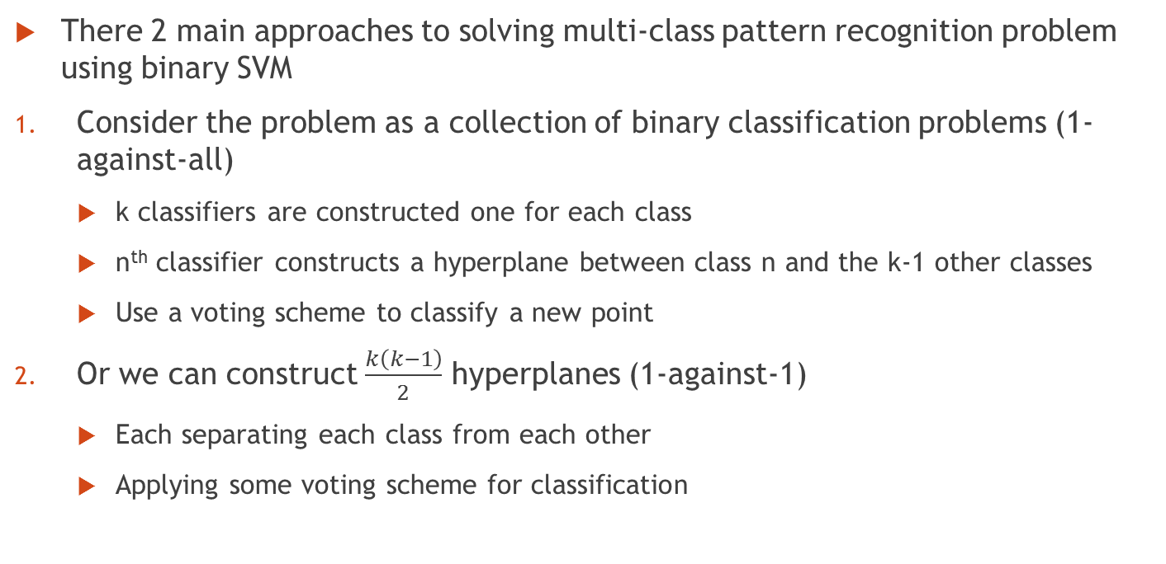
Multi-Class Classification Using Binary SVM
There 2 main approaches to solving multi-class pattern recognition problem using binary SVM
Consider the problem as a collection of binary classification problems (1-against-all)
k classifiers are constructed one for each class
n^{th} classifier constructs a hyperplane between class n and the k-1 other classes
Use a voting scheme to classify a new point
Or we can construct $\frac{k\left(k−1\right)}{2}$ hyperplanes (1-against-1)
Each separating each class from each other
Applying some voting scheme for classification
Notes:
Applying some voting scheme for classification

Slide 7
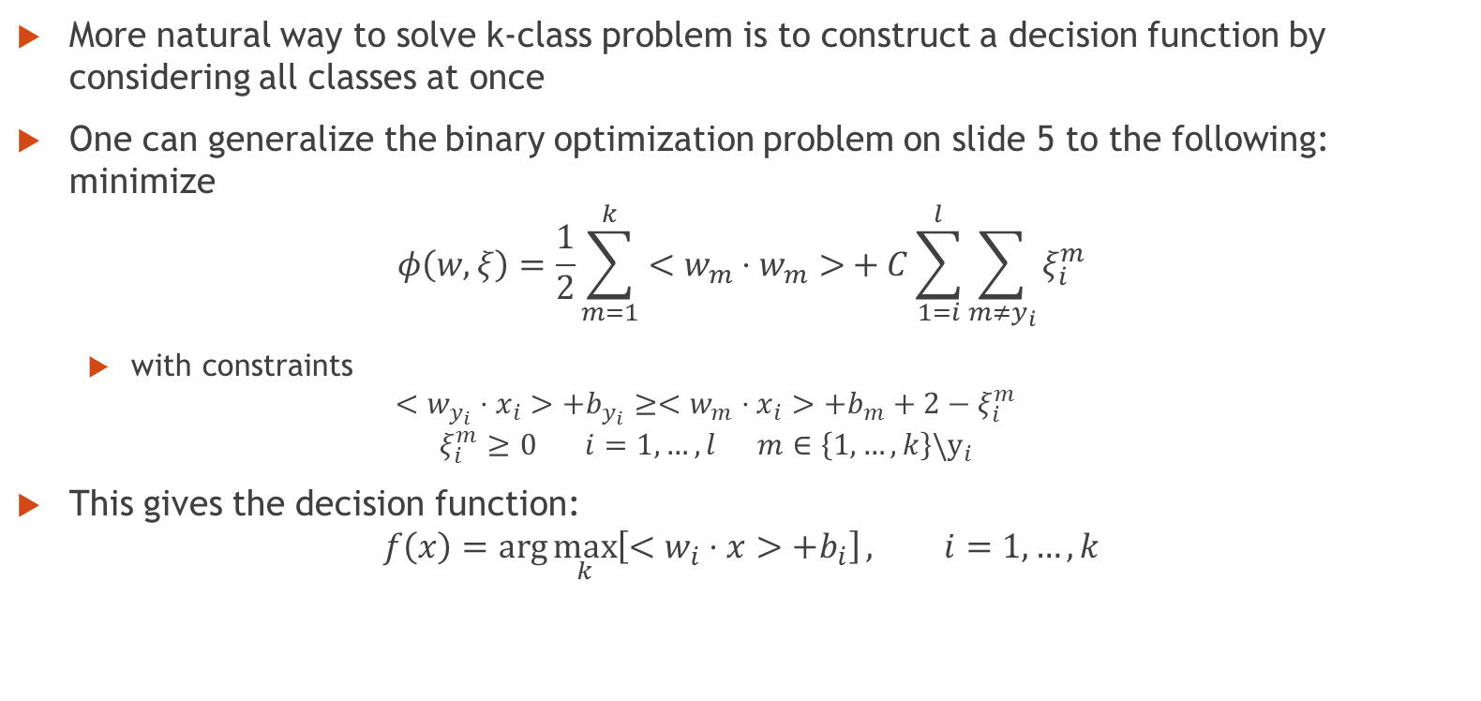
k-class Support Vector Machines
More natural way to solve k-class problem is to construct a decision function by considering all classes at once
One can generalize the binary optimization problem on slide 5 to the following: minimize
$$φ\left(w,ξ\right)=\frac{1}{2}\sum_{m=1}^{k}{<w_{m}⋅w_{m}>}+C\sum_{1=i}^{l}{\sum_{m≠y_{i}}{ξ_{i}^{m}}}$$
with constraints
$$<w_{y_{i}}⋅x_{i}>+b_{y_{i}}≥<w_{m}⋅x_{i}>+b_{m}+2−ξ_{i}^{m}$$
$$ξ_{i}^{m}≥0 i=1,…,l m∈\left\{1,…,k\right\}\backslash y_{i}$$
This gives the decision function:
$$f\left(x\right)=\arg{\max_{k}\left[<w_{i}⋅x>+b_{i}\right]}, i=1,…,k$$
Notes:
This gives the decision function:
$$f\left(x\right)=\arg{\max_{k}\left[<w_{i}⋅x>+b_{i}\right]}, i=1,…,k$$

Slide 8
k-class Support Vector Machines continued
Solution to this optimization problem in 2 variables is the saddle point of the Lagrangian:
$$L\left(w,b,ξ,α,β\right)=\frac{1}{2}\sum_{m=1}^{k}{<w_{m}⋅w_{m}>}+C\sum_{i=1}^{l}{\sum_{m=1}^{k}{ξ_{i}^{m}}}$$
$$−\sum_{i=1}^{l}{\sum_{m=1}^{k}{α_{i}^{m}[}}<\left(w_{y_{i}}−w_{m}\right)⋅x_{i}>+b_{y_{i}}−b_{m}−2+ξ_{i}^{m}]−\sum_{i=1}^{l}{\sum_{m=1}^{k}{β_{i}^{m}ξ_{i}^{m}}}$$
with the dummy variables $α_{i}^{y_{i}}=0, ξ_{i}^{y_{i}}=2, { β}_{i}^{y_{i}}=0, i=1,…,l$
and constraints $α_{i}^{m}≥0, β_{i}^{m}≥0, ξ_{i}^{m}≥0, i=1,…,l m∈\left\{i,…,k\right\}\backslash y_{i}$
which has to be maximized with respect to $α$ and $β$ and minimized with respect to $w$ and $ξ$
Notes:
which has to be maximized with respect to $α$ and $β$ and minimized with respect to $w$ and $ξ$

Slide 9
k-class Support Vector Machines cont.
After taking partial derivatives and simplifying we end up with
$$L\left(α\right)=2\sum_{i,m}{α_{i}^{m}}+\sum_{i,j,m}{\left[−\frac{1}{2}c_{i}^{y_{i}}A_{i}A_{j}+α_{i}^{m}α_{j}^{y_{i}}−\frac{1}{2}α_{i}^{m}α_{j}^{m}\right]<x_{i}⋅x_{j}>}$$
where $c_{i}^{n}=\left\{\begin{matrix}1 \text{if} y_{i}=n \\ 0 \text{if} y_{i}≠n\end{matrix}\right.$ and $A_{i}=\sum_{m=1}^{k}{α_{i}^{m}}$
Which is a quadratic function in terms of $α$ with linear constraints
$$\sum_{i=1}^{l}{α_{i}^{n}}=\sum_{i=1}^{l}{c_{i}^{n}A_{i}}, n=1,…,k$$
and $0≤α_{i}^{m}≤C, α_{i}^{y_{i}}=0 i=1,…,l m∈\left\{0,…,k\right\}\backslash y_{i}$
Please see slides 19 to 22 for complete derivation of $L(α)$
Notes:
Please see slides 18 to 21 for complete derivation of $L(α)$

Slide 10
K-class Support Vector Machines cont.
This gives the decision function
$$f\left(x, α\right)=\arg{\max_{n}{[\sum_{i=1}^{l}{\left(c_{i}^{n}A_{i}−α_{i}^{n}\right)<x_{i}⋅x>+b_{n}}]}}$$
The inner product $<x_{i},x_{j}>$ can be replaced with the kernel function $K(x_{i},x_{j})$
When our k=2 the resulting hyperplane is identical to the one that we get using binary SVM
Notes:
When our k=2 the resulting hyperplane is identical to the one that we get using binary SVM

Slide 11
k-Class Linear Programing Machine
Instead of considering the decision function as separating hyperplane we can view each class having its own decision function
Defined only by training points belonging to the class
This gives us that the decision rule is the largest decision function at point $x$
For this method minimize the following linear program
$$\sum_{i=1}^{l}{α_{i}}+C\sum_{i=1}^{l}{ }\sum_{j≠y_{i}}{ξ_{i}^{j}}$$
Subject to the following constraints
$$\sum_{m:y_{m}=y_{i}}{α_{i}K(x_{i},x_{m})}+b_{y_{i}}≥\sum_{n:y_{n}=y_{j}}{α_{i}K\left(x_{i},x_{j}\right)}+b_{y_{j}}+2−ξ_{i}^{j}$$
$$α_{i}≥0, ξ_{i}^{j}≥0, i=1,…, l, j∈\left\{1,…,k\right\}\backslash y_{i}$$
and use the decision rule
$$f\left(x\right)=\arg{\max_{n}\left(\sum_{i:y_{i}=n}{α_{i}K\left(x,x_{i}\right)+b_{n}}\right)}$$
Notes:
and use the decision rule
$$f\left(x\right)=\arg{\max_{n}{(\sum_{i:y_{i}=n}{α_{i}K\left(x,x_{i}\right)+b_{n}})}}$$

Slide 12
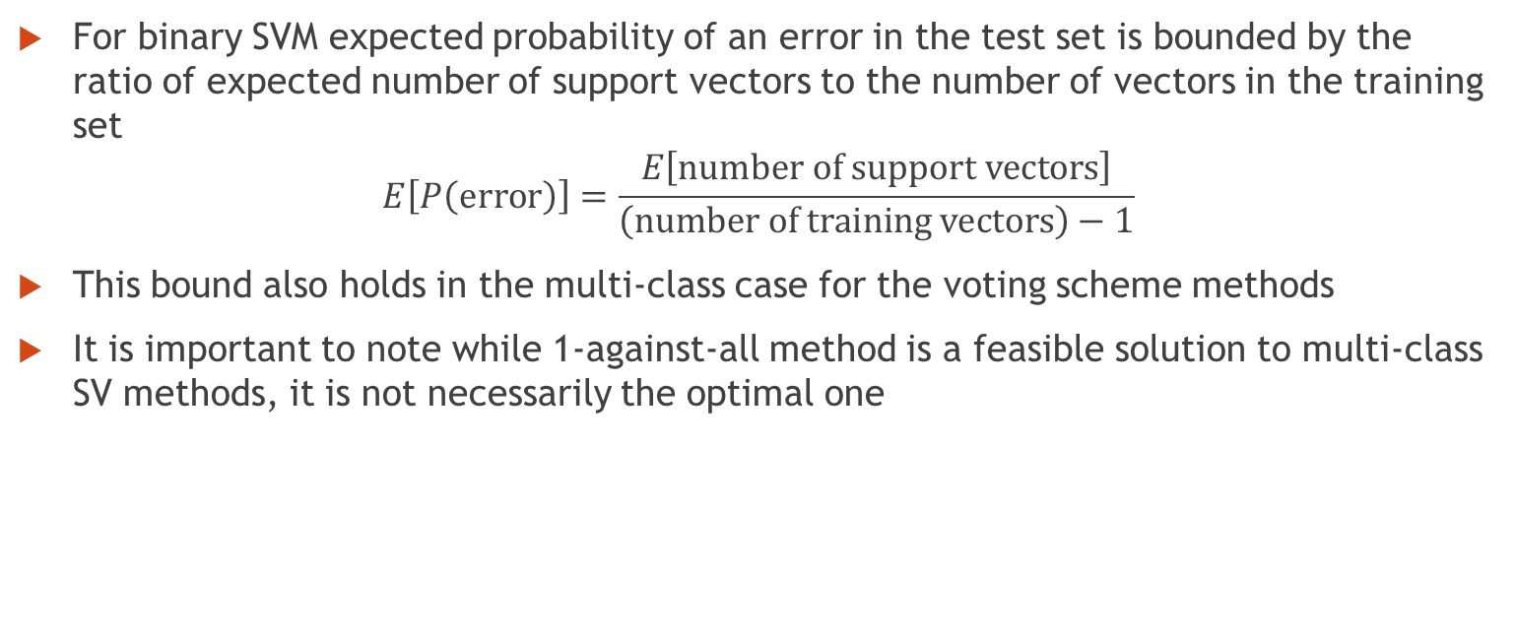
Further Analysis
For binary SVM expected probability of an error in the test set is bounded by the ratio of expected number of support vectors to the number of vectors in the training set
$$E\left[P\left(\text{error}\right)\right]=\frac{E\left[\text{number} \text{of} \text{support} \text{vectors}\right]}{\left(\text{number} \text{of} \text{training} \text{vectors}\right)−1}$$
This bound also holds in the multi-class case for the voting scheme methods
It is important to note while 1-against-all method is a feasible solution to multi-class SV methods, it is not necessarily the optimal one
Notes:
It is important to note while 1-against-all method is a feasible solution to multi-class SV methods, it is not necessarily the optimal one

Slide 13
Benchmark Data Set Experiments
The 2 methods were tested using 5 benchmark problems from UCI machine learning repository
If test set was not provided the data was split randomly 10 times with a tenth of the data used as test set
All 5 of the data sets chosen were small due to the fact that at the time of the publication decomposition algorithm for larger data sets was not available
Notes:
All 5 of the data sets chosen were small due to the fact that at the time of the publication decomposition algorithm for larger data sets was not available

Slide 14
Description of the Datasets part 1
Iris dataset
contains 3 classes of 50 instances each, where each class refers to a type of iris plant
Each instance has 4 numerical attributes
Each attribute is a continuous variable
Wine dataset
results of a chemical analysis of wines grown in the same region in Italy but derived from three different cultivars representing different classes
Class 1 has 59 instances, Class 2 has 71 instances and Class 3 has 48 instances for a total of 178
Each instance has 13 numerical attributes
Each attribute is a continuous variable
Glass dataset
7 classes for different types of glass
Class 1 has 70 instances, Class 2 has 76, Class 3 has 17, Class 4 has 0, Class 5 has 13, Class 6 has 9 and Class 7 has 29 for a total of 214
Each instance has 10 numerical attributes of which 1 is an index and thus irrelevant
The 9 relevant attributes are continuous variables
Notes:
Glass dataset
7 classes for different types of glass
Class 1 has 70 instances, Class 2 has 76, Class 3 has 17, Class 4 has 0, Class 5 has 13, Class 6 has 9 and Class 7 has 29 for a total of 214
Each instance has 10 numerical attributes of which 1 is an index and thus irrelevant
The 9 relevant attributes is a continuous variable

Slide 15
Description of the Datasets part 2
Soy dataset
17 classes for different damage types to the soy plant
Classes 1, 2, 3, 6, 7, 9, 10, 11, 13 have 10 instances each; Classes 2, 12 have 20 instances each; Classes 4, 8, 14, 15 have 40 instances each; Classes 16, 17 have 6 instances each for a total 302
Due to the fact that there are missing values for some of the instances we can work only with 289 instances
Each instance has 35 categorical attributes encoded numerically
After converting each categorical value into individual attributes we end up with 208 attributes each of which has either 0 or 1 value
Vowel dataset
11 classes for different vowels
48 instances each for a total of 528 in the training set
42 instances each for a total of 495 in the testing set
Each instance has 10 numerical attributes
Each attribute is a continuous variable
Notes:
Vowel dataset
11 classes for different vowels
48 instances each for a total of 528 in the training set
42 instances each for a total of 495 in the testing set
Each instance has 10 numerical attributes
Each attribute is a continuous variable

Slide 16
Results of the Benchmark Experiments
The table summarizing results of the experiments is
1-a-a means 1-against-all
1-a-1 means 1-against-1
qp-mc-sv is Quadratic multiclass SVM
lp-mc-sv is Linear multiclass SVM
svs is the number on non-zero coefficients
%err is the raw error percentage
 |  |  |  | 1-a-a |  | 1-a-1 |  | qp-mc-sv |  | lp-mc-sv
Name | # pts | # att | # class | %err | svs | %err | svs | %err | svs | %err | svs
Iris | 150 | 4 | 3 | 1.33 | 75 | 1.33 | 54 | 1.33 | 31 | 2.0 | 13
Wine | 178 | 13 | 3 | 5.6 | 398 | 5.6 | 268 | 3.6 | 135 | 10.8 | 110
Glass | 214 | 9 | 7 | 35.2 | 308 | 36.4 | 368 | 35.6 | 113 | 37.2 | 72
Soy | 289 | 208 | 17 | 2.43 | 406 | 2.43 | 1669 | 2.43 | 316 | 5.41 | 102
Vowel | 528 | 10 | 11 | 39.8 | 2170 | 38.7 | 3069 | 34.8 | 1249 | 39.6 | 258
Notes:
1-a-a
1-a-a
qp-mc-sv
lp-mc-sv
Name
# pts
# att
# class
%err
svs
%err
svs
%err
svs
%err
svs
Iris
150
3
4
1.33
75
1.33
54
1.33
31
2.0
13
Wine
178
13
3
5.6
398
5.6
268
3.6
135
10.8
110
Glass
214
9
7
35.2
308
36.4
368
35.6
113
37.2
72
Soy
289
208
17
2.43
406
2.43
1669
2.43
316
5.41
102
Vowel
528
10
11
39.8
2170
38.7
3069
34.8
1249
39.6
258

Slide 17
Results of the Benchmark Experiments
Quadratic multi-class SV method gave results that are comparable to the 1-against-all, while reducing number of support vectors
Linear programing method also gave reasonable results
Even through the results are worse then with quadratic or 1-against-all methods, number of support vectors was reduced significantly compared to all other methods
Smaller number of support vectors means faster classification speed, this has been a problem for the SV methods when compared to other techniques
1-against-1 performed worse then the quadratic method. It also tended to have the most support vectors
Notes:
1-against-1 performed worse then the quadratic method. It also tended to have the most support vectors

Slide 18
Limitations and Conclusions
Optimization problem that we need to solve is very large
For the quadratic method our optimization function is quadratic is $\left(k−1\right)∗l$ variables
Linear programing method optimization is linear with $k∗l$ variable and $k∗l$ constraints
This could lead to slower training times then in 1-against-all especially in the case of the quadratic method
The new methods do not out perform the 1-agains-all and 1-against-1 methods, however both methods reduce number of support vectors needed for the decision function
Further research is need to test how the methods perform for large datasets
Notes:
Further research is need to test how the methods perform for large datasets

Slide 19
Derivation of $L(α)$ on slide 9
We need to find a saddle point so we start with the Lagrangian
$$L\left(w,b,ξ,α,β\right)=\frac{1}{2}\sum_{m=1}^{k}{<w_{m}⋅w_{m}>}+C\sum_{i=1}^{l}{\sum_{m=1}^{k}{ξ_{i}^{m}}}$$
$$−\sum_{i=1}^{l}{\sum_{m=1}^{k}{α_{i}^{m}[}}<\left(w_{y_{i}}−w_{m}\right)⋅x_{i}>+b_{y_{i}}−b_{m}−2+ξ_{i}^{m}]−\sum_{i=1}^{l}{\sum_{m=1}^{k}{β_{i}^{m}ξ_{i}^{m}}}$$
Using the notation
$$c_{i}^{n}=\left\{\begin{matrix}1 \text{if} y_{i}=n \\ 0 \text{if} y_{i}≠n\end{matrix}\right.\text{and} A_{i}=\sum_{m=1}^{k}{α_{i}^{m}}$$
Take partial derivatives with respect to $w_{n}, b_{n} \text{and} ξ_{j}^{n}$ and set them equal to 0

Slide 20

Derivation of $L(α)$ on slide 9 cont.
The derivatives are
$$\frac{∂L}{∂w_{n}}=w_{n}+\sum_{i=1}^{l}{α_{i}^{n}x_{i}}−\sum_{i=1}^{l}{A_{i}c_{i}^{n}x_{i}}=0$$
$$\frac{∂L}{∂b_{n}}=−\sum_{i=1}^{l}{A_{i}c_{i}^{n}}+\sum_{i=1}^{l}{α_{i}^{n}}=0$$
$$\frac{∂L}{∂ξ_{j}^{n}}=−α_{j}^{n}+C−β_{j}^{n}=0$$
From this we get
$$w_{n}=\sum_{i=1}^{l}{\left(c_{i}^{n}A_{i}−α_{i}^{n}\right)x_{i}}, \sum_{i=1}^{l}{α_{i}^{n}}=\sum_{i=1}^{l}{A_{i}c_{i}^{n}}, β_{j}^{n}+α_{j}^{n}=C$$
$$\text{and} 0≤α_{j}^{n}≤C$$

Slide 21
Derivation of $L(α)$ on slide 9 cont.
After substituting the equations that we got on previous slides into the Lagrangian we get
$$L\left(α\right)=2\sum_{i,m}{α_{i}^{m}}+\sum_{i,j,m}{\left(\frac{1}{2}c_{i}^{m}c_{j}^{m}A_{i}A_{j}−\frac{1}{2}c_{i}^{m}A_{i}α_{j}^{m}−\frac{1}{2}c_{j}^{m}A_{j}α_{i}^{m}+\frac{1}{2}α_{i}^{m}α_{j}^{m}−c_{j}^{y_{i}}A_{j}α_{i}^{m}+α_{i}^{m}α_{j}^{y_{i}}+c_{j}^{m}A_{j}α_{i}^{m}−α_{i}^{m}α_{j}^{m}\right)<x_{i}⋅x_{j}>}$$

Slide 22
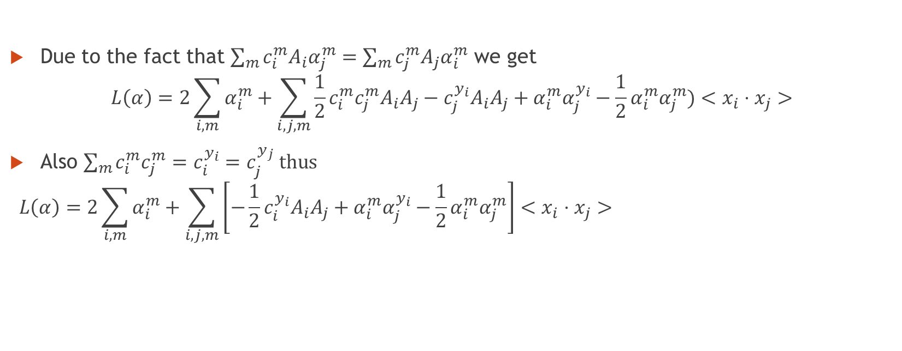
Derivation of $L(α)$ on slide 9 cont.
Due to the fact that $\sum_{m}{c_{i}^{m}A_{i}α_{j}^{m}}=\sum_{m}{c_{j}^{m}A_{j}α_{i}^{m}}$ we get
$$L\left(α\right)=2\sum_{i,m}{α_{i}^{m}}+\sum_{i,j,m}{\frac{1}{2}c_{i}^{m}c_{j}^{m}A_{i}A_{j}−c_{j}^{y_{i}}A_{i}A_{j}+α_{i}^{m}α_{j}^{y_{i}}−{\frac{1}{2}α}_{i}^{m}α_{j}^{m})<x_{i}⋅x_{j}>}$$
Also $\sum_{m}{c_{i}^{m}c_{j}^{m}}=c_{i}^{y_{i}}=c_{j}^{y_{j}} \text{thus}$
$$L\left(α\right)=2\sum_{i,m}{α_{i}^{m}}+\sum_{i,j,m}{\left[−\frac{1}{2}c_{i}^{y_{i}}A_{i}A_{j}+α_{i}^{m}α_{j}^{y_{i}}−\frac{1}{2}α_{i}^{m}α_{j}^{m}\right]<x_{i}⋅x_{j}>}$$

